Slide 1
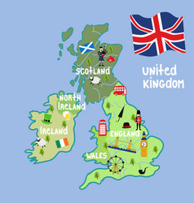
The British Isles
Autor: Oliwia Wójcik
Nauczyciel: Marta Kruk
Adres szkoły:
Publiczna Szkoła Podstawowa w Sarnowie
Sarnów 19B
21-421 Tuchowicz
Woj. lubelskie

Slide 2
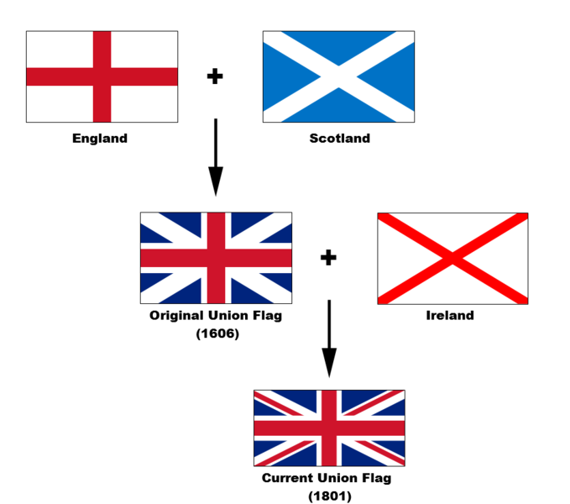
UNION JACK – OFFICIAL FLAG united kingdom

Slide 3
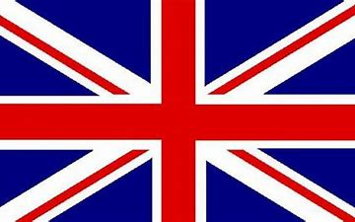
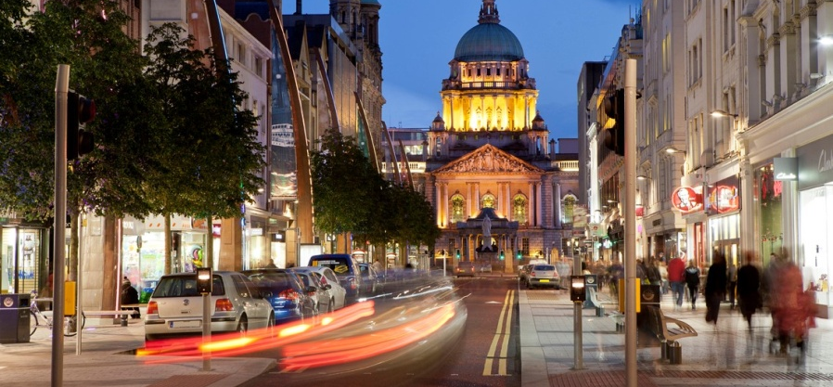
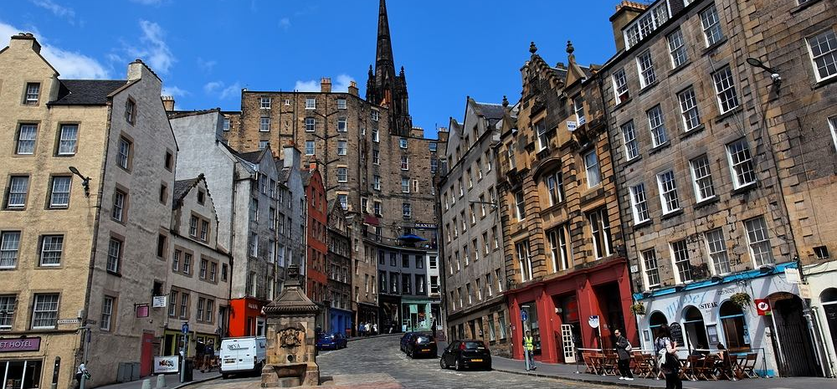
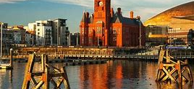
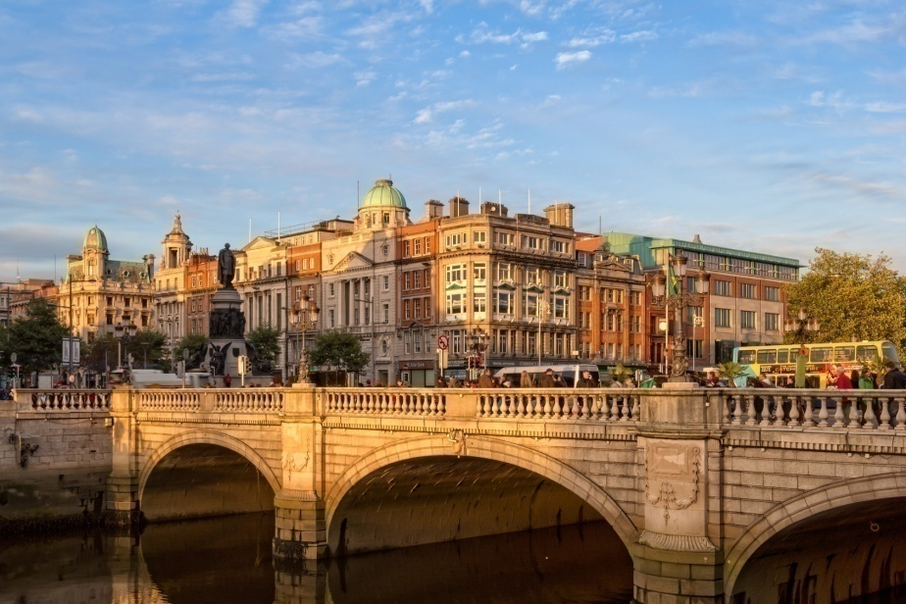
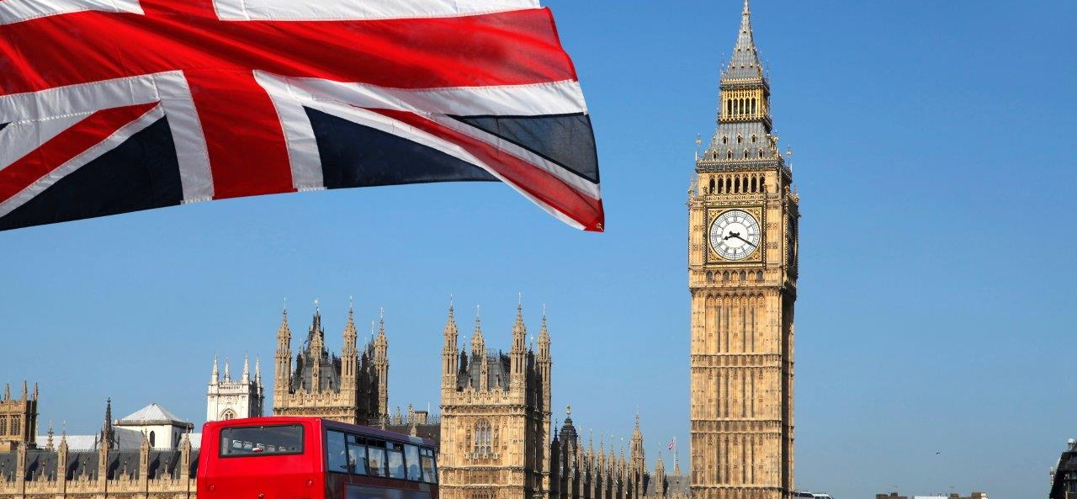
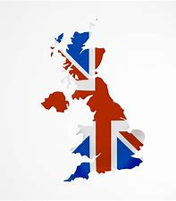
British Islands:
United Kingdom (The UK): England, Scotland, Wales, Northern Ireland and Ireland.

Slide 4
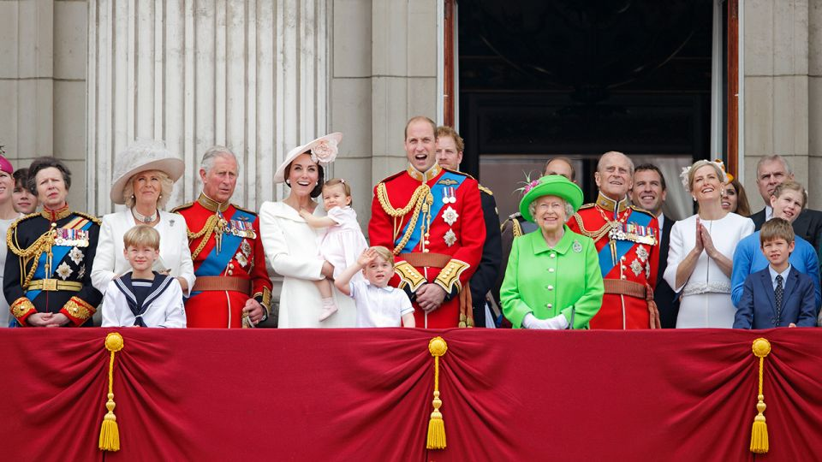
BRITISH ROYAL FAMILY

Slide 5
ENGLAND

Slide 6
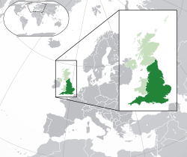

Slide 7
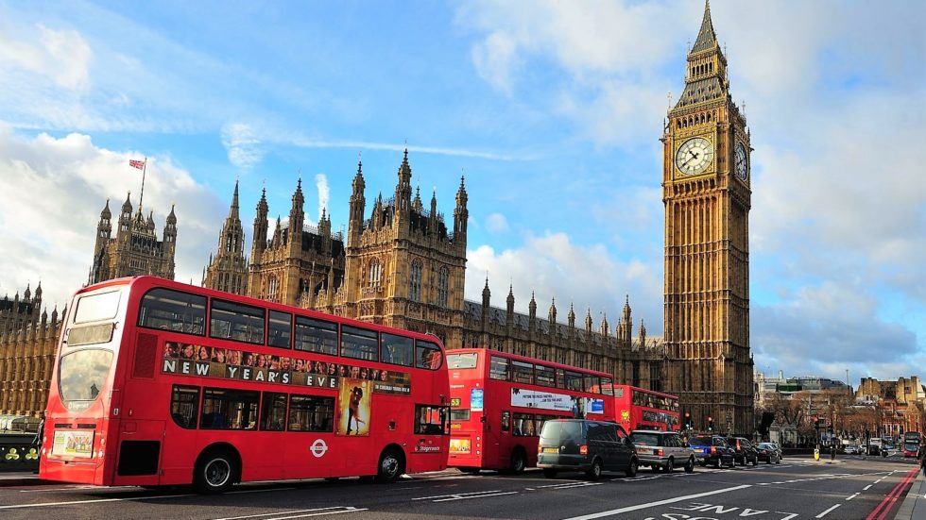
CAPITAL
Londyn is a capital city of England.

Slide 8
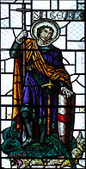
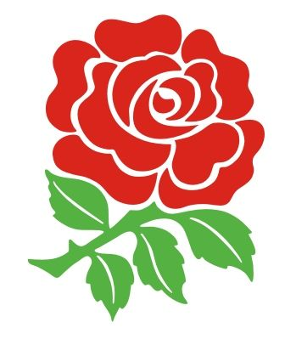
PATRON
NATIONAL SYMBOL
ST. GEORGE
ROSE

Slide 9
FLAG:
THE MOST IMPORTANT INFORMATION:
Official laguage: lack
Capital: Londyn
Political system: constitutional monarchy
State type: part of UK
Head of state: Queen Elizabeth II
Prime Minister: Prime Minister Boris Johnson
Total surface: 130 395km²
Population: 56 286 961
Population density: 432 people/km
Currency: Pount sterling (£, GBP)
Dominat religion: Anglicanism
Time zone: UTC +0, summertime: UTC +1
Phone code: +44
ROYAL ARMS:

Slide 10
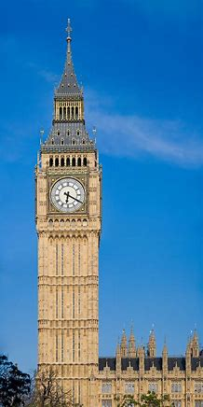
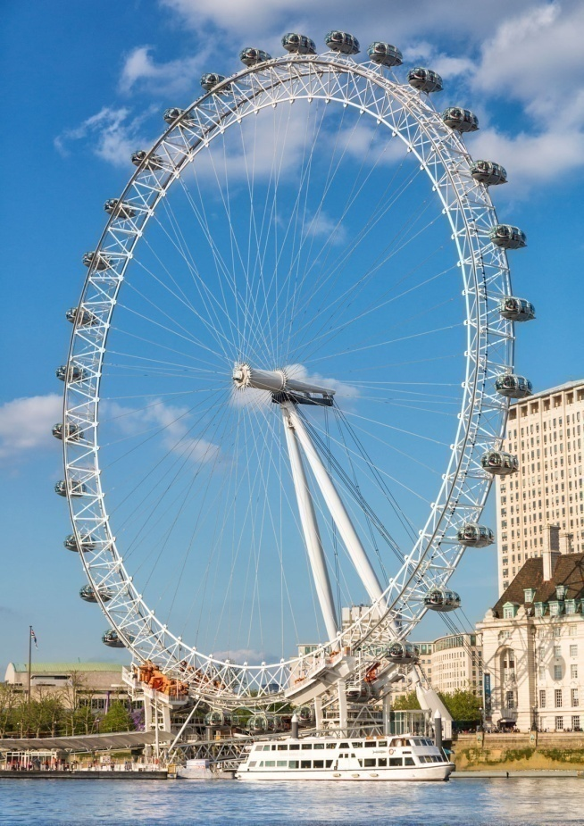
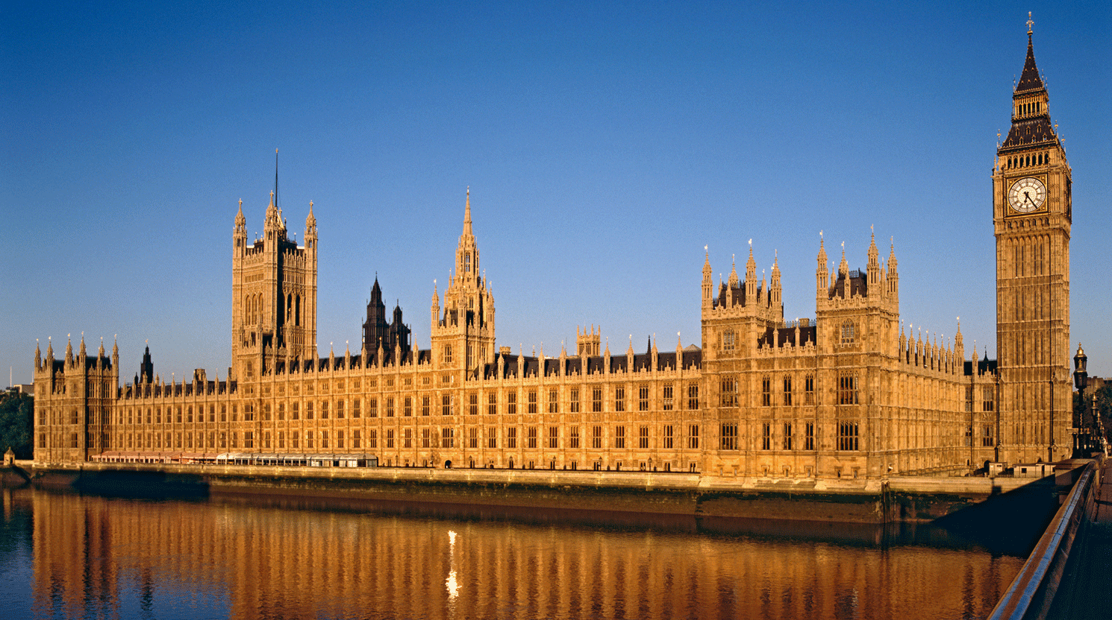
INTERESTING PLACES IN LONDON
BIG BEN
LONDON EYE
HOUSE OF PARLIAMENT

Slide 11
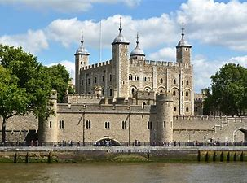
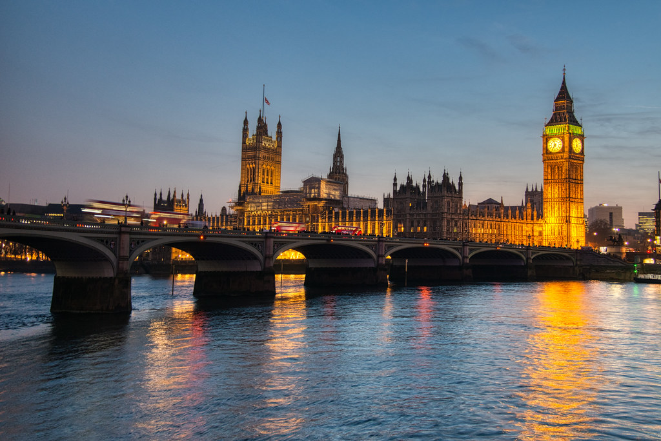
LONDON TOWER
WESTMINSTER

Slide 12
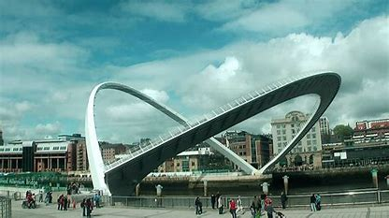
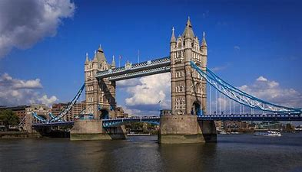
MILLENNIUM BRIDGE
TOWER BRIDGE

Slide 13
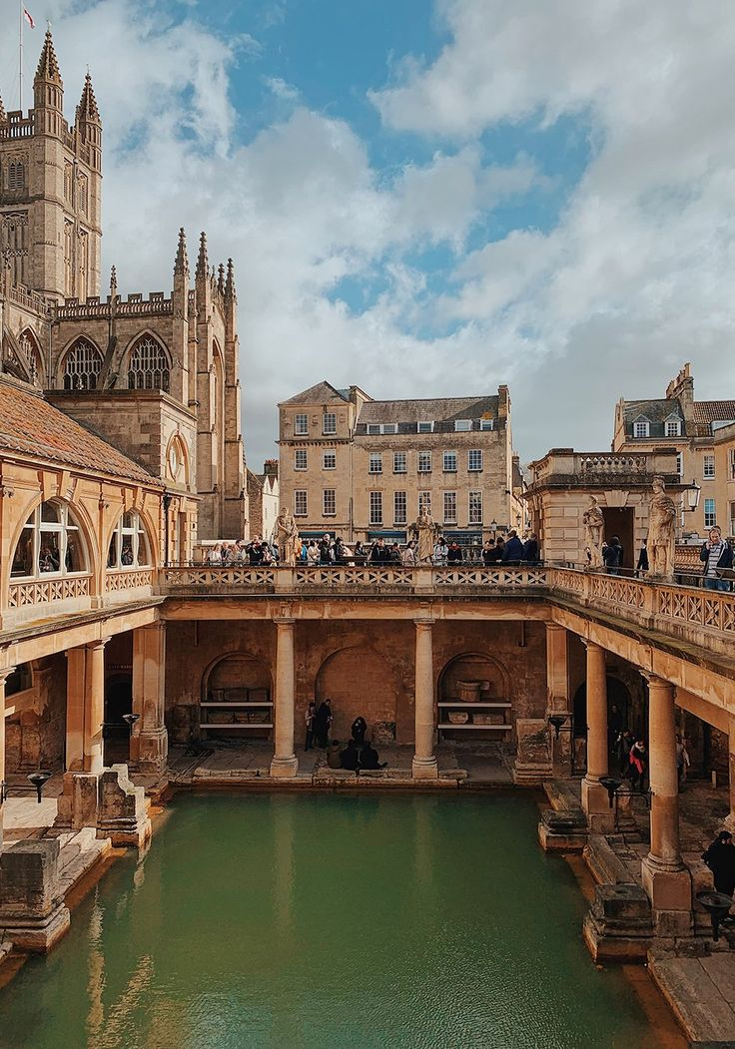
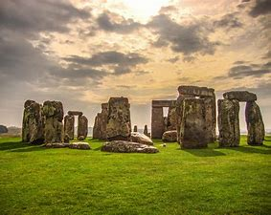
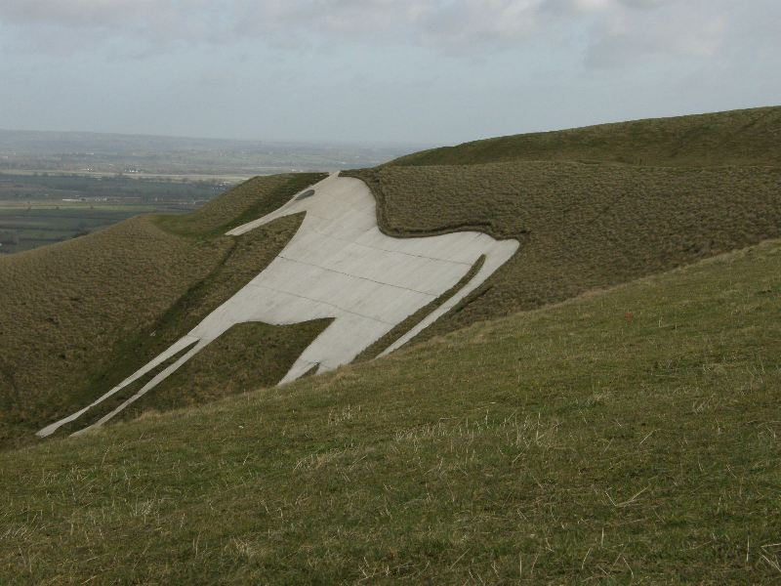
OTHER POPULAR PLACES
BATH
STONEHENGE
BIAŁY KOŃ Z WESTBURY

Slide 14
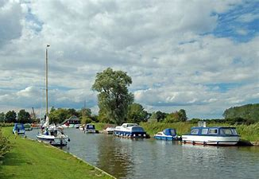
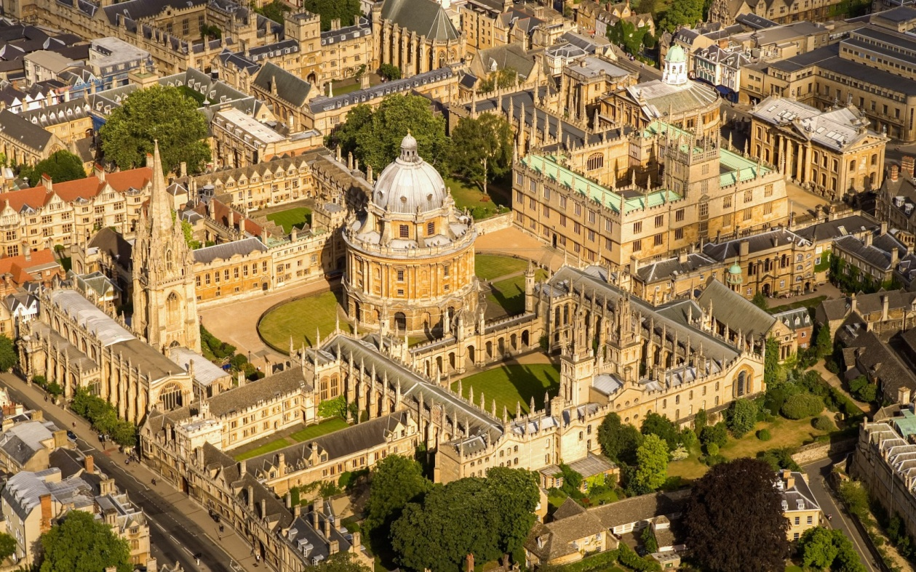
NORFOLK BROADS
OXFORD

Slide 15
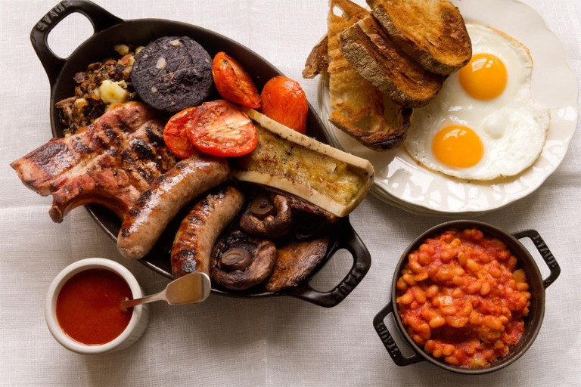
FAMOUS ENGLISH BEAKFAST

Slide 16
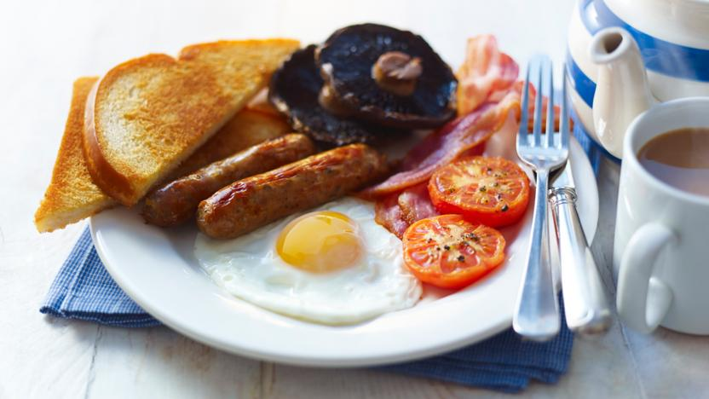
RECIPE
Ingredients
Per person, allow:
2 sausages
2-3 rashers of bacon
2 flat mushrooms
1-2 ripe tomatoes
1 thick slice of black pudding
1 large egg
1 slice of bread

Slide 17
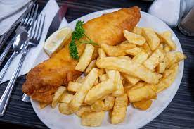
Popular meal
Fish and chips is a hot dish consisting of fried fish in batter, served with chips. The dish originated in England, where these two components had been introduced from separate immigrant cultures; it is not known who created the culinary fusion that became the emblematic British meal.

Slide 18
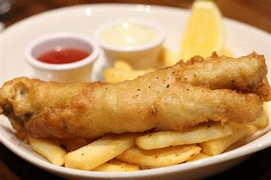
RECIPE
Ingredients
900 g potatoes
sunflower oil , for deep-frying
225 g white fish fillets , skin off, pin-boned, from sustainable sources
225 g plain flour , plus extra for dusting
285 ml cold beer
3 heaped teaspoons baking powder
MUSHY PEAS
a few sprigs of fresh mint
1 knob of unsalted butter
4 handfuls of podded peas
½ a lemon

Slide 19
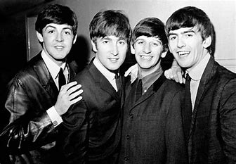
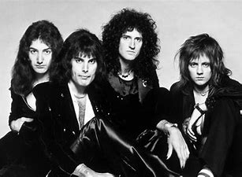
MUSIC BANDS
QUEEN
BEATLES

Slide 20
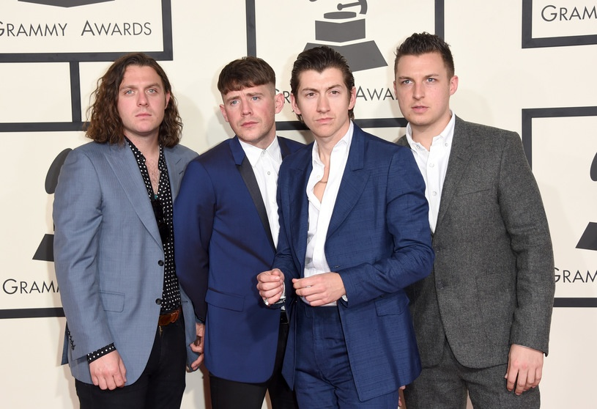
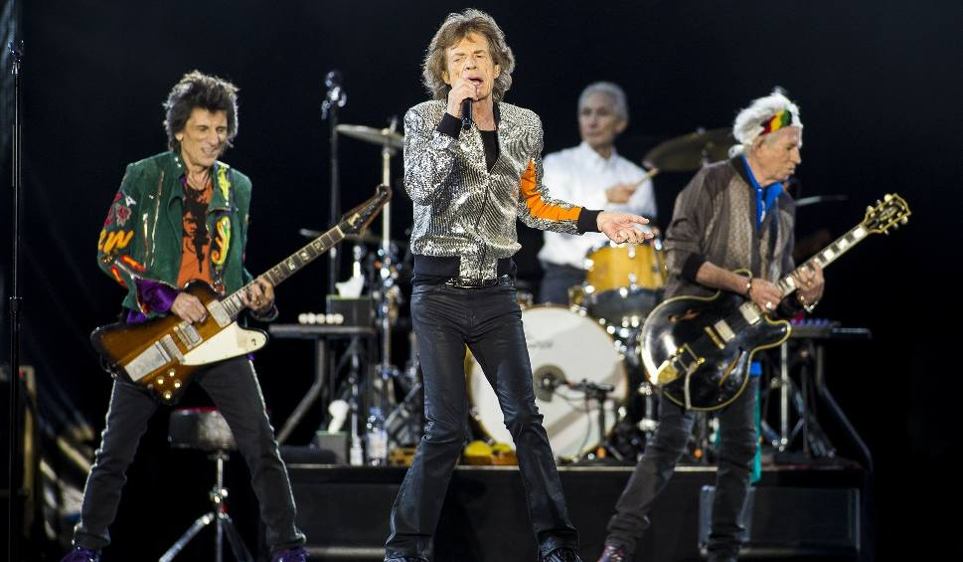
ARTIC MONKEYS
ROLLING STONES

Slide 21
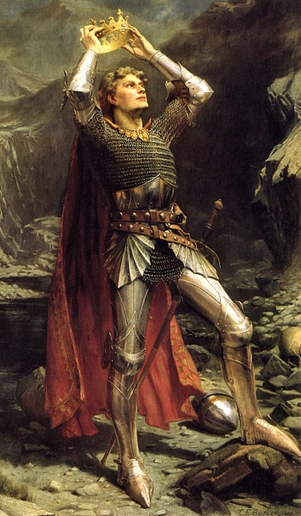
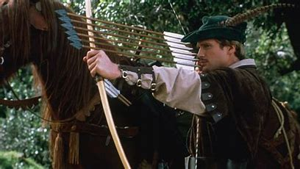
Famous historical figures
KING ARTHUR
ROBIN HOOD

Slide 22
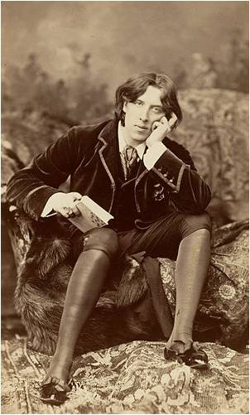
POPULAR WRITER
Oscar Wilde (16 October 1854 – 30 November 1900) was an Irish writer, poet and playwright.
He wrote The Picture of Dorian Gray, and the plays Salomé, The Importance of Being Earnest, An Ideal Husband, and Lady Windermere's Fan.

Slide 23
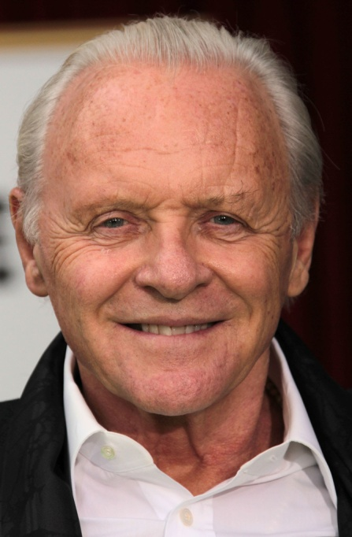
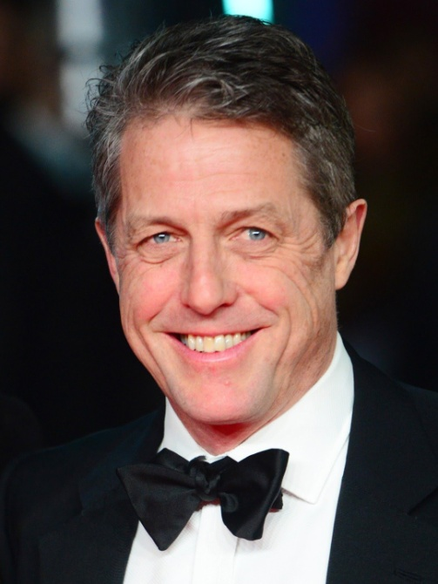
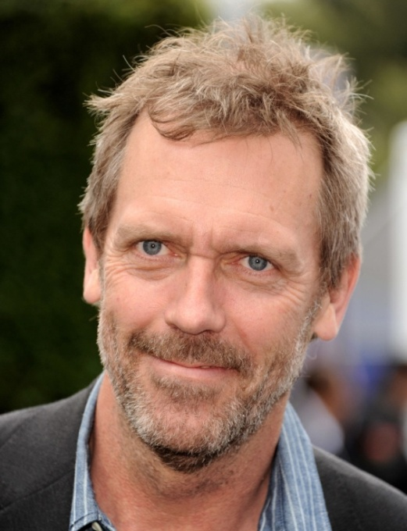
ENGLISH ACTORS
HUGH GRANT
HUGH LAURIE
TOM HOLLAND
Anthony Hopkins

Slide 24
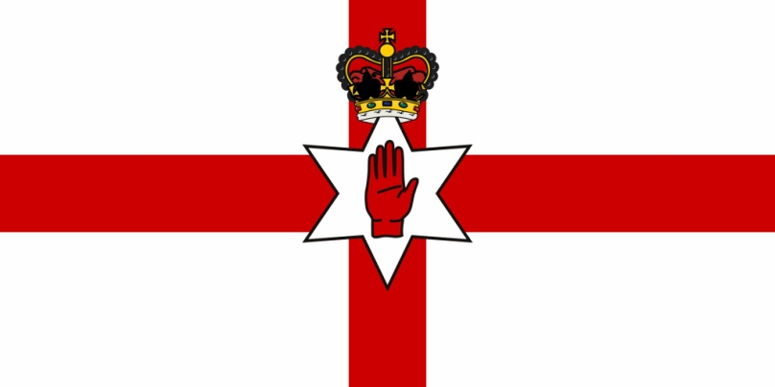
NOTHERN IRELAND
Northern Ireland is a constituent country of the United Kingdom, which is on the island of Ireland.

Slide 25
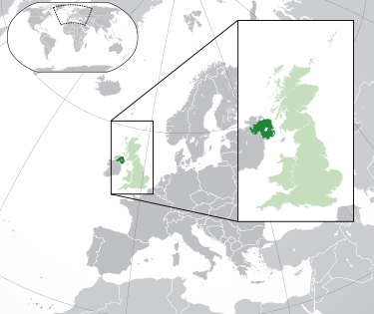

Slide 26
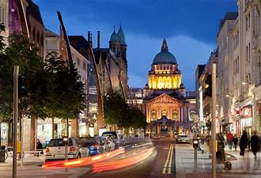
capital
BELFAST is a capital city of Nothern Ireland.

Slide 27
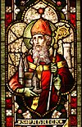
PATRON
NATIONAL SYMBOL
SHAMROCK
ST. PATRICK

Slide 28
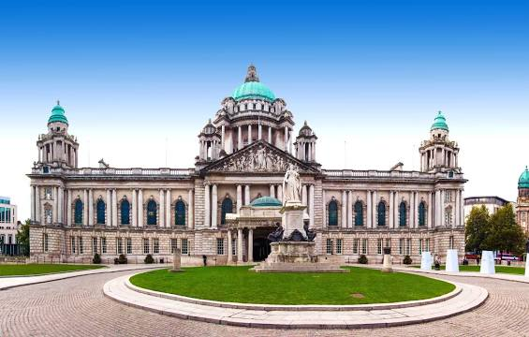
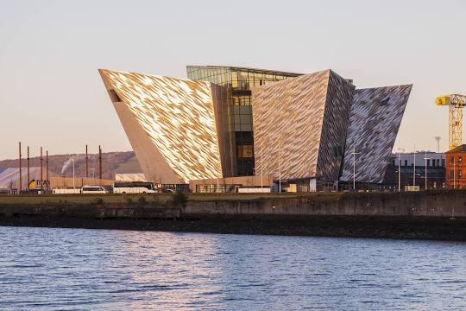
Interesting places
BELFAST CITY HALL
TITANIC BELFAST

Slide 29
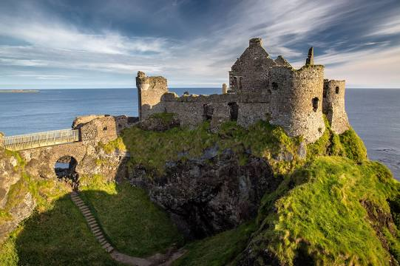
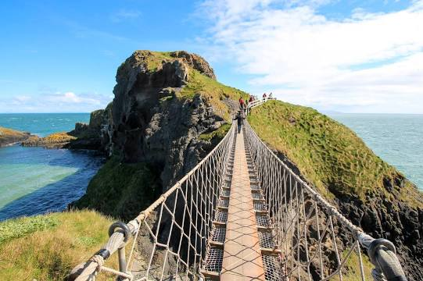
DUNLUCE CASTLE
NATIONAL TRUST CARRICK-A-REDE

Slide 30
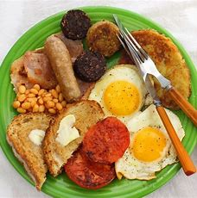
POPULAR FOOD
The Ulster Fry is seen by many as the national dish of Northern Ireland.
The Ulster Fry consists of bacon, egg, sausage (can be either pork or beef), the farl form of soda bread , potato bread and fried tomato.
Additional ingredients may be added, such as black pudding, white pudding, mushrooms, wheaten bread and pancakes.

Slide 31
THE BEST SONGS
Brown Eyed Girl - Van Morrison
The Town I Loved So Well – Phil Coulter
Alternative Ulster – Stiff Little Fingers
Belfast Child – Simple Minds
Girl from Mars - Ash
Mary – The Four of Us
Chasing Cars – Snow Patrol

Slide 32
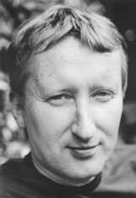
WRITER
COLIN BATEMAN

Slide 33
ACTORS
LIAM NEESON
IAN MCELHINNEY
JAMES NESBITT

Slide 34
FOOTBALL
The Northern Ireland national football team represents Northern Ireland in international association football.
From 1882 to 1920, all of Ireland was represented by a single side, the Ireland national football team, organised by the Irish Football Association (IFA).

Slide 35
SOCCER TEAM

Slide 36
SCOTLAND
Scotland is one of the four countries that make up the United Kingdom.
It is the northern half of the island of Great Britain, along with many other islands, with about five million people living there.
To the south of Scotland is England, the North Sea to the east, the Atlantic Ocean to the west and the Irish Sea to the south-west.

Slide 38
capital
Edinburgh is a capital city of Scotland .

Slide 39
patron
NATIONAL SYMBOL
ST. ANDREW
THISTLE

Slide 40
Popular places
GLASGOW SKYE
EDINBURGH CASTLE

Slide 41
IVERNESS
NESSIE- LOCH NESS MONSTER

Slide 42
POPULAR MEAL
NEEPS AND TATTIES is the most popular meal in Scotland

Slide 43
WRITER
WILLIAM EDMONDSTOUN AYTOUN is a Scottish writer.

Slide 44
SCOTTISH OUTFIT
A kilt is a ceremonial article of clothing worn in Scotland. It resembles a pleated skirt except that it is worn by men.
It is still worn during ceremonies by some Scottish and Canadian military units and by people who play the bagpipes.

Slide 46
NICE VIEWS

Slide 47
WALES
Wales is a country on the island of Great Britain. It is one of the four countries that make up the United Kingdom. It is west of England, and east of the Irish Sea and Ireland.

Slide 49
CAPITAL
CARDIFF is a capital city of Wales.

Slide 50
National symbols
PATRON
DAFFODIL
LEEK
ST. DAVID
RED DRAGON

Slide 51
POPULAR PLACES
GREAT ORME
SNOWDON

Slide 52
CASTLE IN CARDIFF
BODNANT GARDEN

Slide 53
POPULAR FOOD
Cawl is a Welsh dish.

Slide 54
TRANSPORT
Railway
Cardiff Central is Wales' busiest railway station. The area around Cardiff also has its own rail network.
Trains from north to south Wales go through the English towns of Chester and Shrewsbury on the Welsh Marches Line.

Slide 55
Sea
Wales has four ferry ports. Regular ferries to Ireland go from Holyhead, Pembroke and Fishguard.

Slide 56
It is the most important city in Wales for tourism, culture, government, sport, transport, nightlife and business.
Cardiff has a big port that used to be known as Tiger Bay.

Slide 57
IRELAND
Ireland also known as the Republic of Ireland is a European country on the island of Ireland.
It is a member of the European Union.
The republic's capital is Dublin.
The population of Ireland is 4.6 million.
English is the main language spoken.

Slide 59
CAPITAL
DUBLIN is a capital city of Ireland.

Slide 60
PATRON
National symbol
ST. PATRICK
SHAMROCK

Slide 61
POPULAR PLACE
KYLEMORE ABBEY
ROCK OD CASHEL

Slide 62
CASTLE IN BLARNEY
CLIFES OF MOHERU

Slide 63
POPULAR FOOD
IRISH STEW IS A POPULAR DISH IN IRELAND.

Slide 64
FAMOUS BRAND MUSIC
Band U2 is popular in Ireland

Slide 65
POPULAR HOLIDAY
Saint Patrick's Day is the feast day of Saint Patrick, the patron saint of Ireland, and a day of celebration for Irish people.

Slide 66
Saint Patrick’s Day is also called Paddy’s day. It is celebrated on March 17 all over Ireland and everywhere in the world where Irish people or their descendants live. New York City has one of the biggest parades
It is a very Irish festival, and it involves a lot of feasting and celebration, including traditional Irish music, drinking beer, and eating bacon and cabbage.

Slide 67
SOURCES:
www.creativecommons.pl
www.britannica.com
www.wiki.kidzsearch.com
www.safesearchkids.com
www.simple.wikipedia.org

