Slide 1
Log Book
Finland-Greece-Italy-Poland
Erasmus 2018-2020

Slide 2
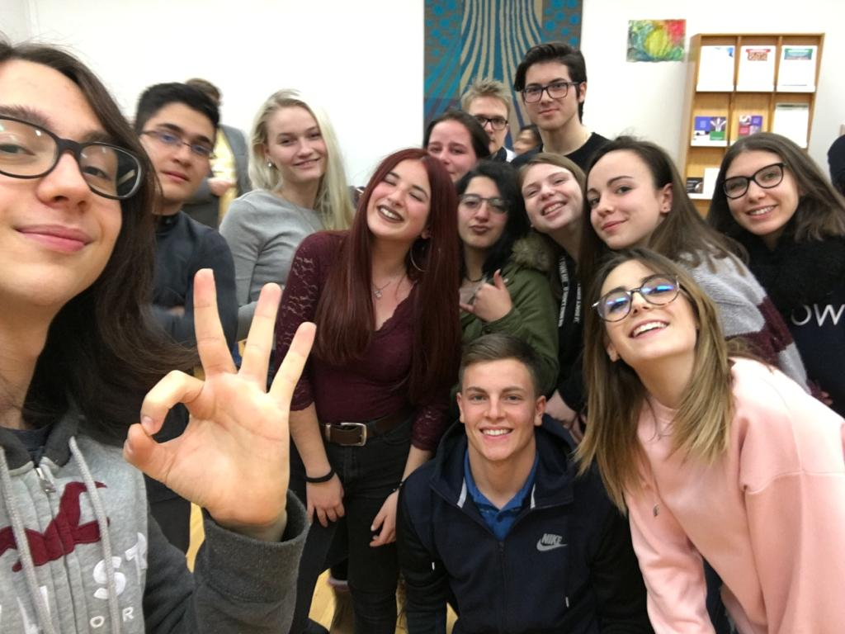
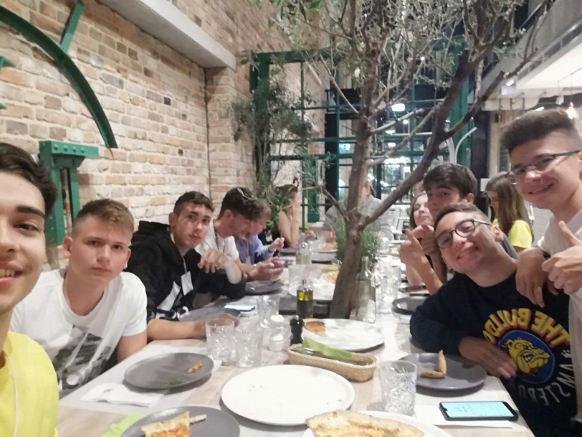
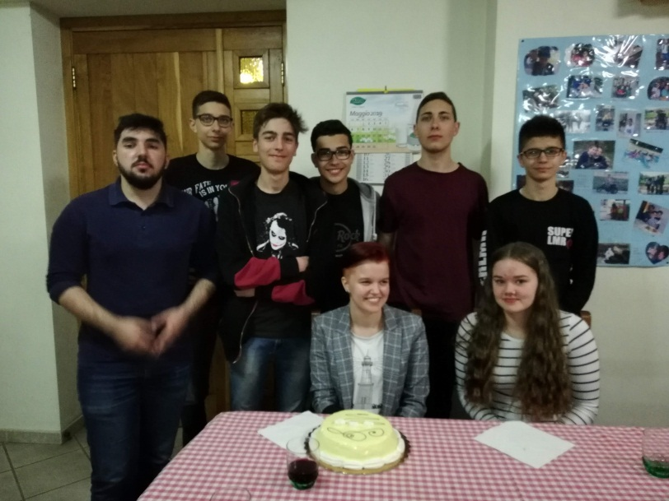
I AM NOR ATHENIAN NEITHER GREEK, I AM ONLY A CITIZEN OF THE WORLD IO NON SONO ATENIESE E NEMMENO GRECO, IO SONO CITTADINO DEL MONDO EN OLE ATEENALAINEN EIKÄ KREIKKALAINEN, OLEN MAAILMAN KANSALAINEN NIE JESTEM ATEŃCZYKIEM ANI GREKIEM, JESTEM OBYWATELEM ŚWIATAA ΔΕΝ ΕΊΜΑΙ ΑΘΗΝΑΊΟΣ, ΟΎΤΕ ΈΛΛΗΝΑΣ ΠΟΛΊΤΗΣ, ΑΛΛΆ ΠΟΛΊΤΗΣ ΤΟΥ ΚΌΣΜΟΥ
~Socrates~

Slide 3
THIS TWO YEAR EXPERIENCE HAS ALLOWED US TO TRAVEL TO DIFFERENT COUNTRIES , TRADITIONS AND CULTURAL HERITAGE
Travelling around the world is wonderful. Do you know why?

Slide 4
SHARING EUROPEAN CULTURAL HERITAGE THOUGH DIGITAL STORYTELLING
This log book is a sort of story told through images of the most beautiful moments of this experience that has involved students and teachers from 4 European countries:
Finland, Greece, Italy and Poland.

Slide 5
Nothing of this experience has been useless, it has been an enrichment in many aspects and fields, we have surely opened our mind to new worlds .
We have made new friendships and created international connections, and this is one of the most beautiful things of the Erasmus project.

Slide 6
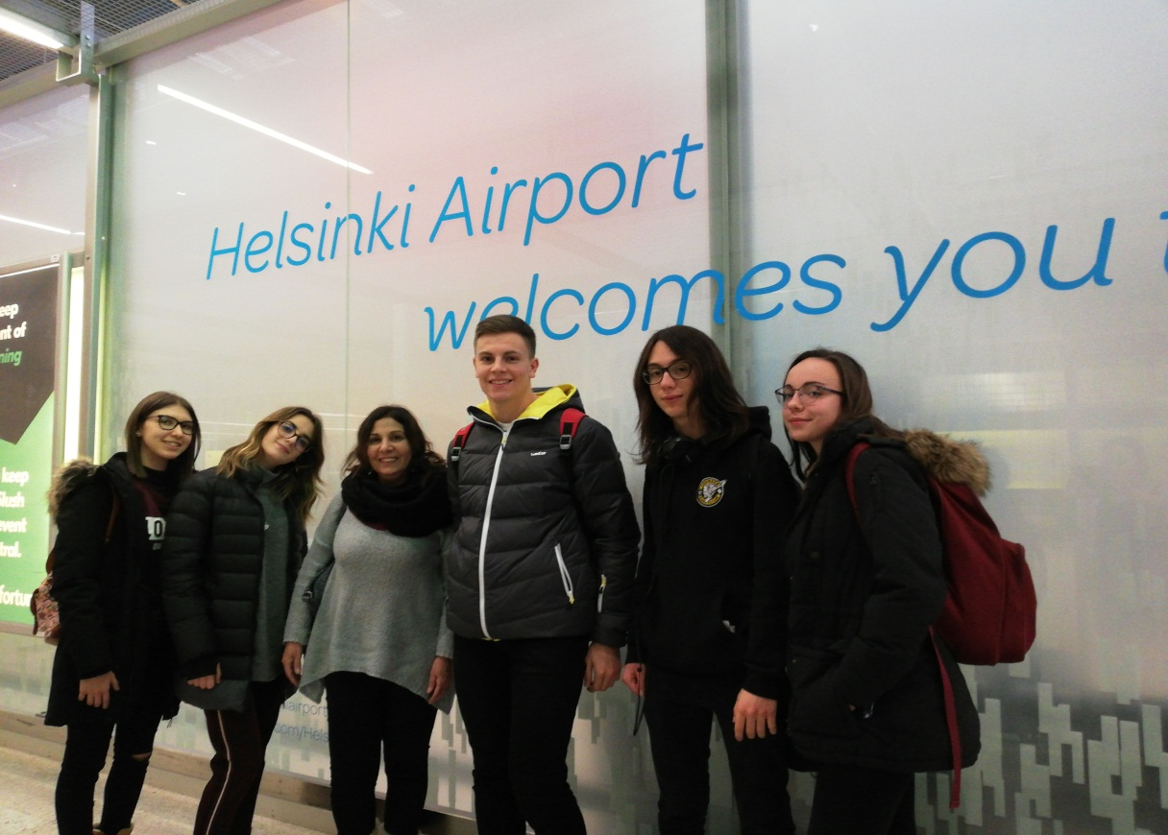
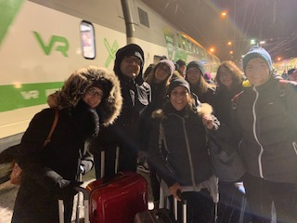
FINLAND HERE WE ARE !!!!!!!!!!

Slide 7
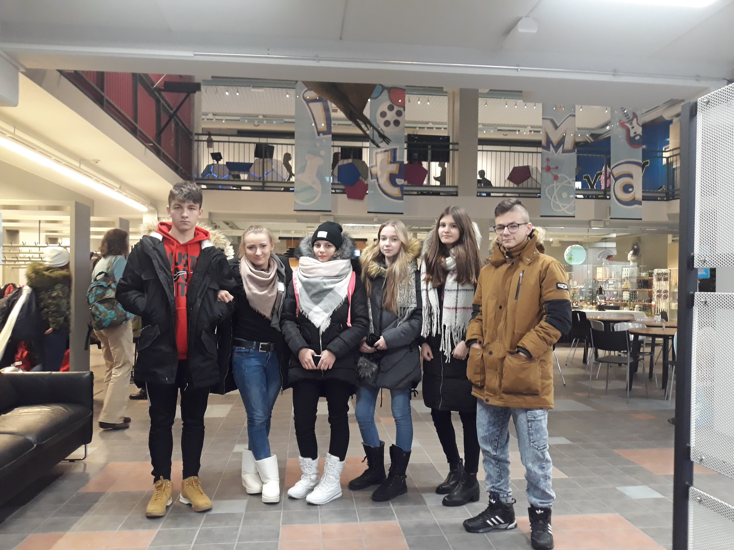
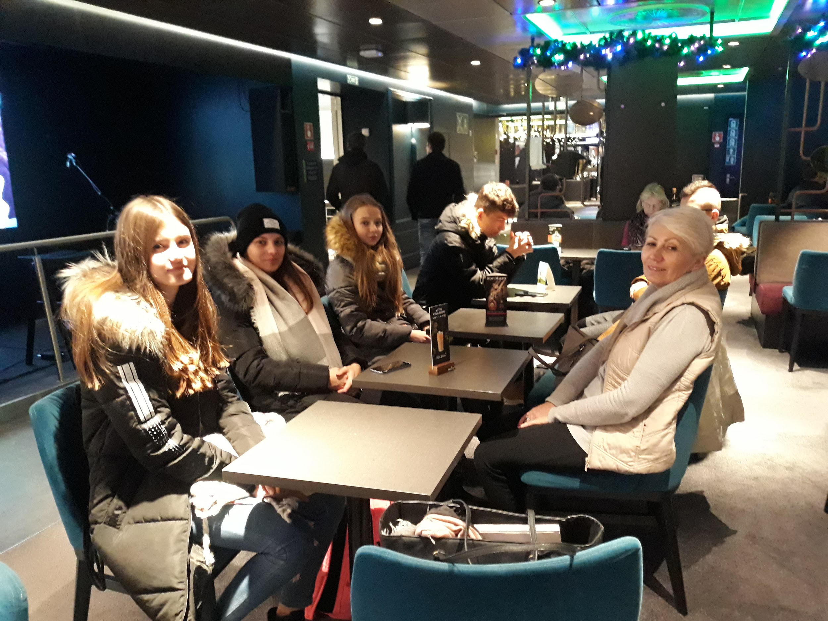
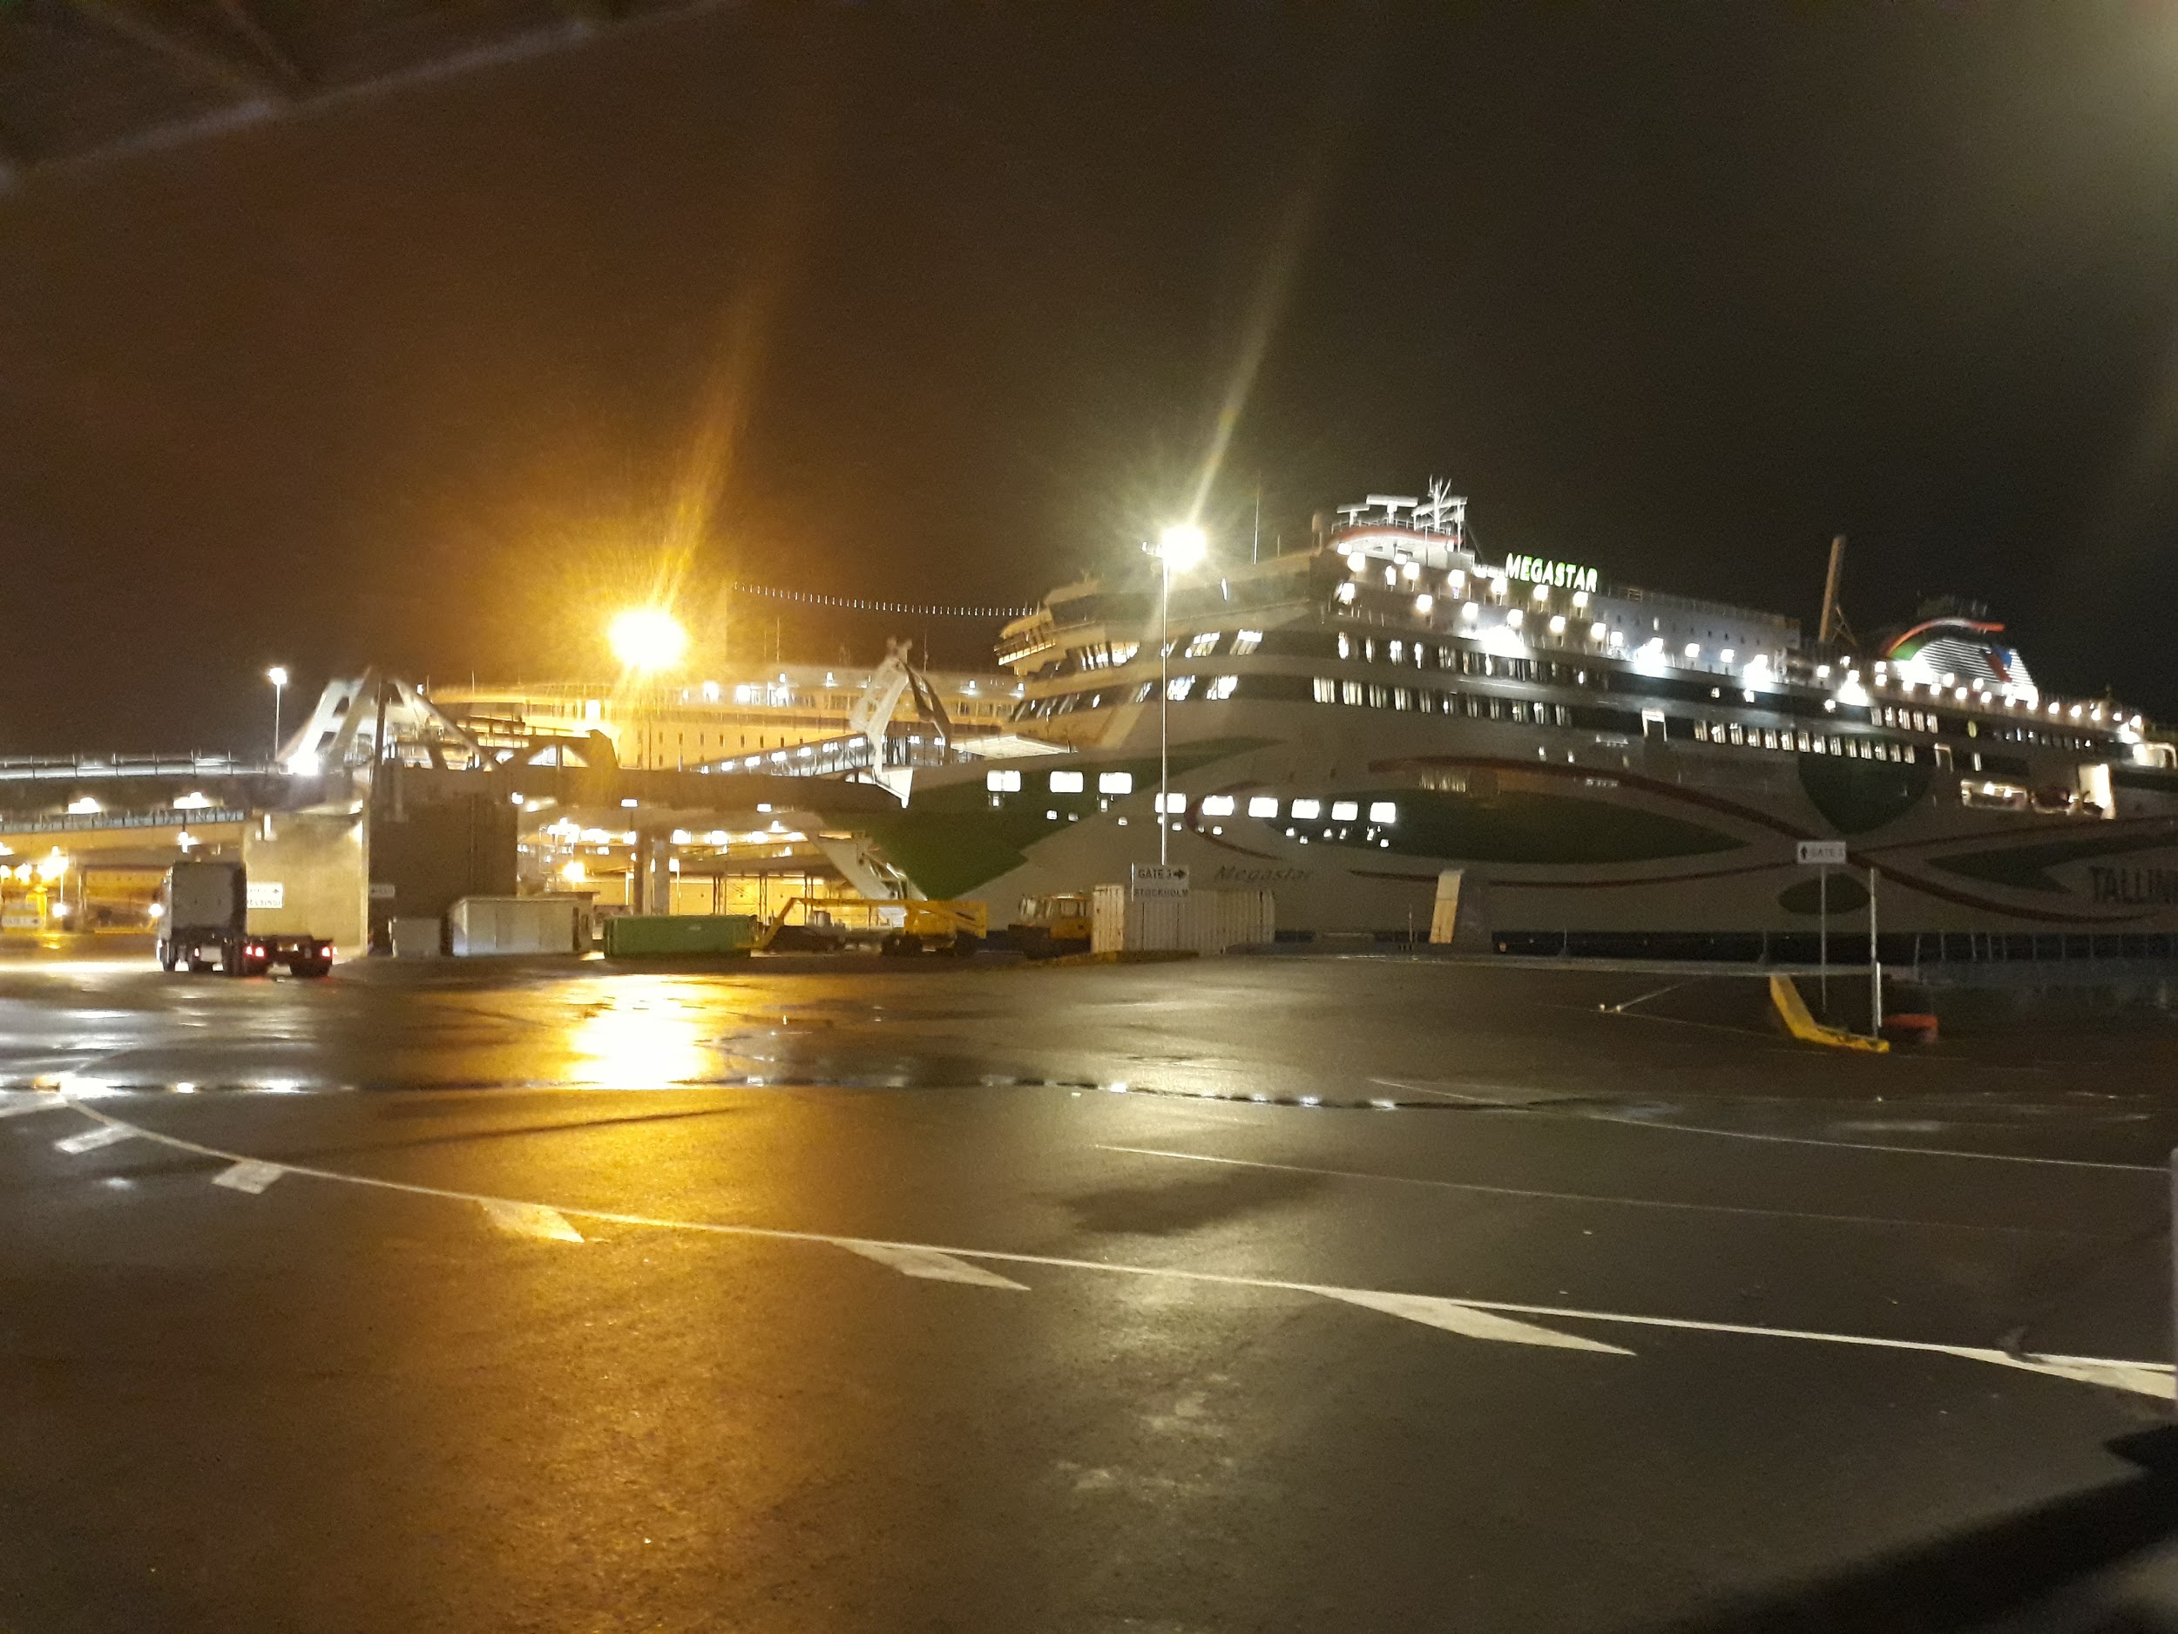

Slide 9
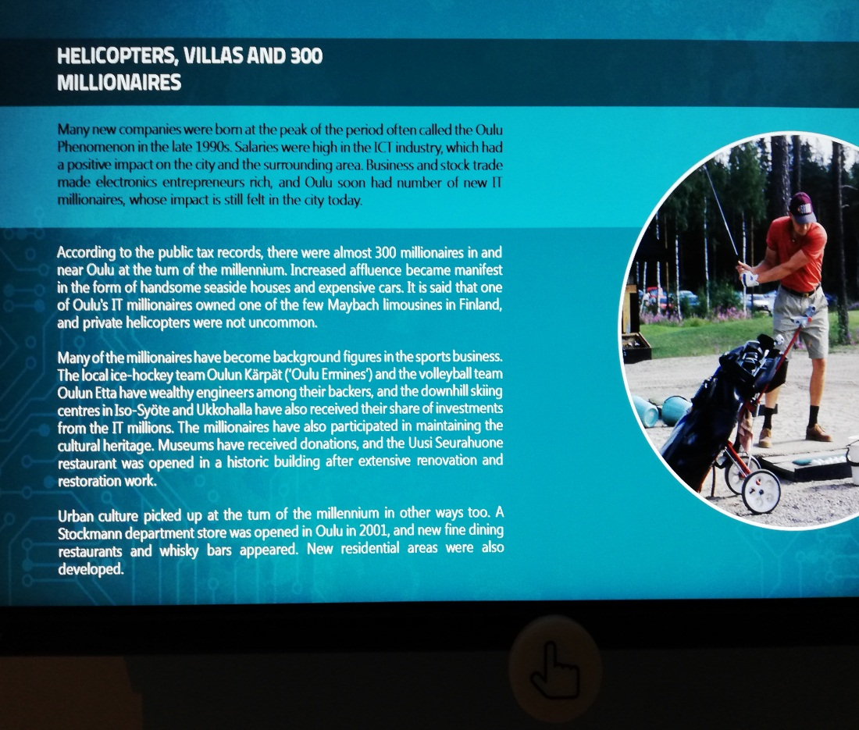
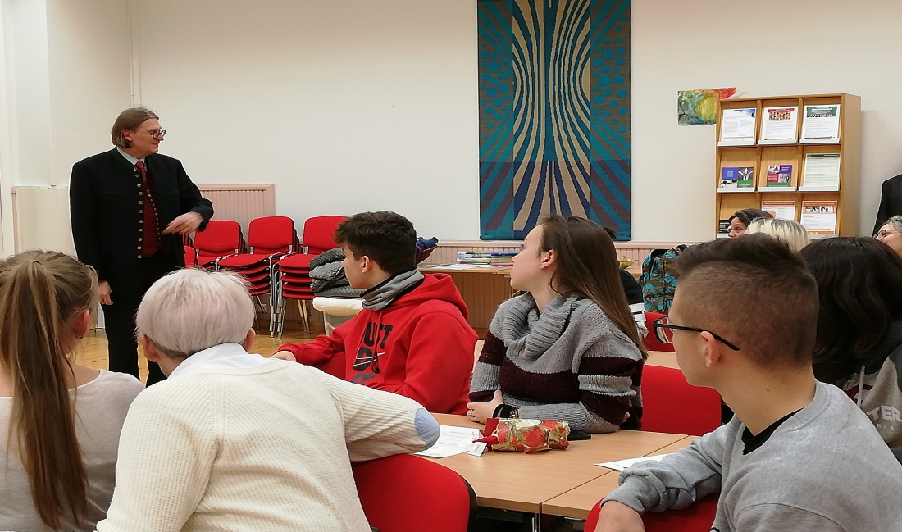
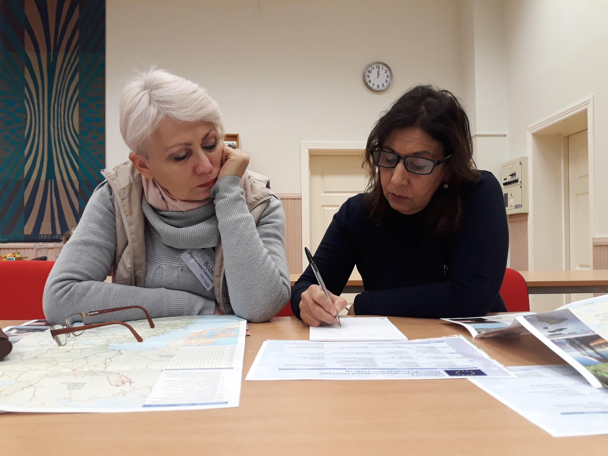
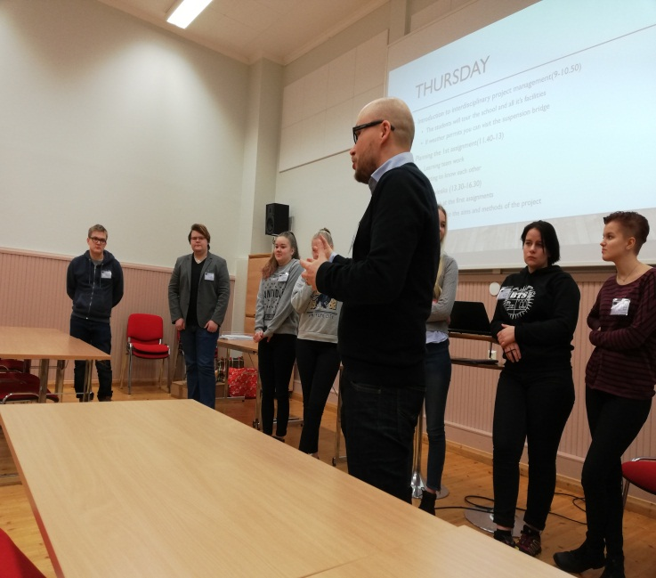
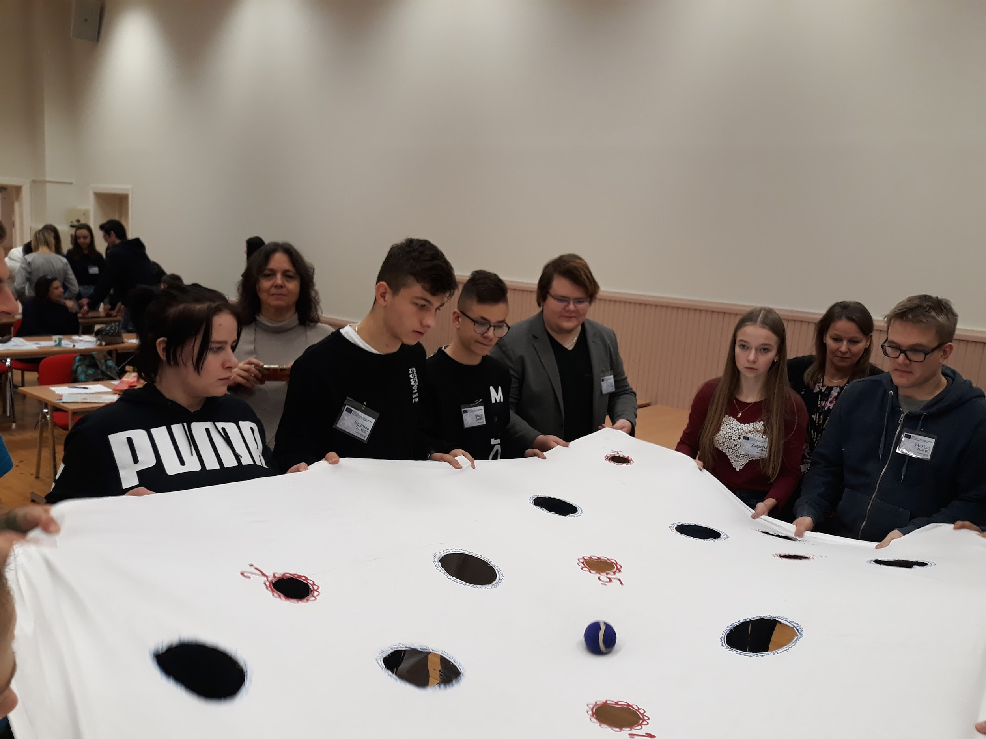
WE HAVE LEARNED

Slide 10
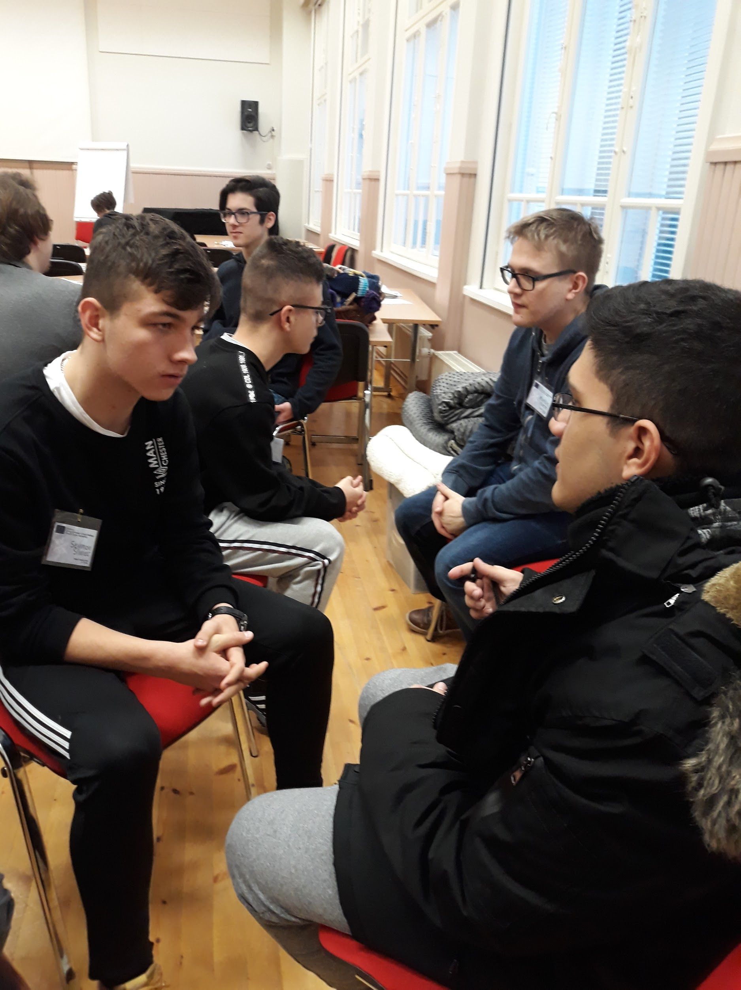
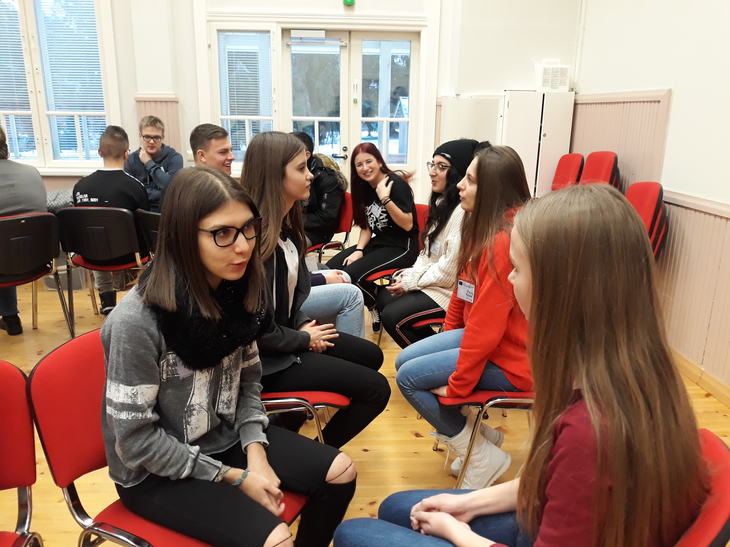
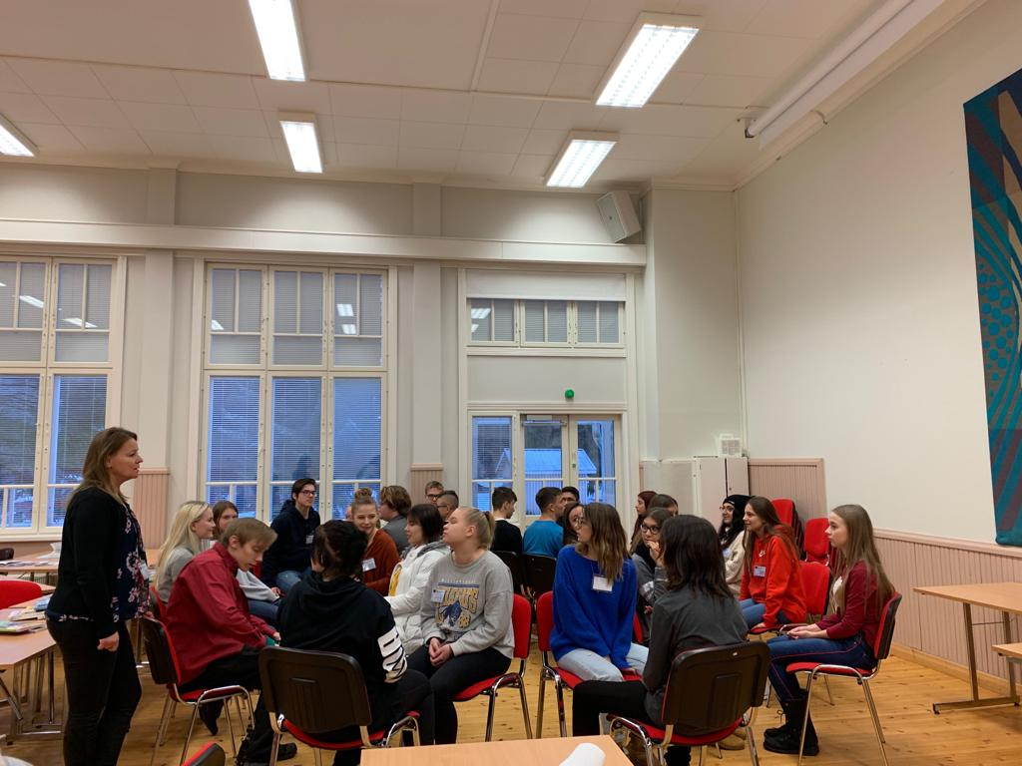

Slide 11
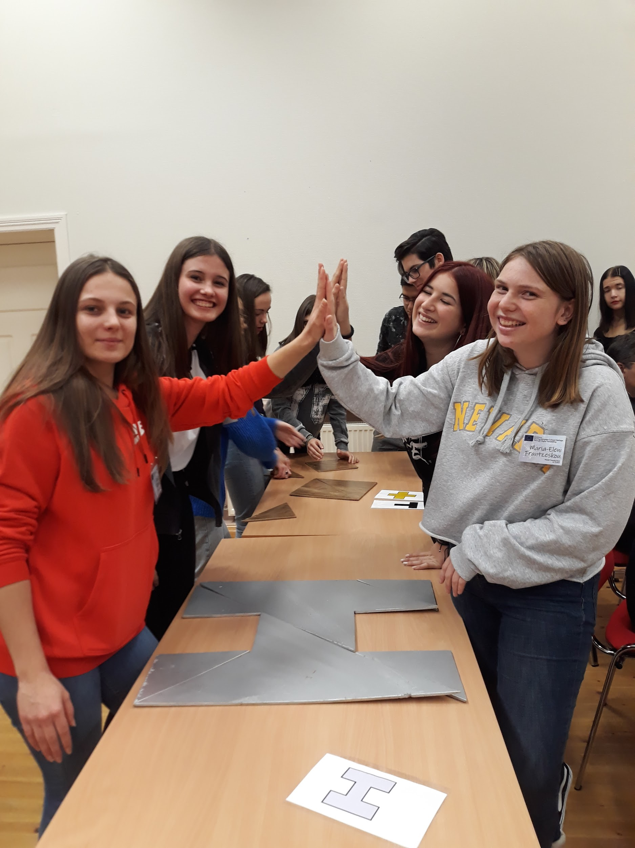
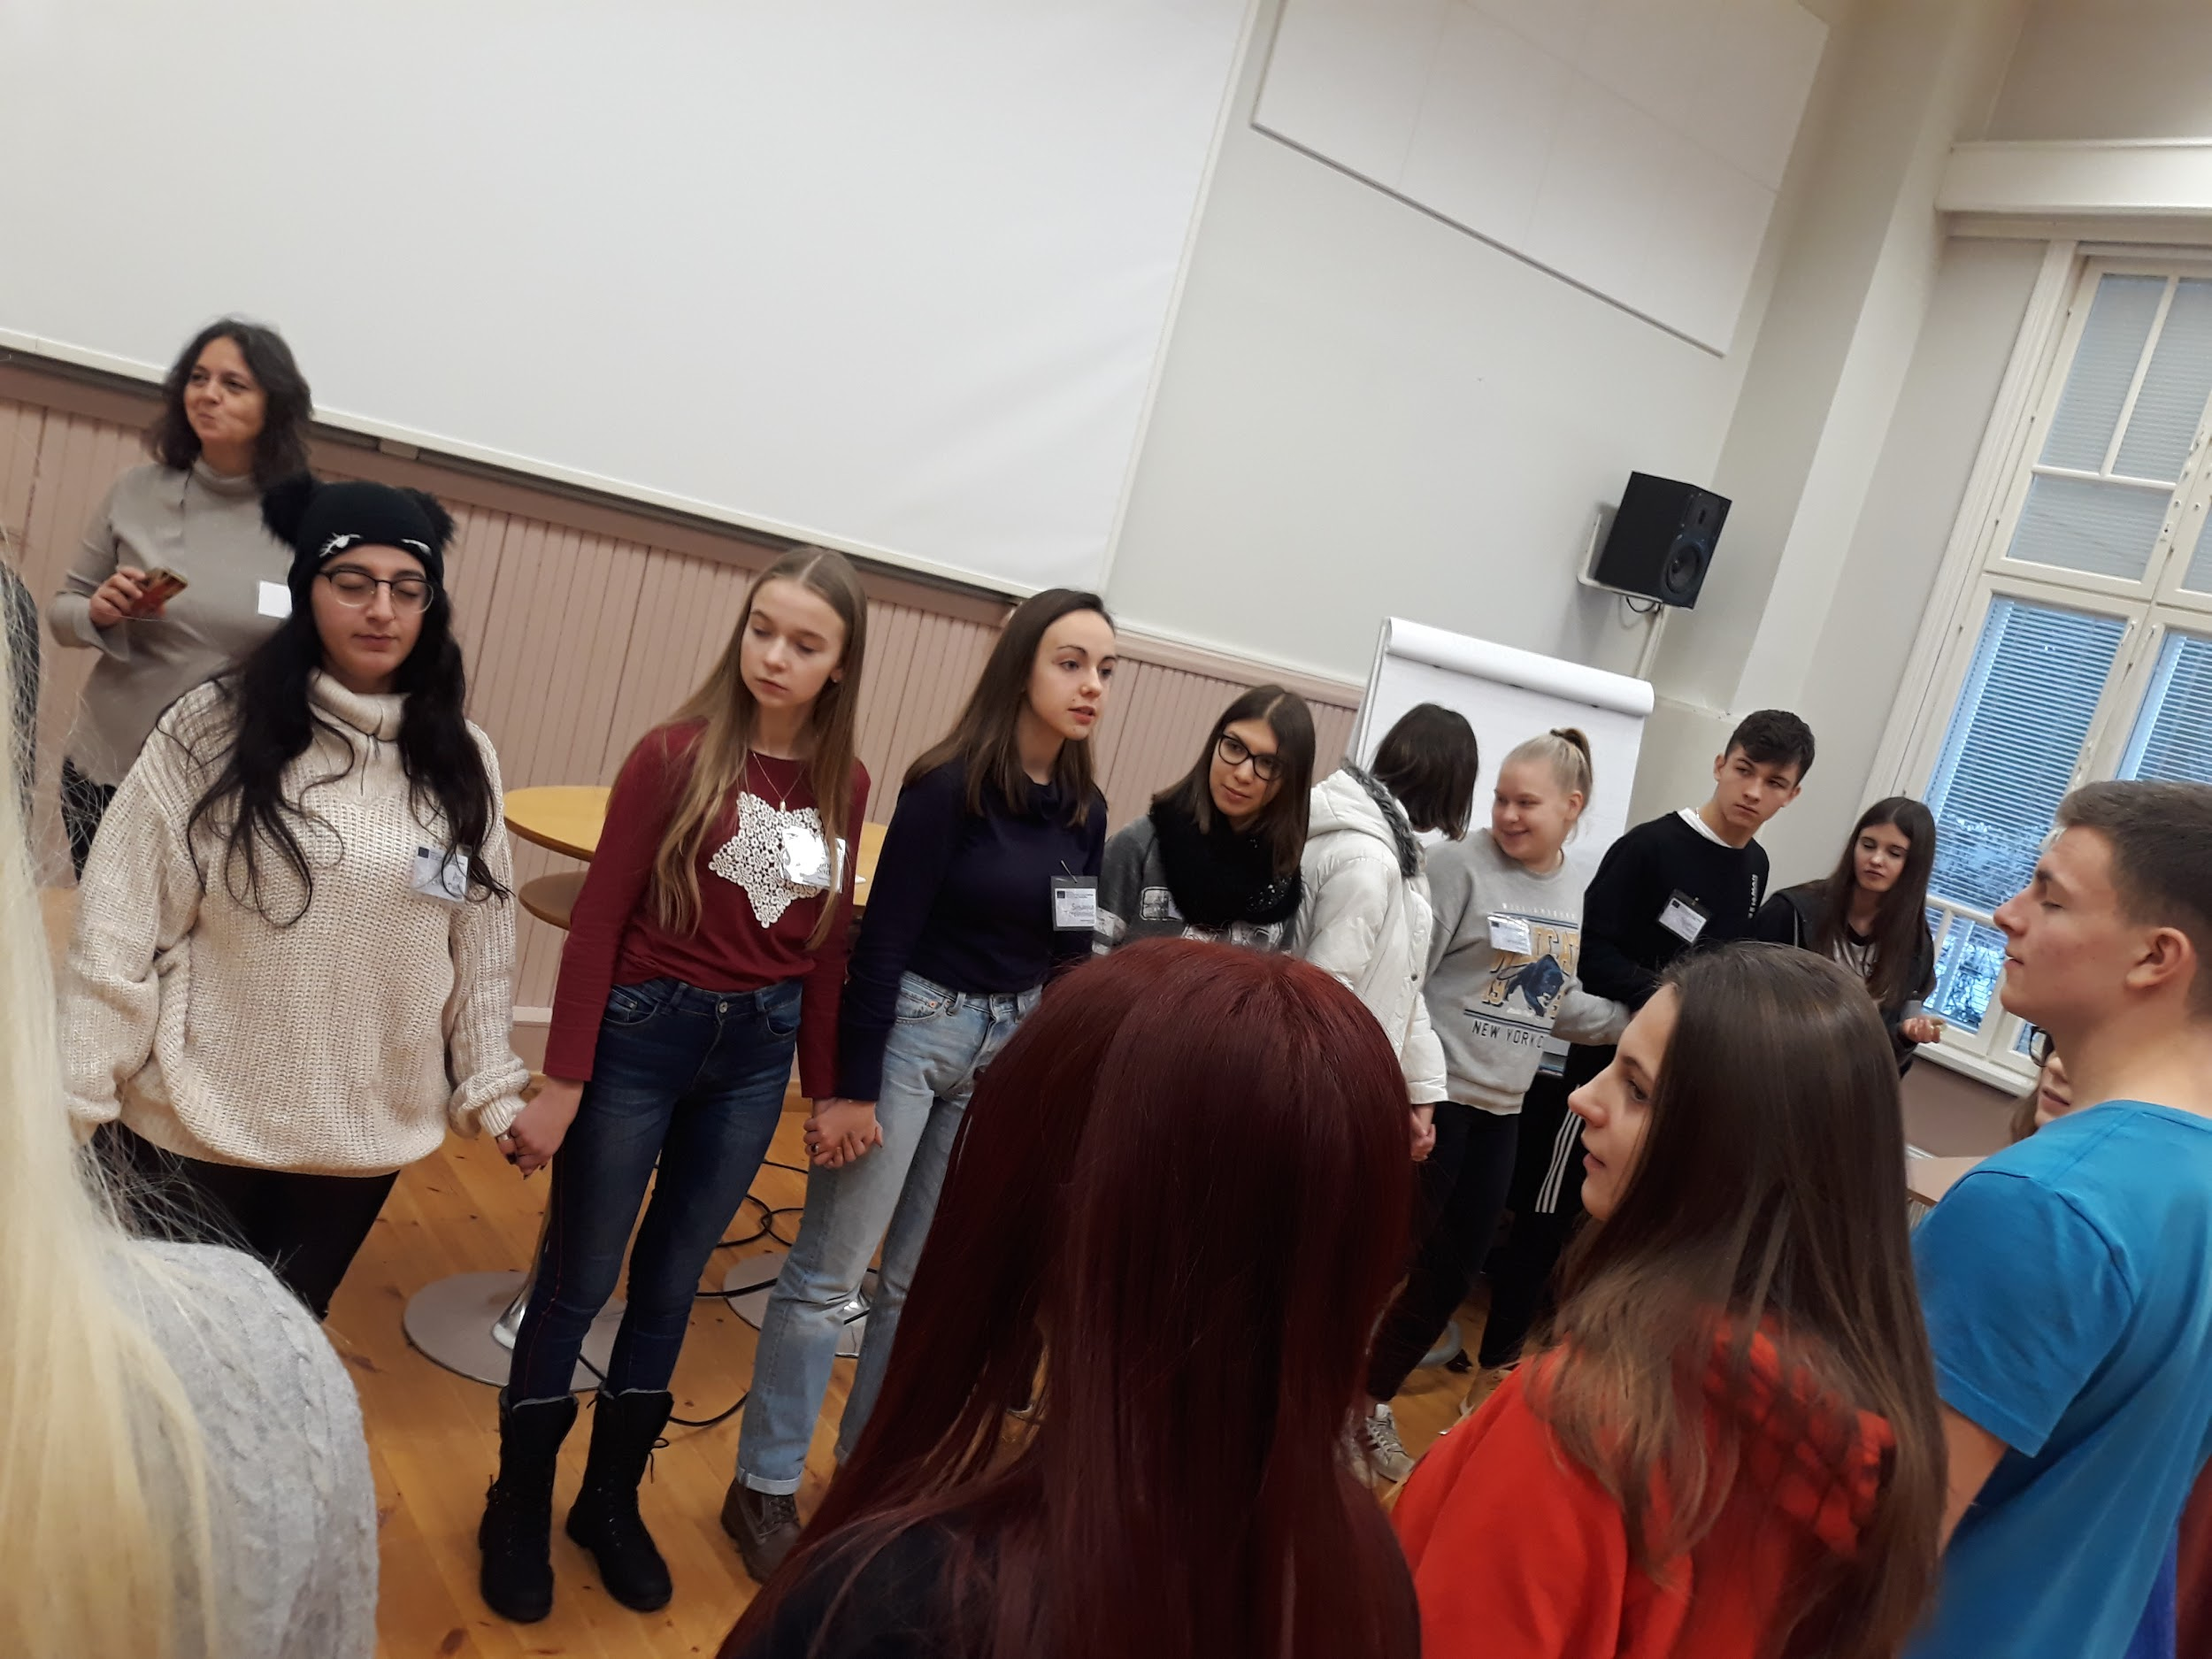
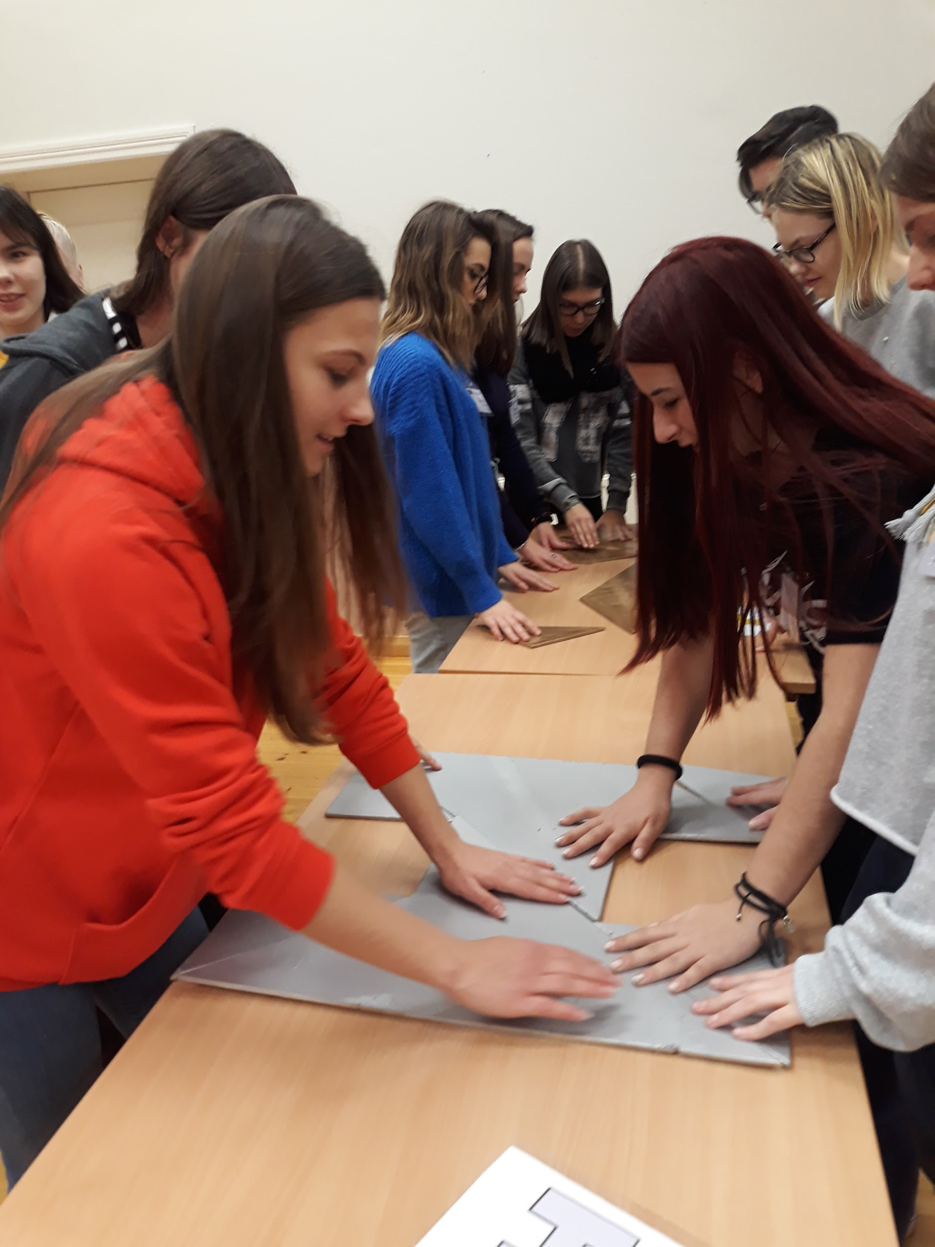

Slide 12
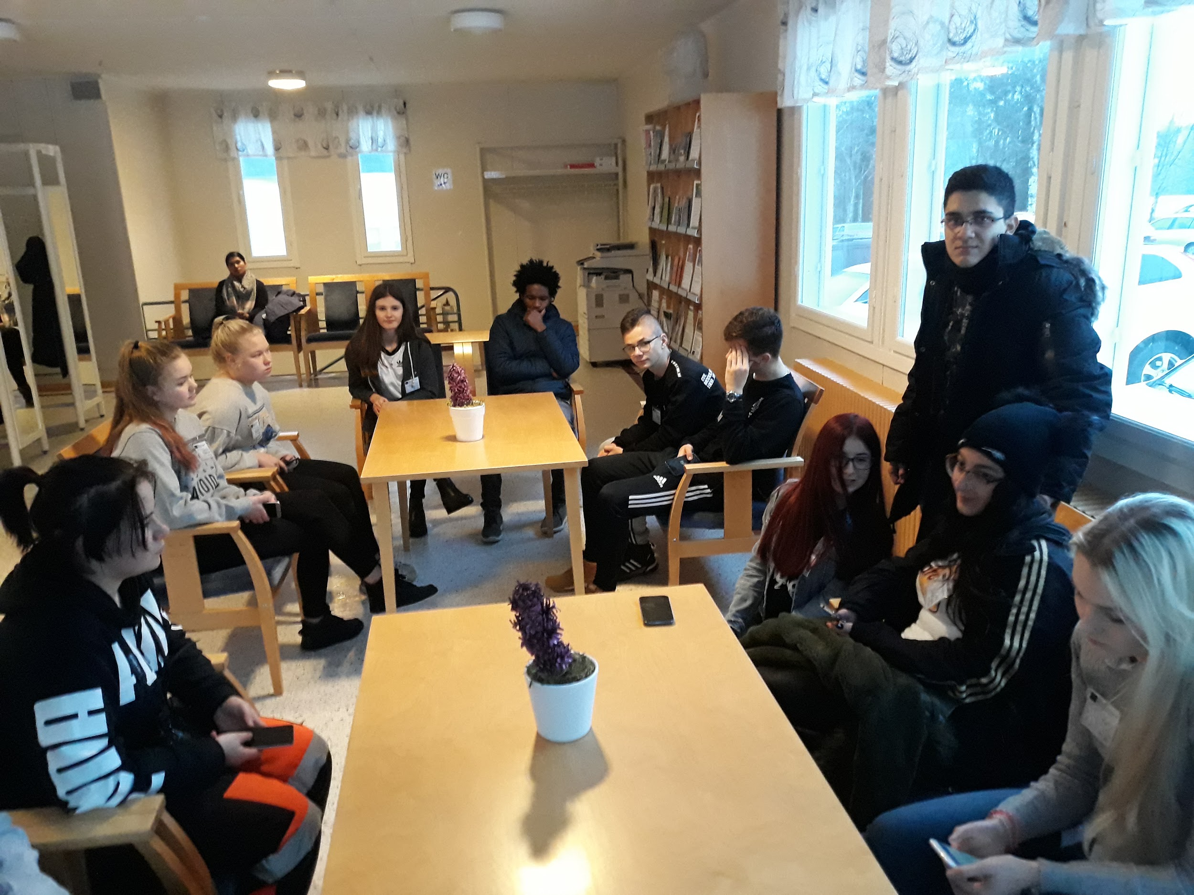
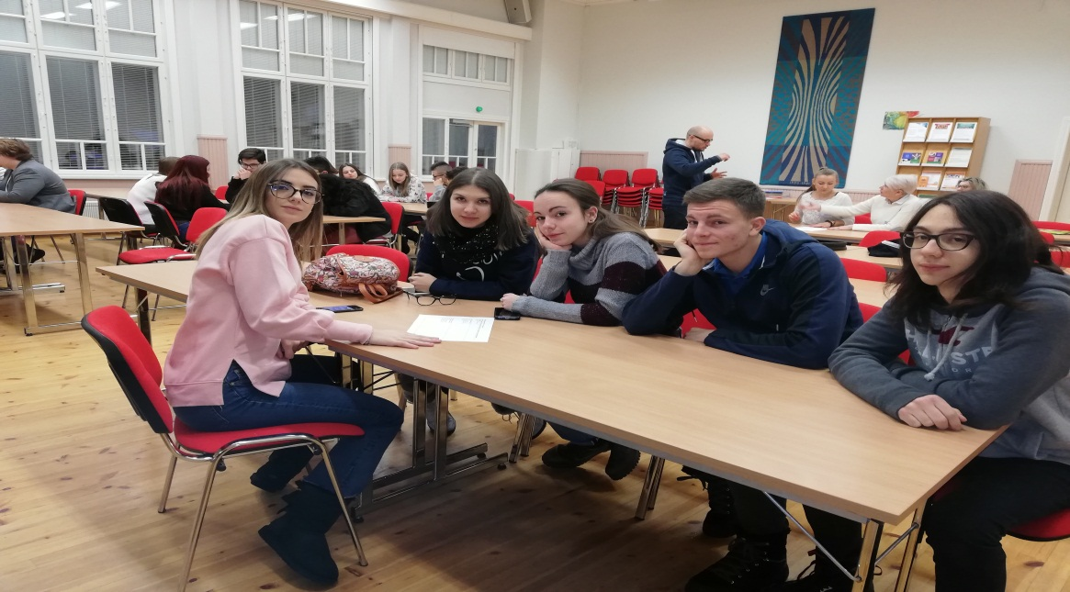
BEEN TOGETHER

Slide 13
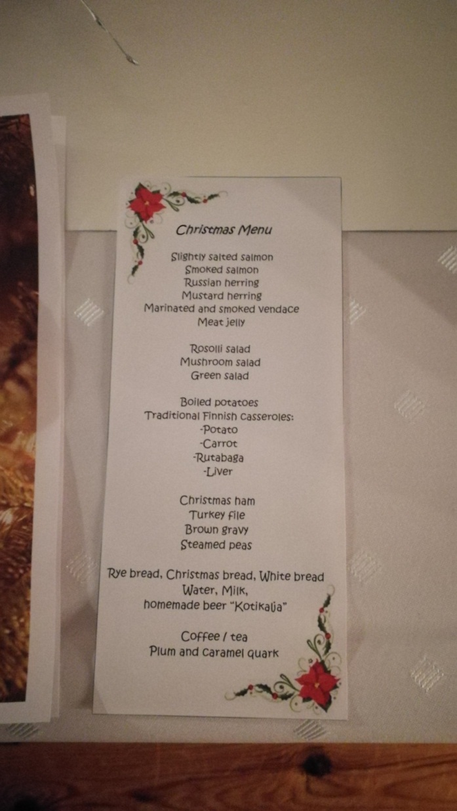
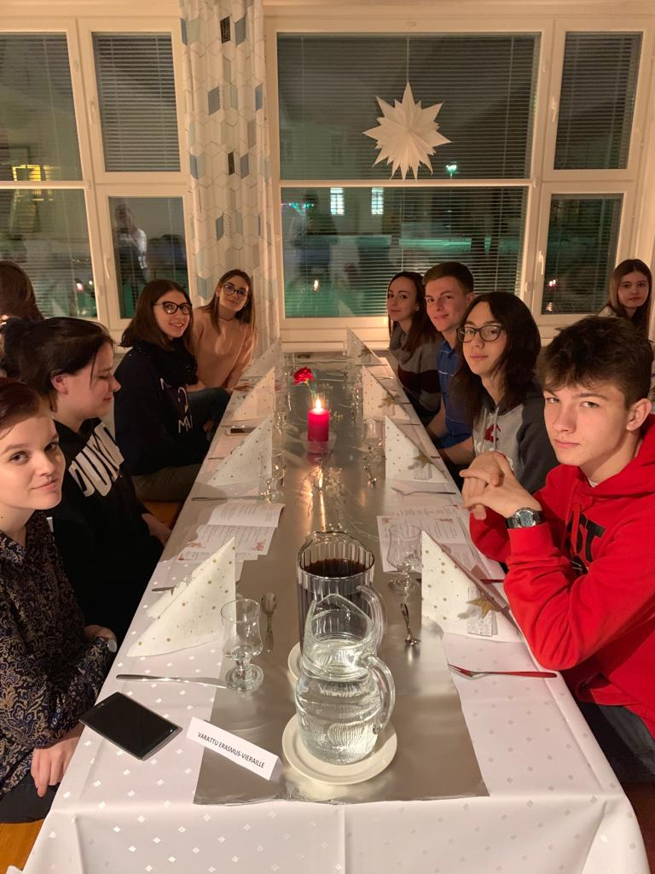
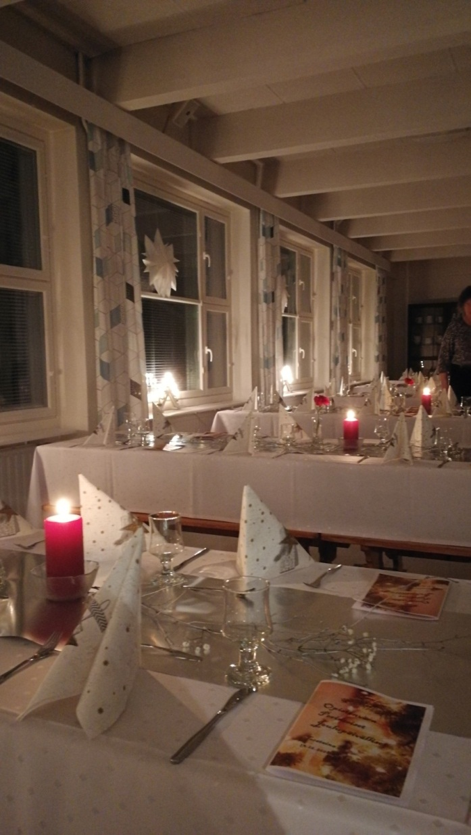
WE HAVE SHARED SUGGESTIVE MOMENTS

Slide 14
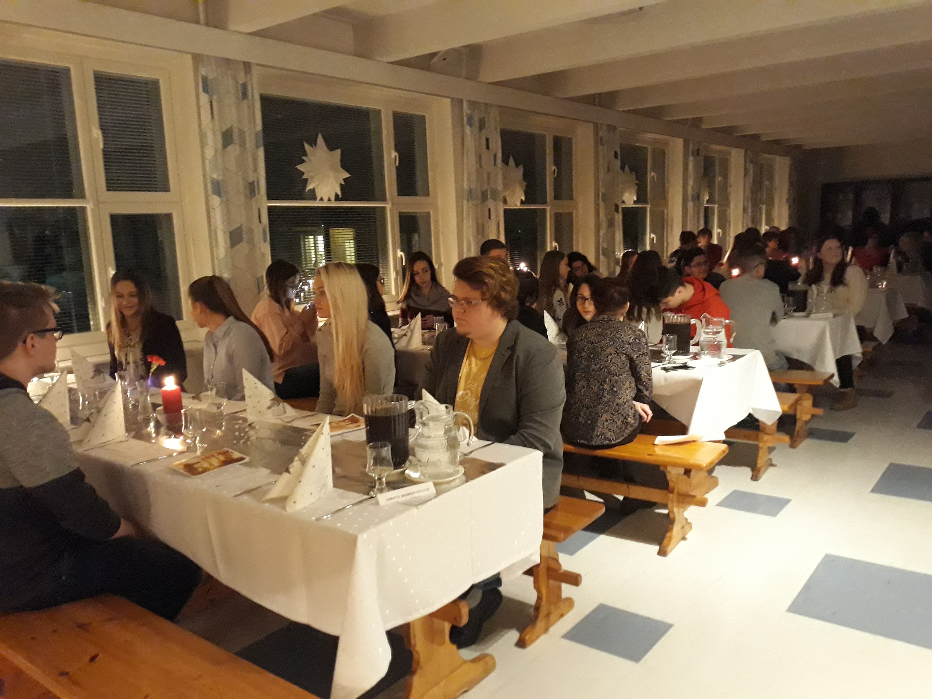
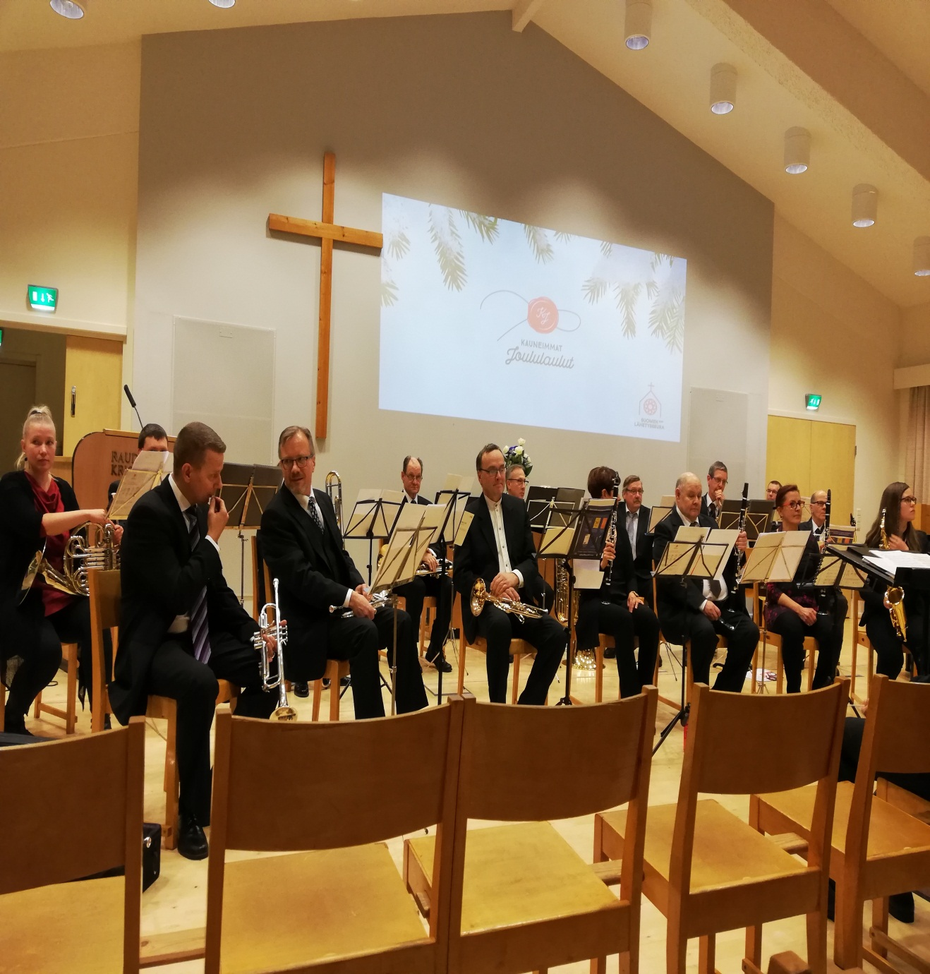
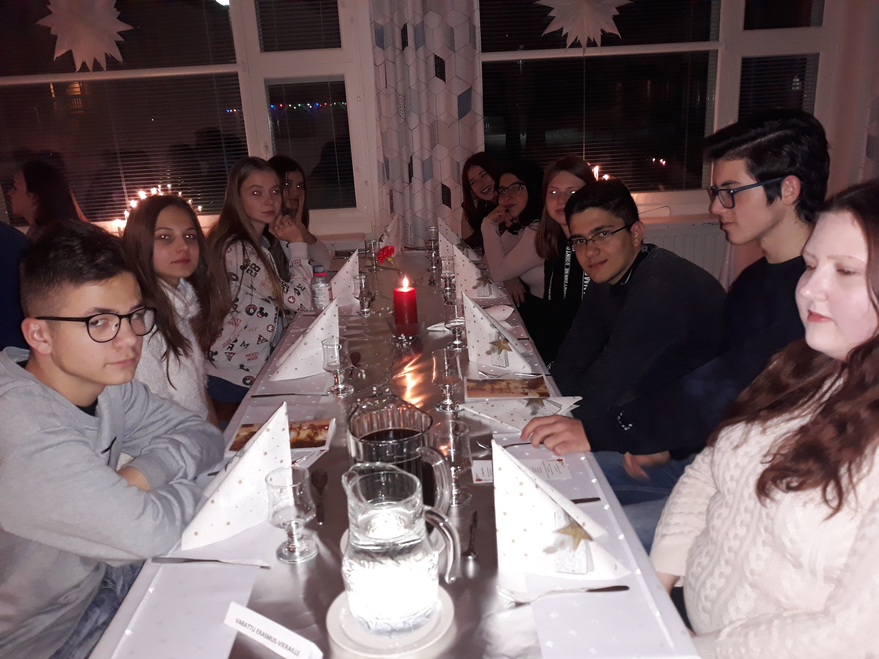

Slide 15
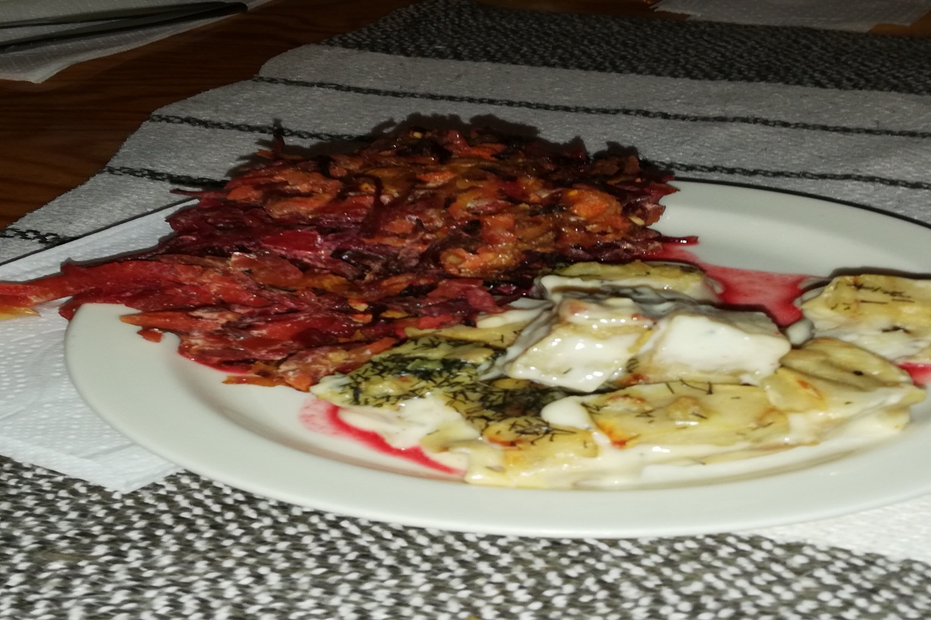
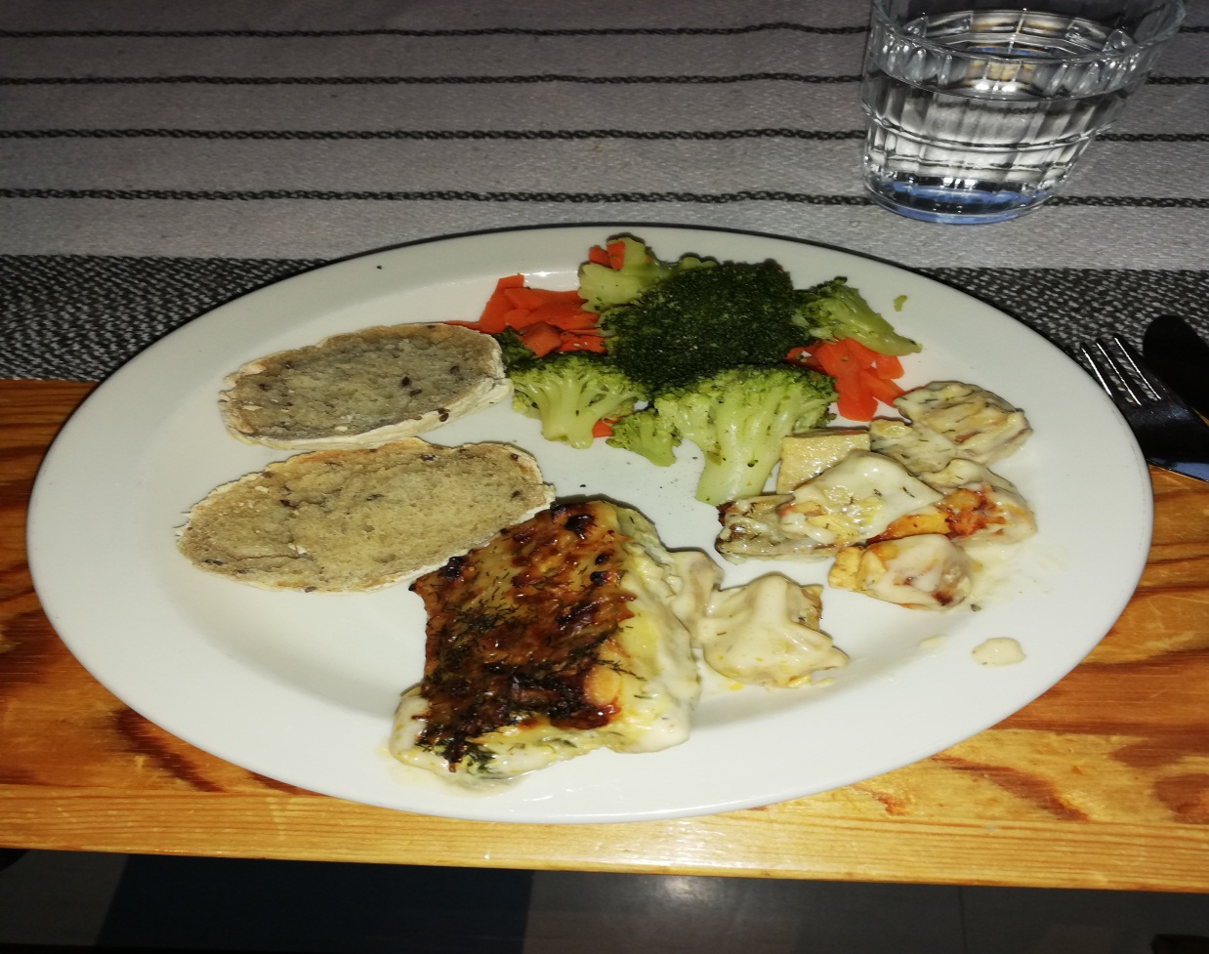
WE HAVE TASTED DIFFERENT FOOD

Slide 16
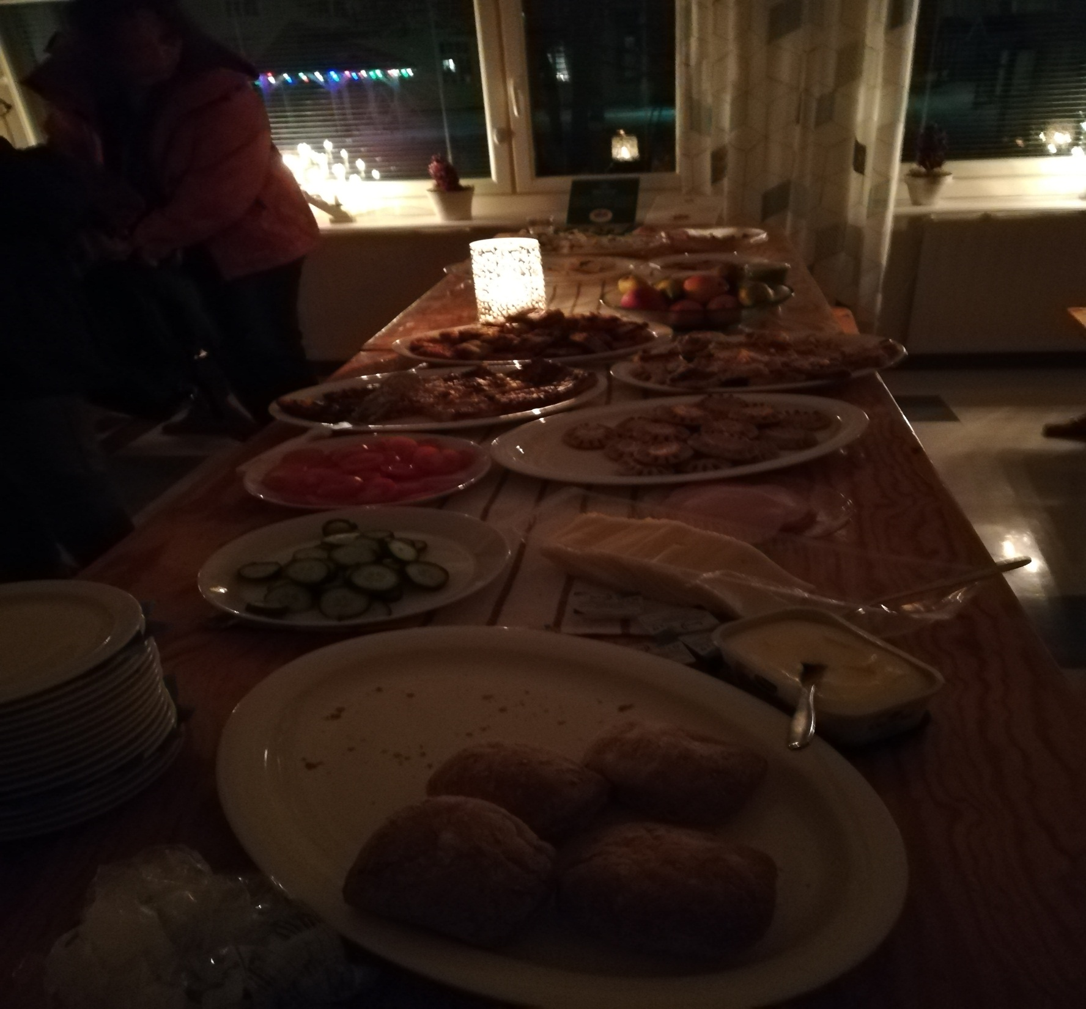

Slide 17
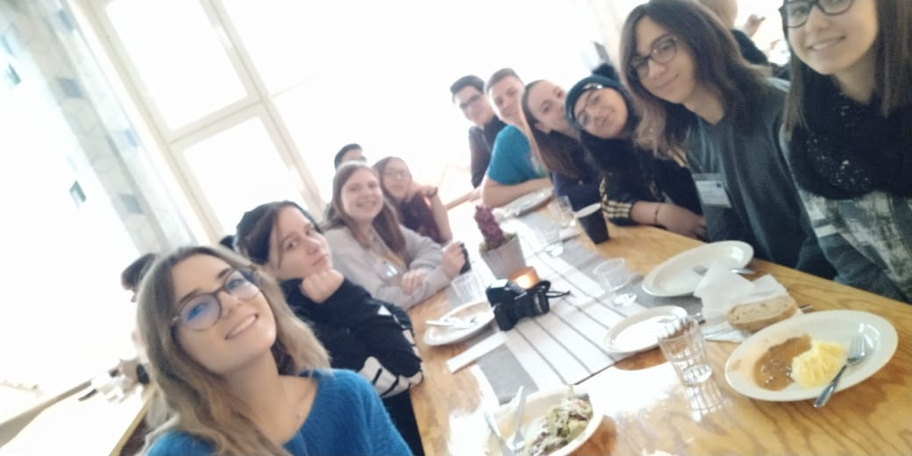
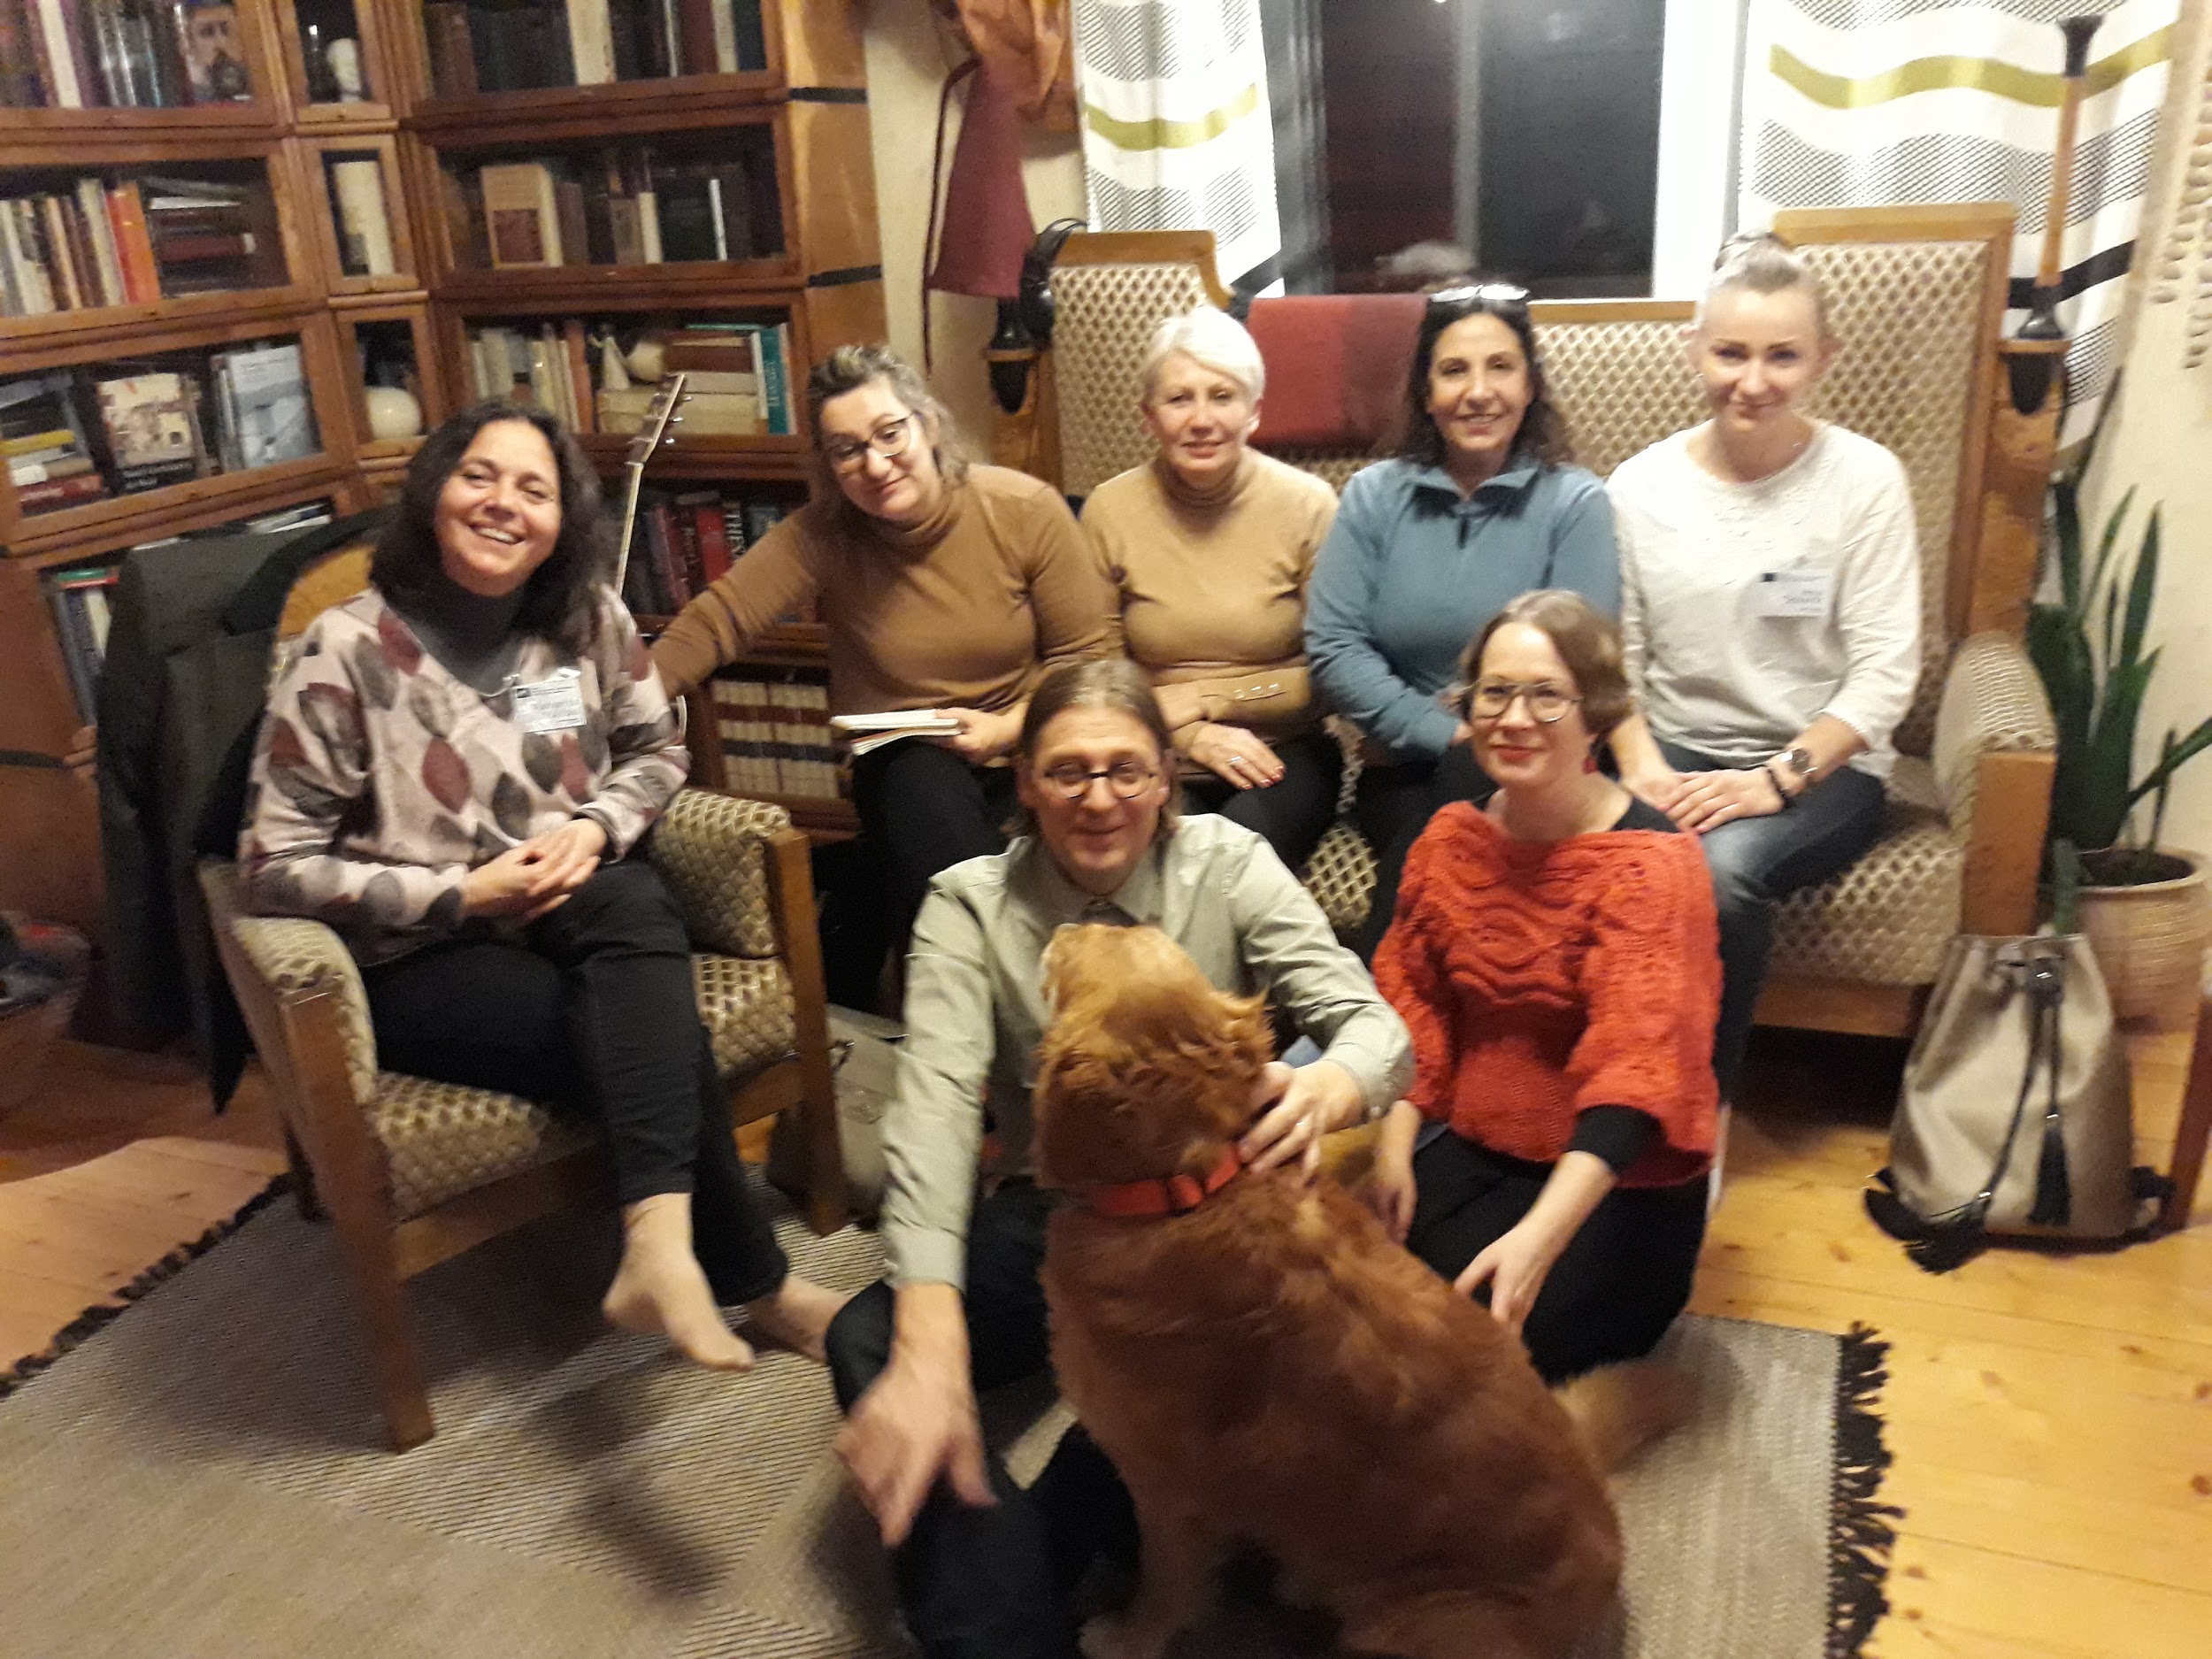
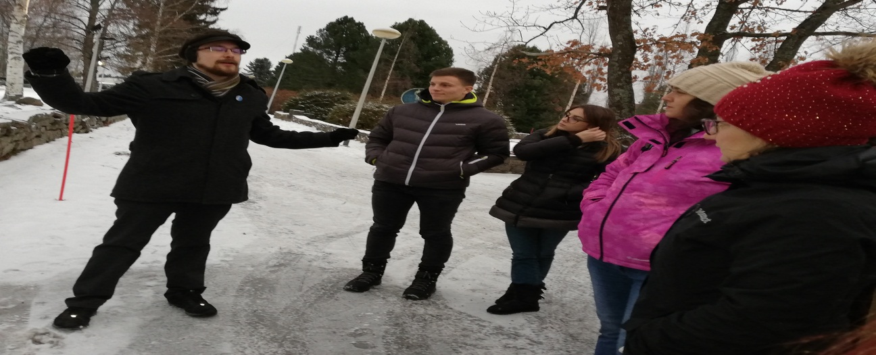
WE HAVE ENJOYED OURSELVES TOGETHER

Slide 18
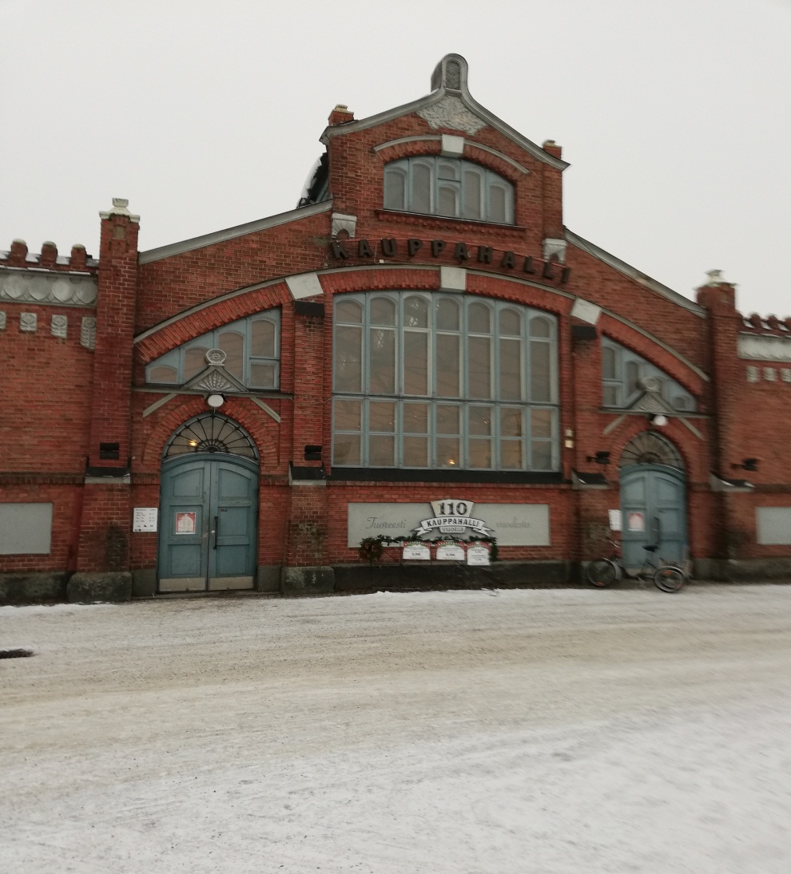
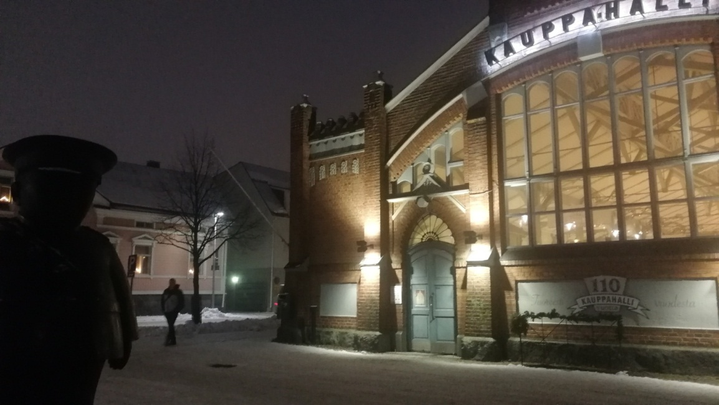
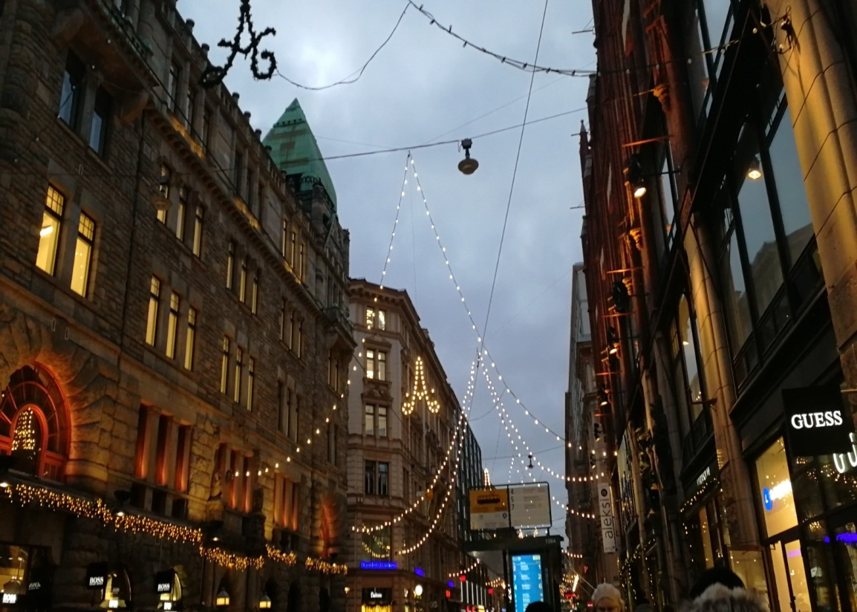
SEEN DIFFERENT PLACES, SHARED SAME FEELINGS

Slide 19
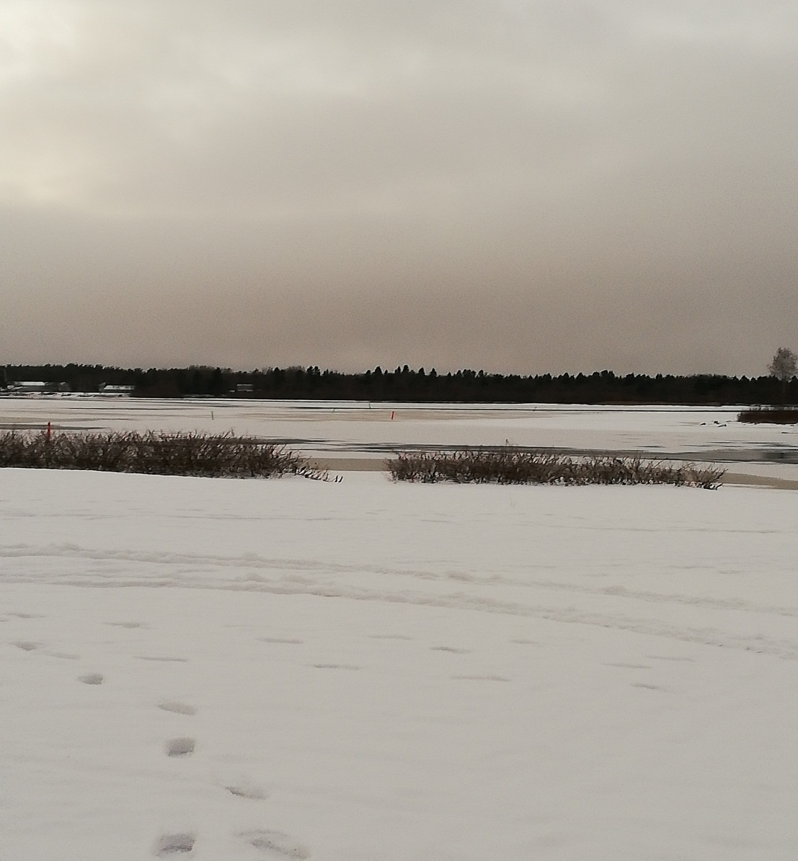
ENJOYED NATURE

Slide 20
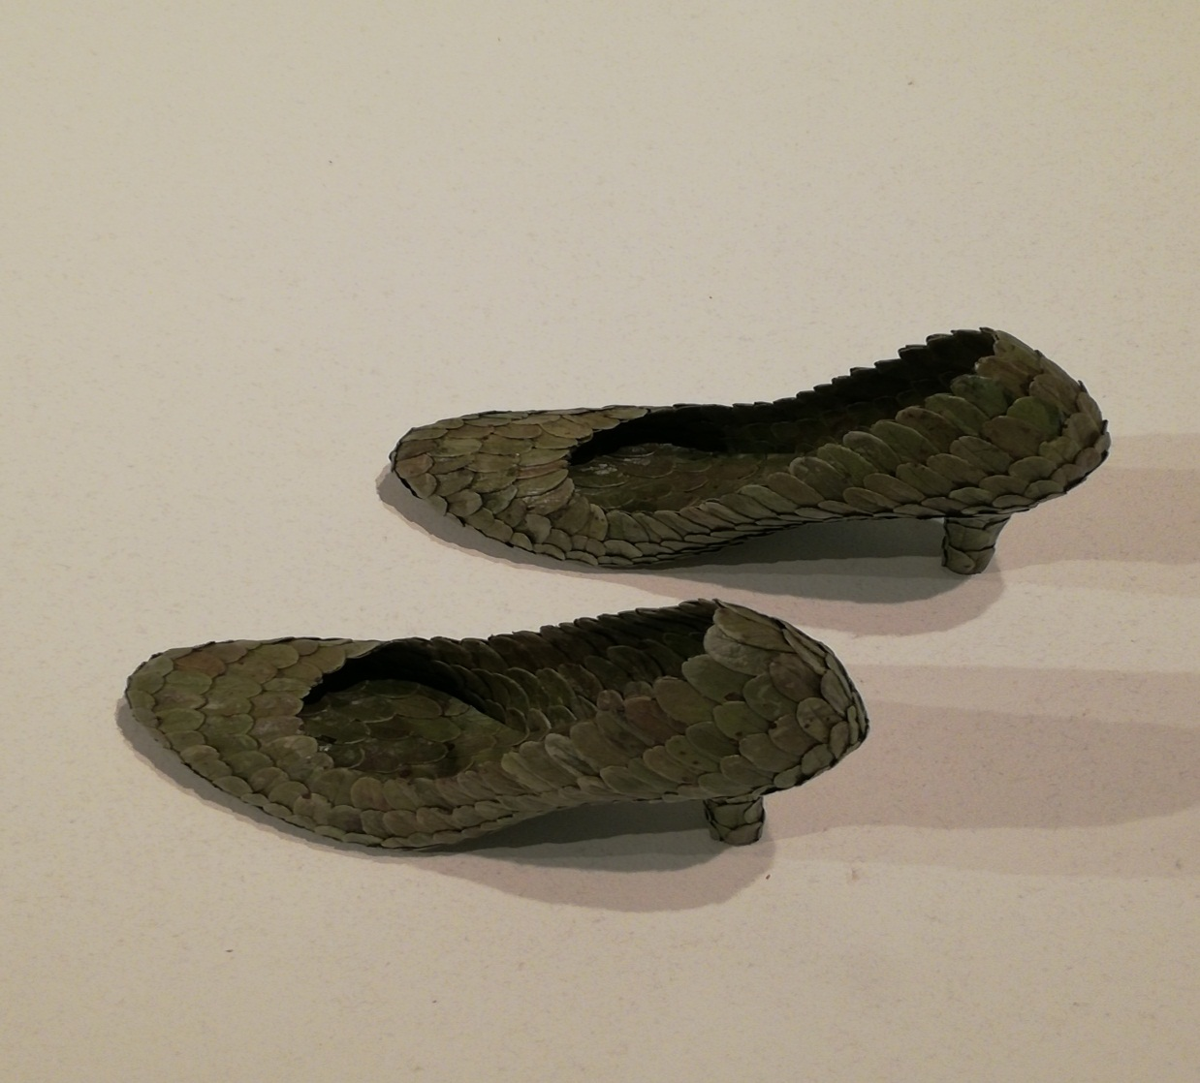
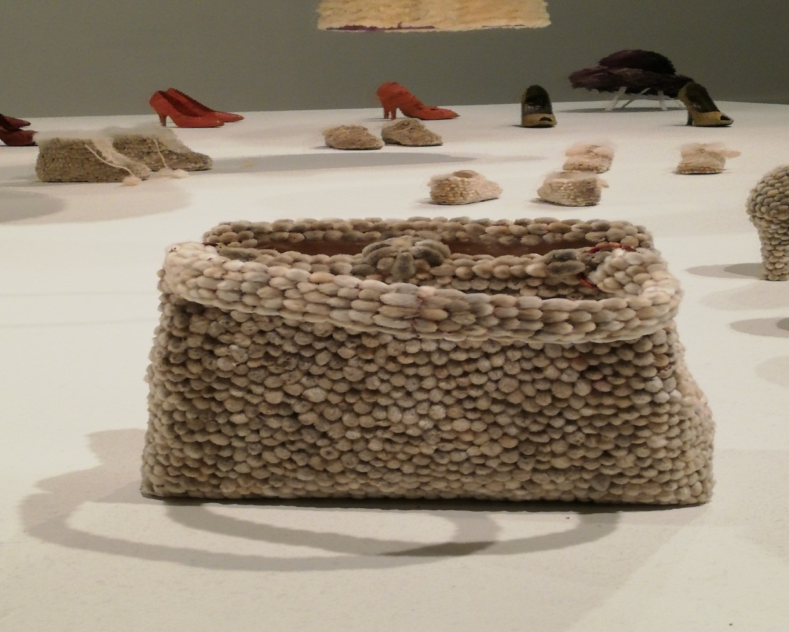
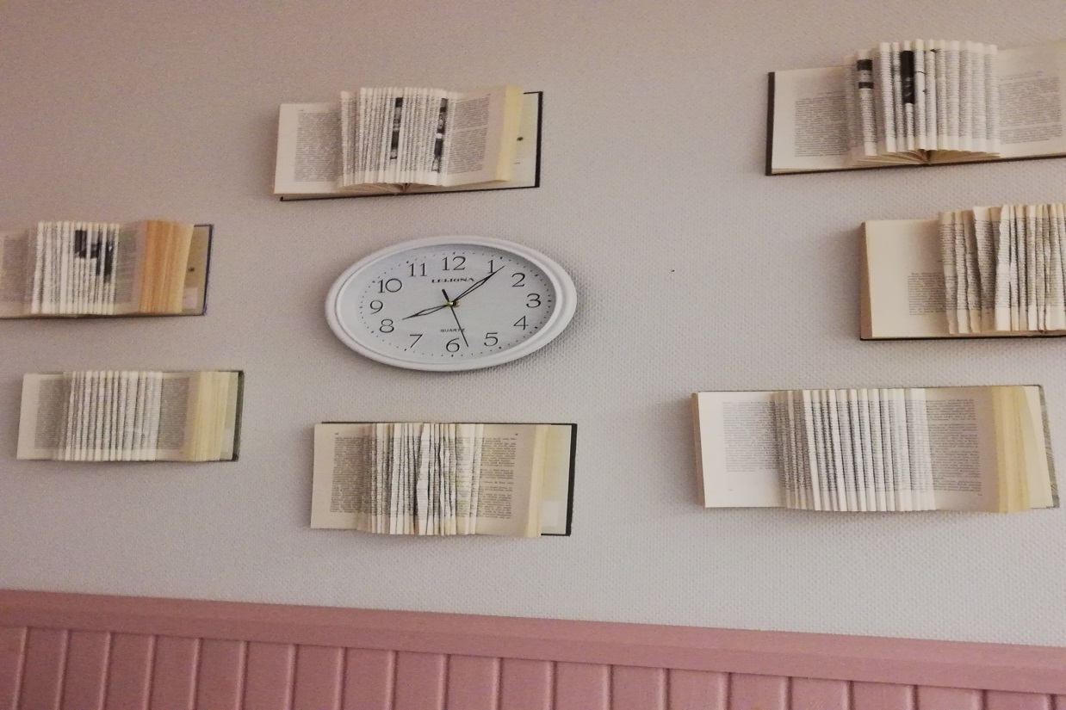
ENJOYED NATURE……. IN ANY FORM

Slide 21
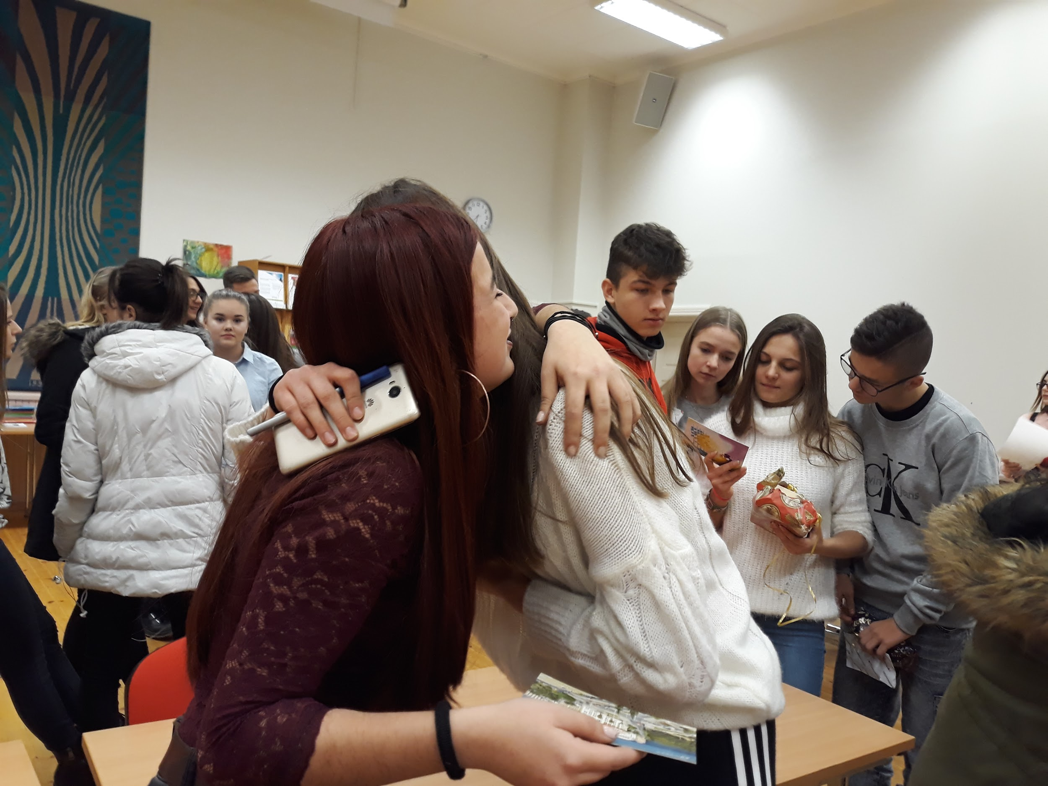
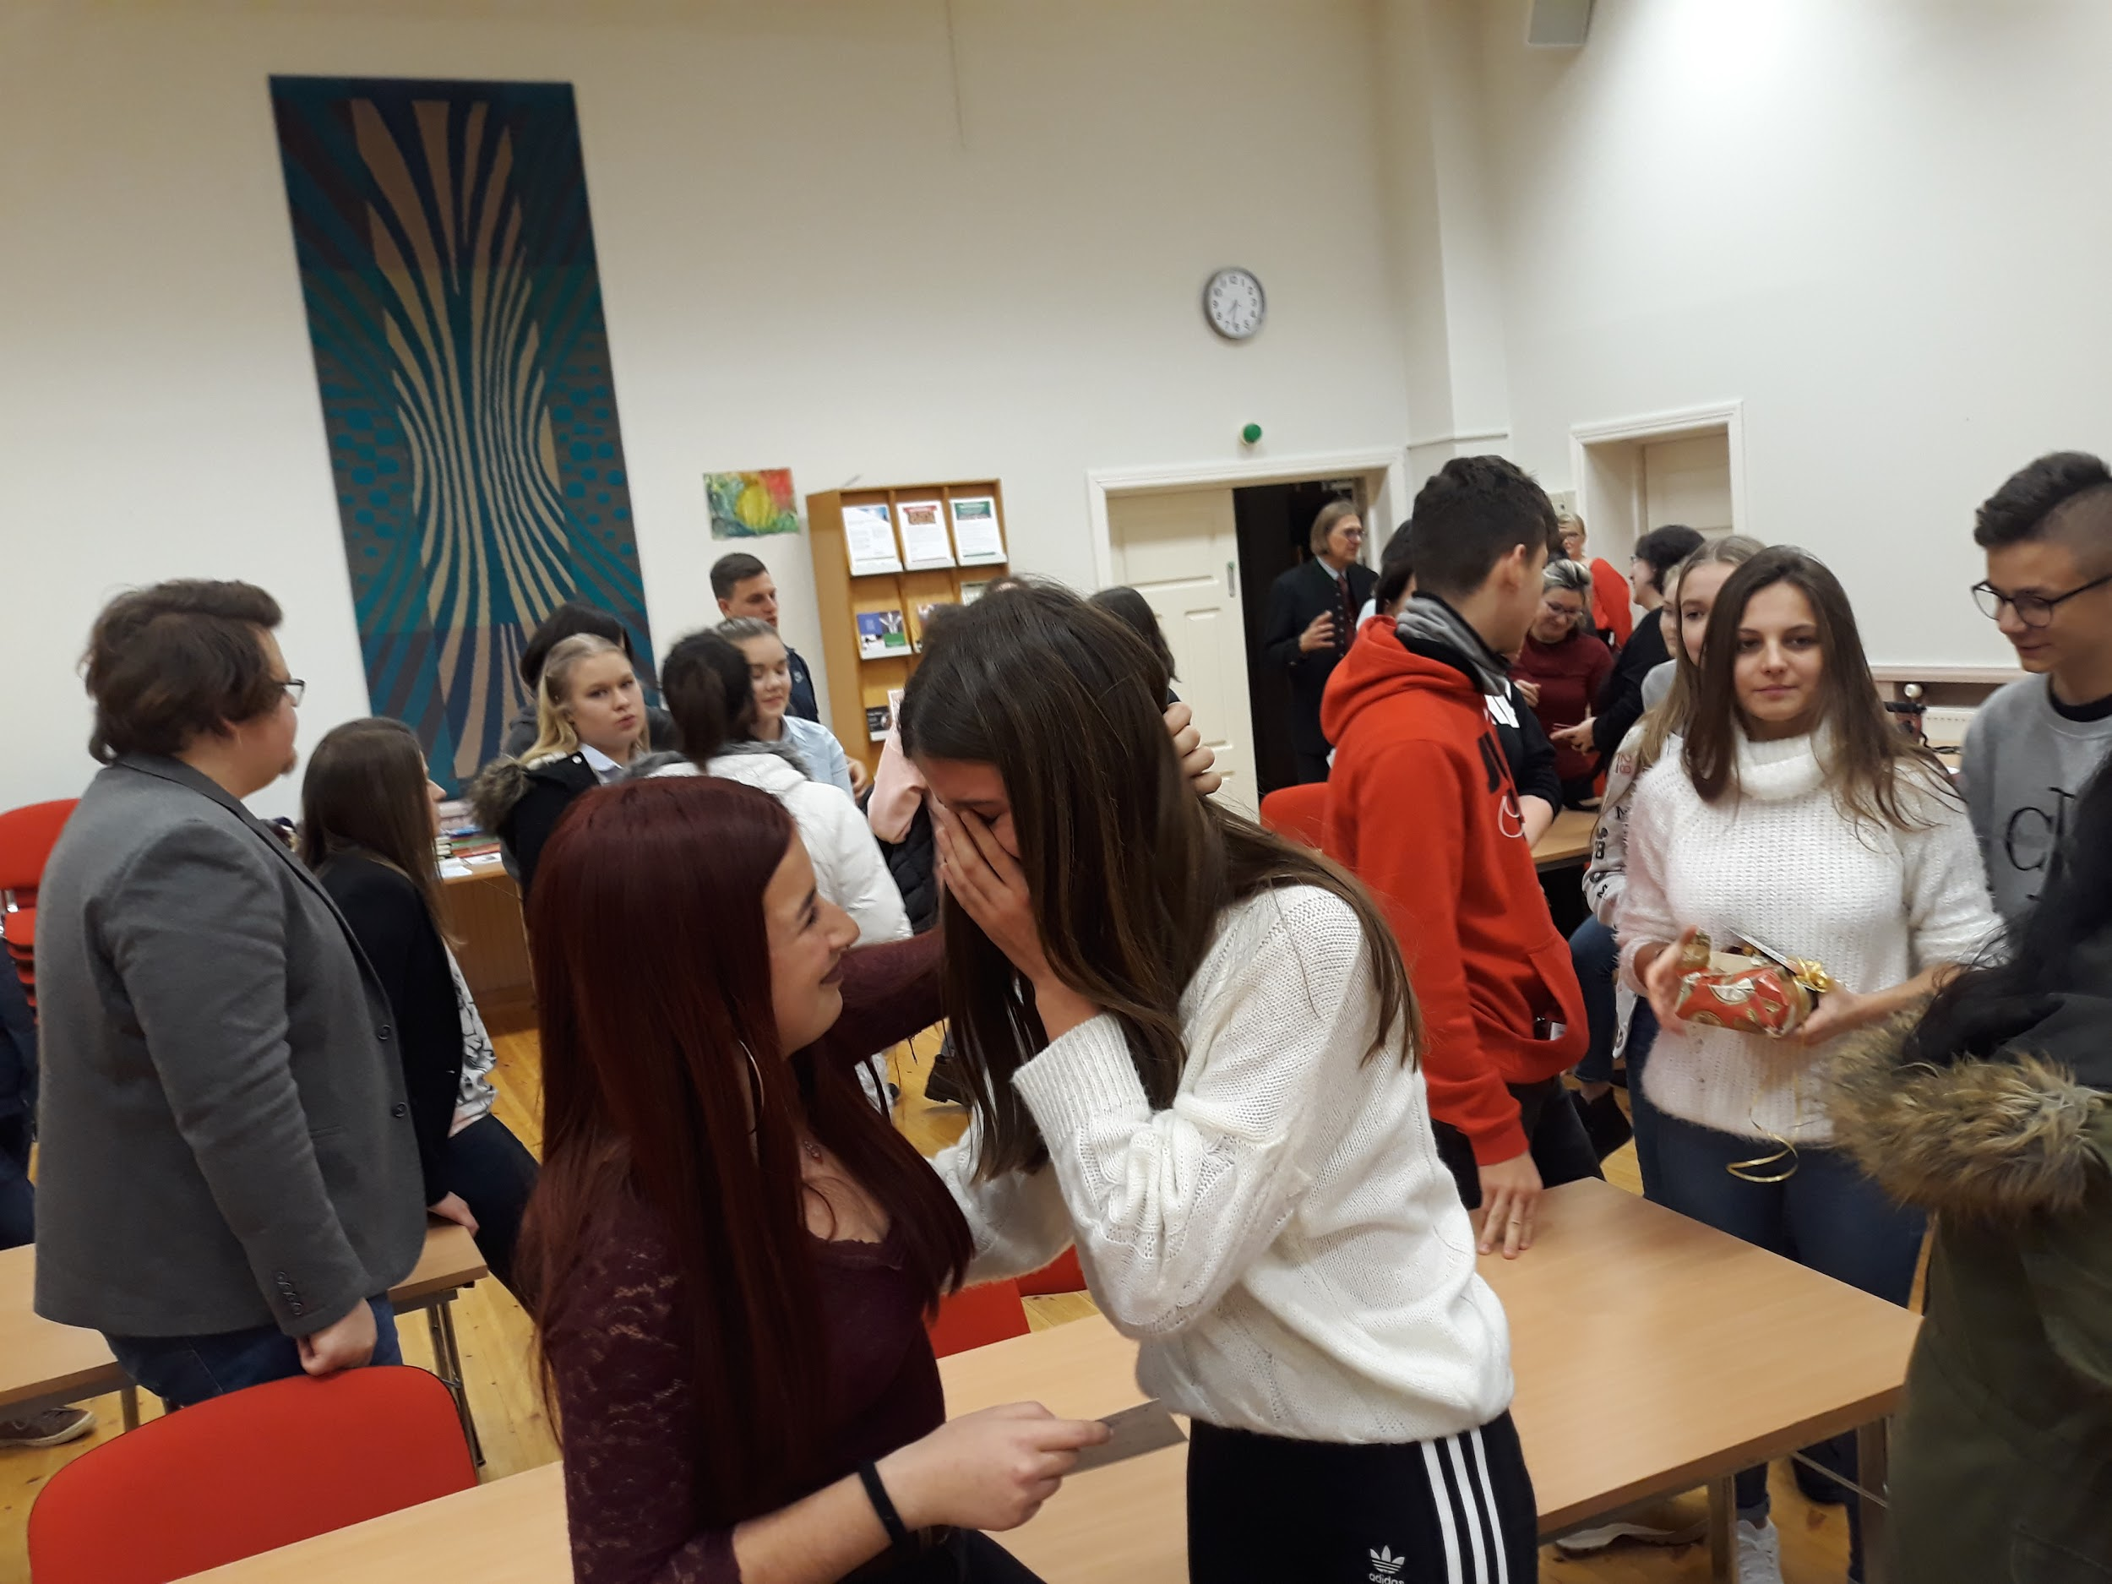
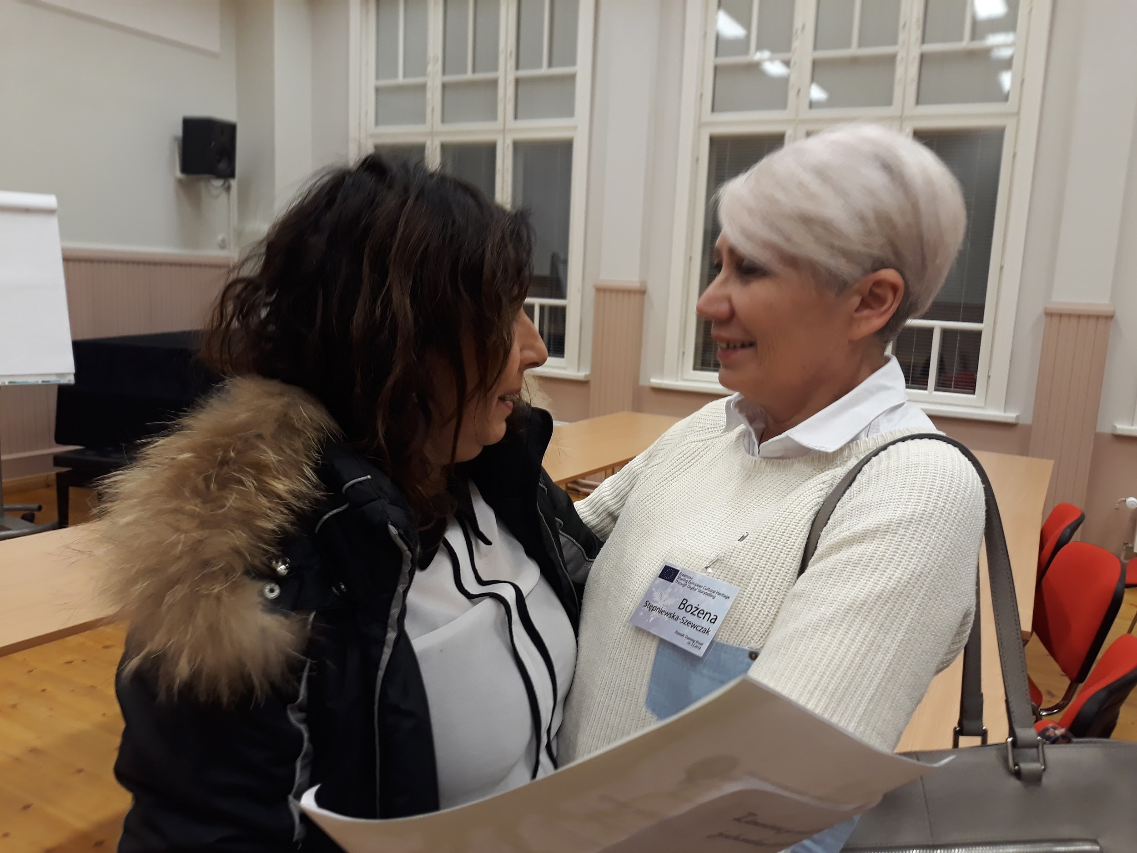
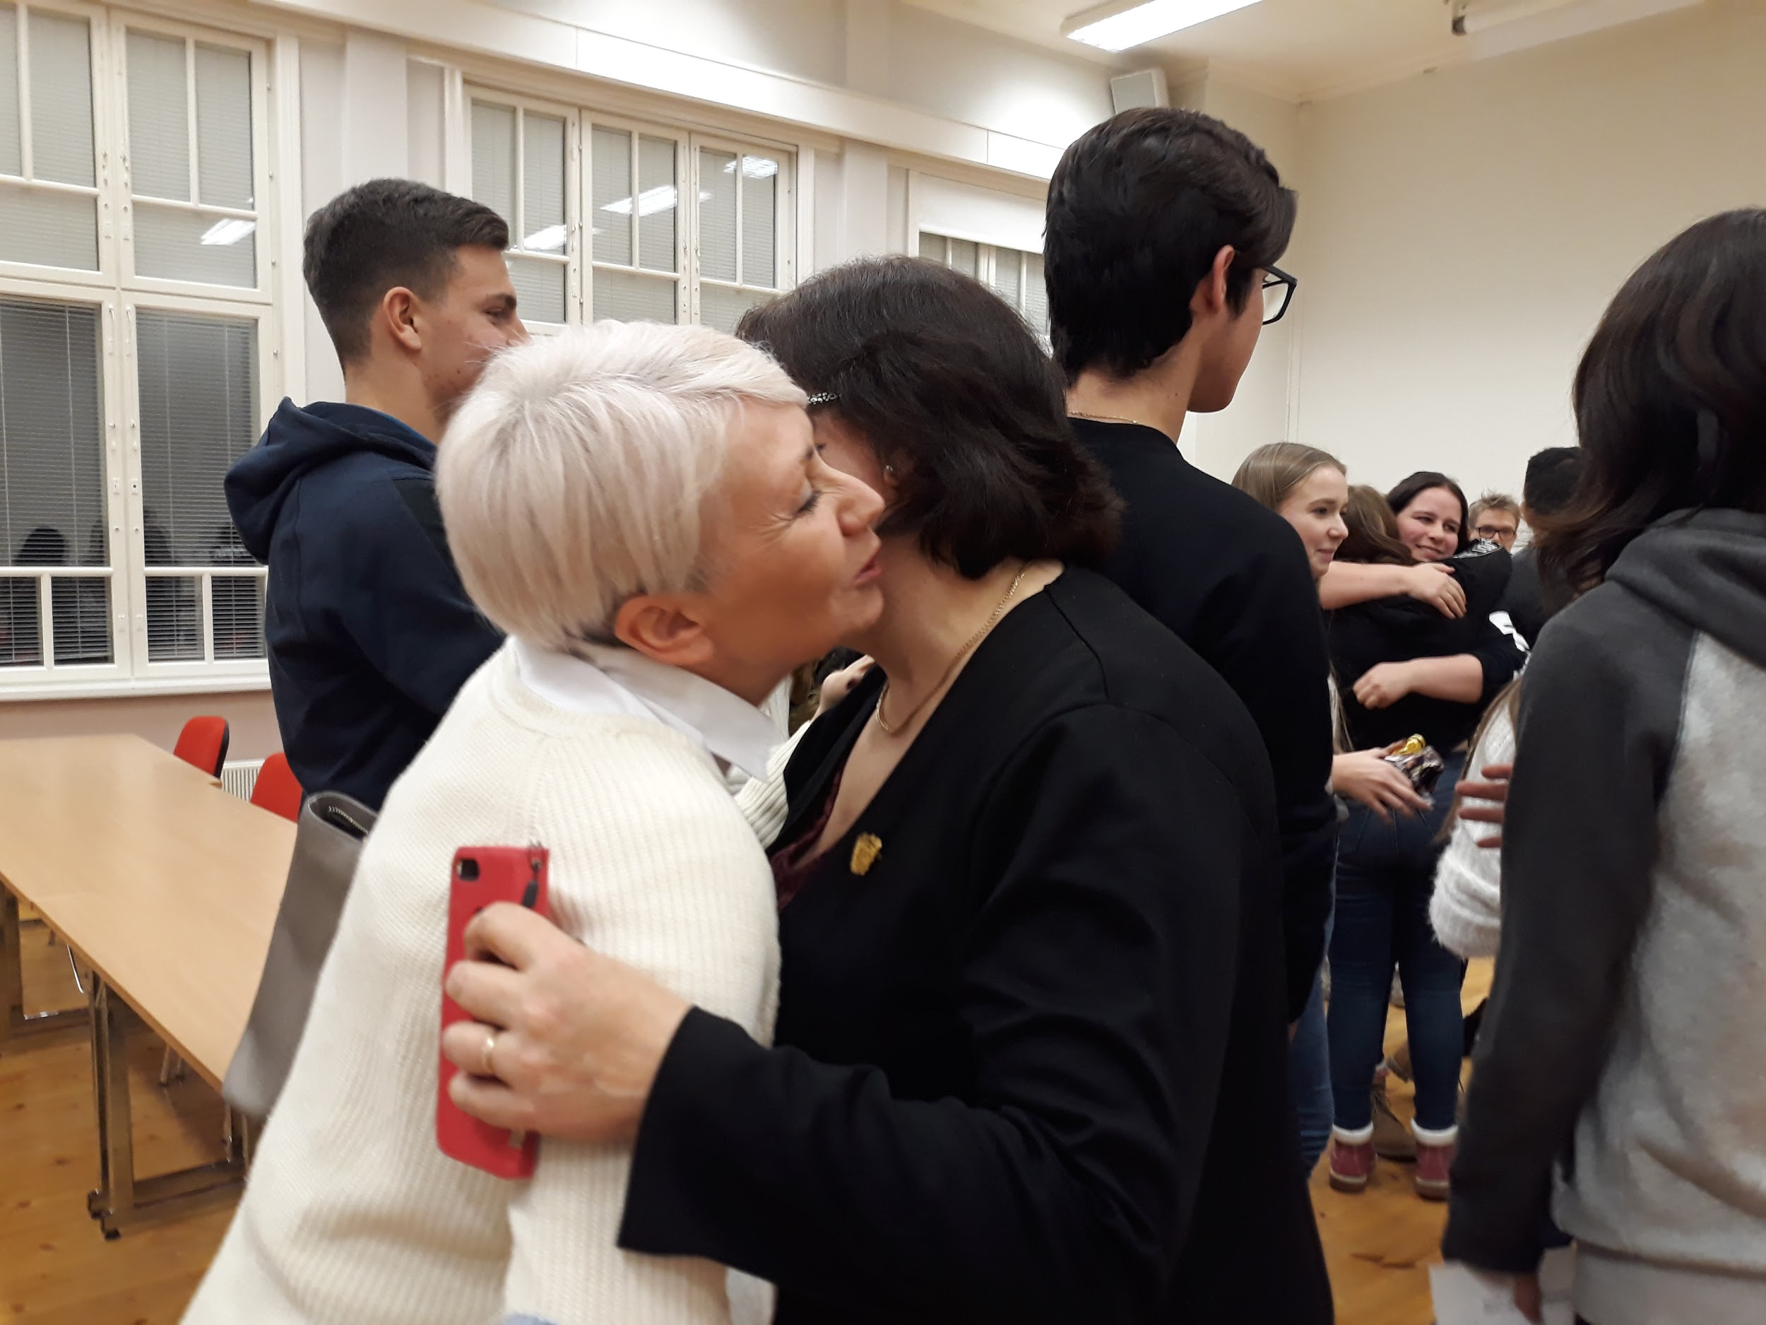
Saying goodbye is not easy

Slide 22
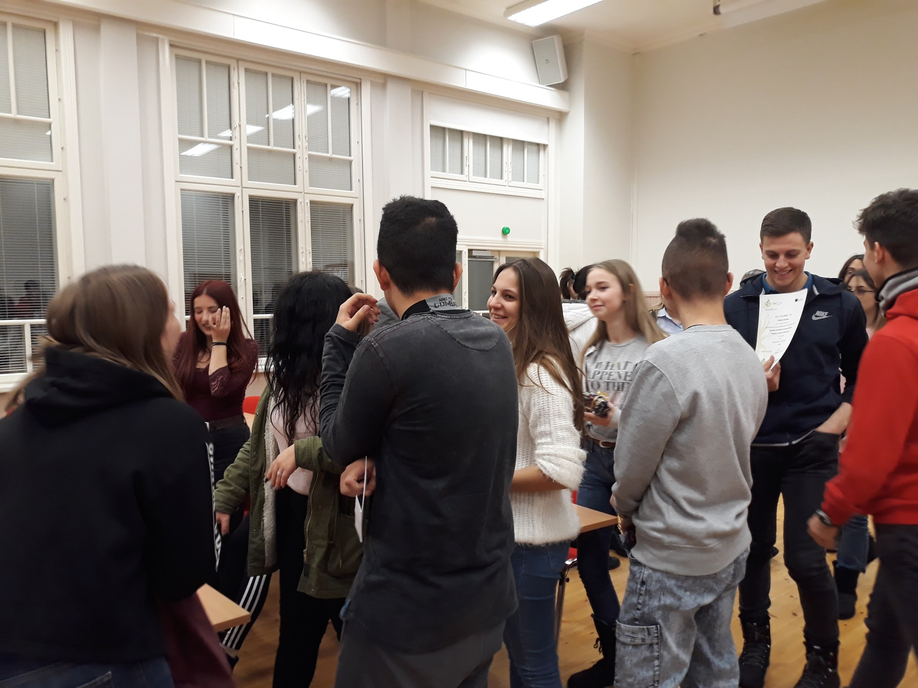
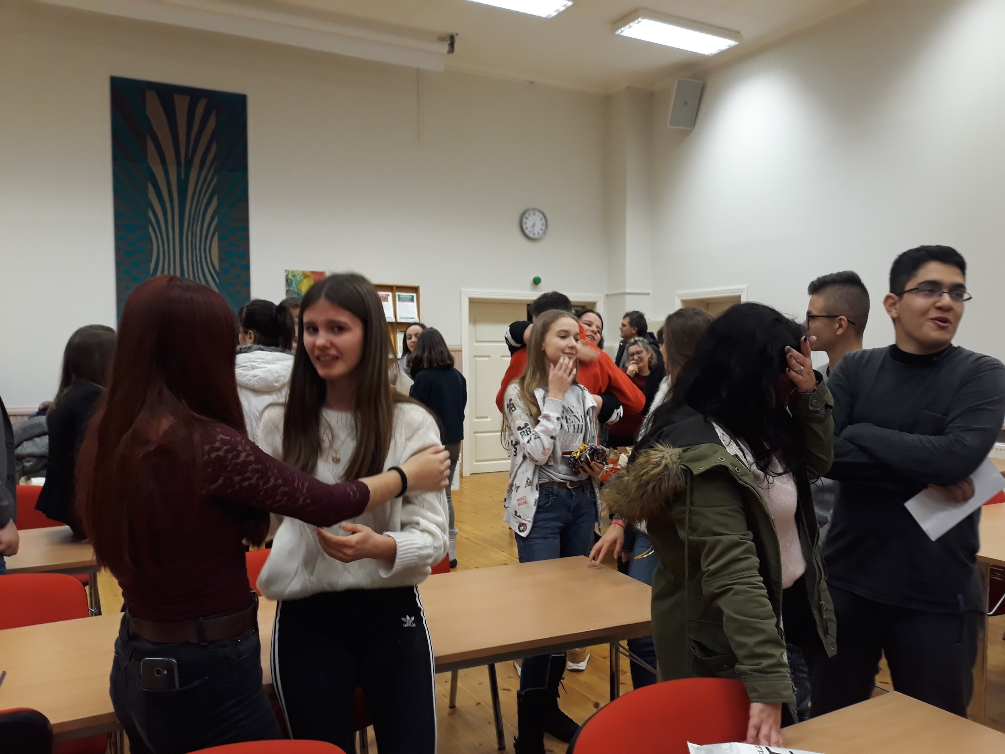

Slide 23
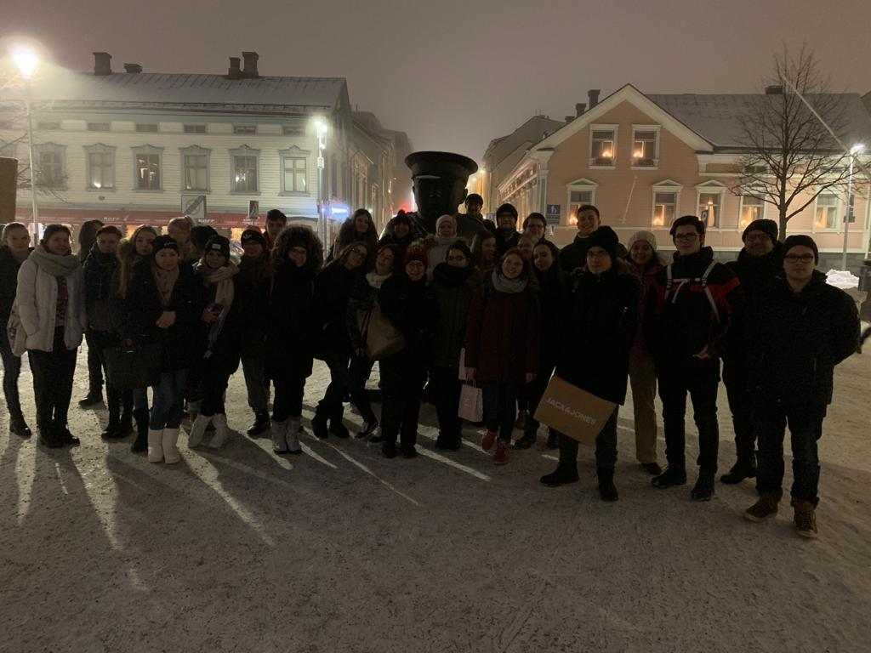
ALL TOGETHER

Slide 24
HOMEWORK: SEE YOU IN ITALY

Slide 25
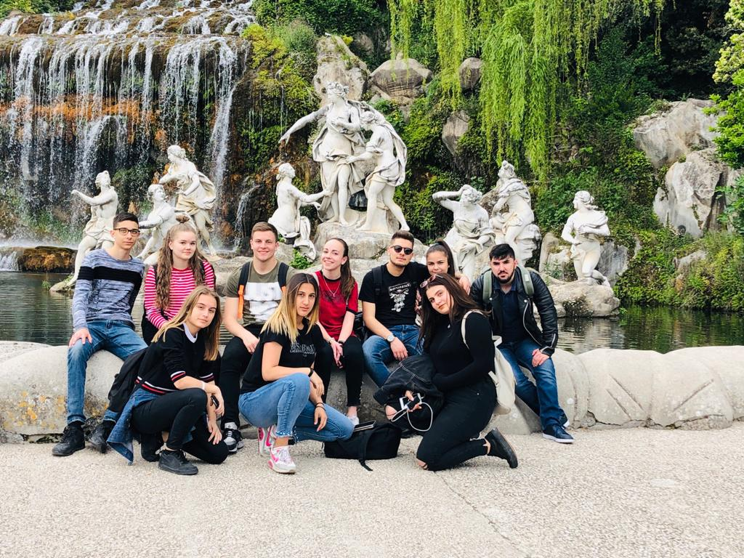
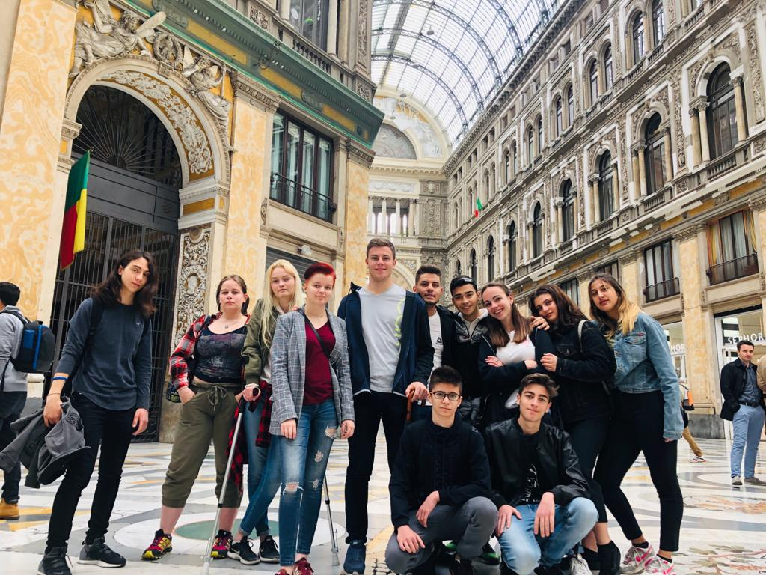
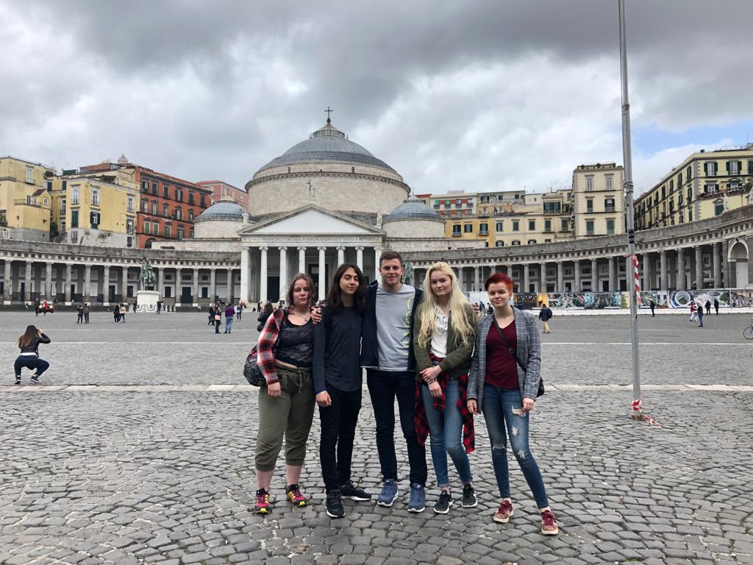
Italy May 2019

Slide 27
WHAT IS DIGITAL STORYTELLING?
Digital storytelling combines the best of two worlds: the "new world" of digitized video, photography and art, and the "old world" of telling stories. This means the "old world" of PowerPoint slides filled with bullet point statements will be replaced by a "new world" of examples via stories, accompanied by evocative images and sounds.“
Dana Atchley, Digital Storytelling pioneer

Slide 28
LEARNING ABOUT MUSIC

Slide 30
LEARNING AND MAKING !!!

Slide 31
The unforgettable music experience at the Concert Hall

Slide 32
LISTENING !!!

Slide 33
MAKING NEW FRIENDS

Slide 34
Sightseeing

Slide 35
Paper production

Slide 36
Making pizza

Slide 38
POLAND OCTOBER 2019

Slide 39
THE WELCOMING COMMITTEE AT THE CHOPIN AIRPORT AND A BUS TRAVEL TO LUKOW

Slide 40
TEACHERS’ DAY ACADEMY AND WELCOME RECEPTION AT SCHOOL

Slide 41
UPCYCLING workshop

Slide 42
THE 19TH CENTURY CHURCH IN TUCHOWICZ

Slide 43
KINEMASTER WORKSHOP

Slide 44
POTTERY WORKSHOP

Slide 45
SCHOOL DISCO

Slide 46
CRACOW

Slide 48
VISITING MONUMENTS

Slide 50
WONDERFUL LANDSCAPES WAWEL CASTLE

Slide 52
AWARENESS ABOUT THE PAST - AUSHWITZ BIRKENAU

Slide 53
DEATH CAMP

Slide 56
WIELICZKA SALT MINE
Press Play ;)

Slide 57
TOGETHER

Slide 60
NEW FOOD TRADITIONS

Slide 62
We didn’t know then that we see each other for the last time...

Slide 63
SEE YOU IN GREECE ???????????? SORRY COVID

