Slide 1
CATHOLIC SHRINES IN POLAND AND IN OUR REGION – stanin
POLAND
ZESPÓŁ SZKÓŁ W TUCHOWICZU

Slide 2
The PolISH NATION IS GENERALLY CATHOLIC AND has a rich Catholic history. FOR THIS REASON, Shrines are really common objects of the sacred architecture in Poland

Slide 3
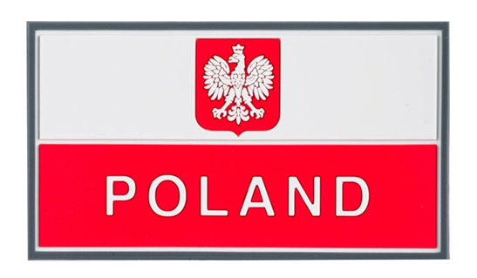
Shrines can be seen in every part of Poland

Slide 4
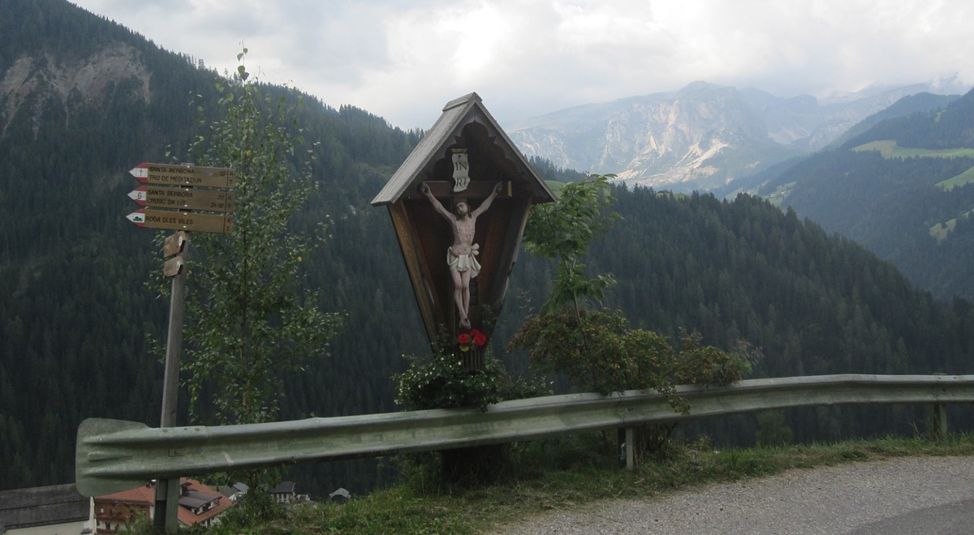
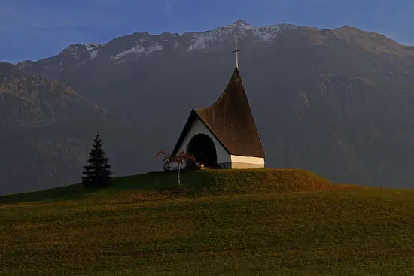
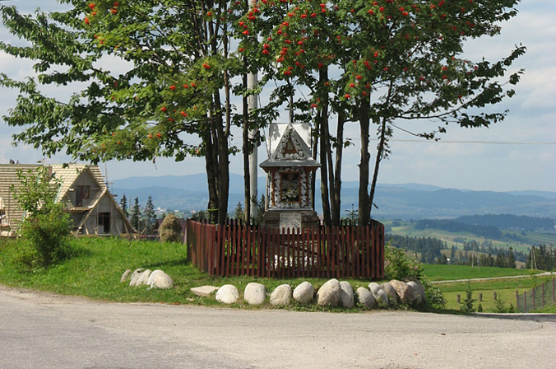
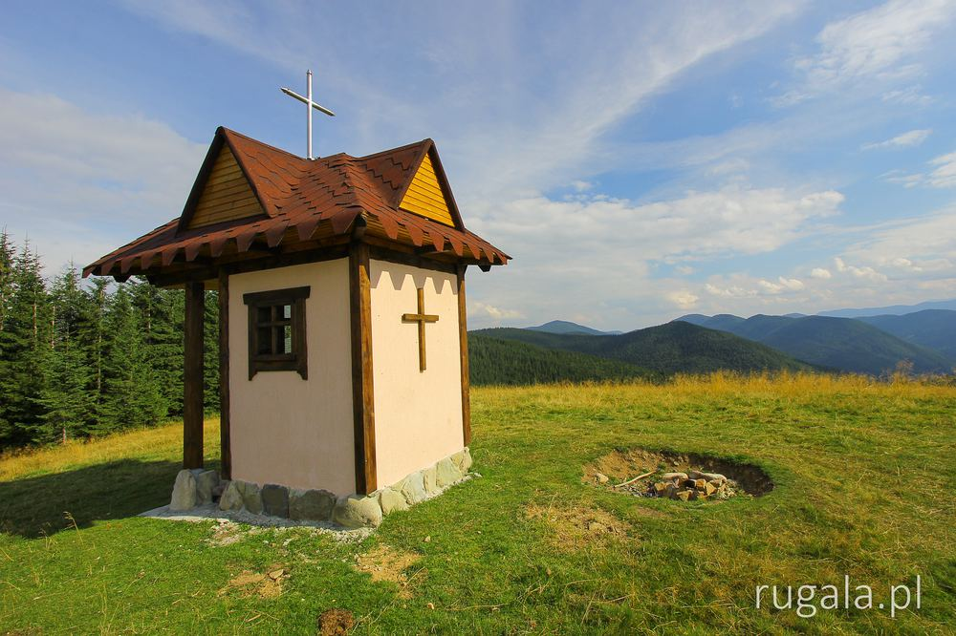
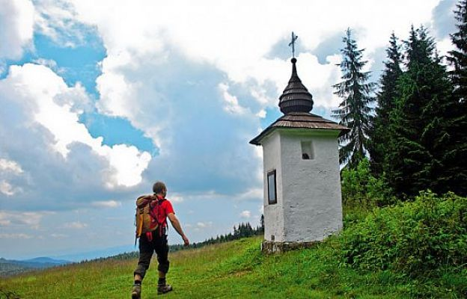
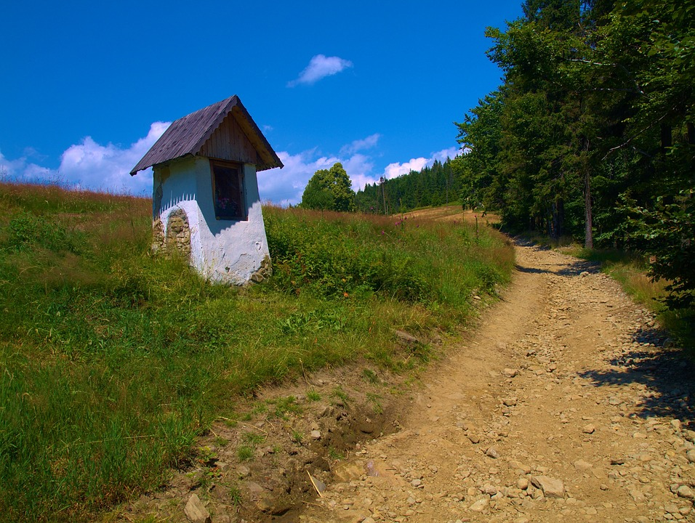
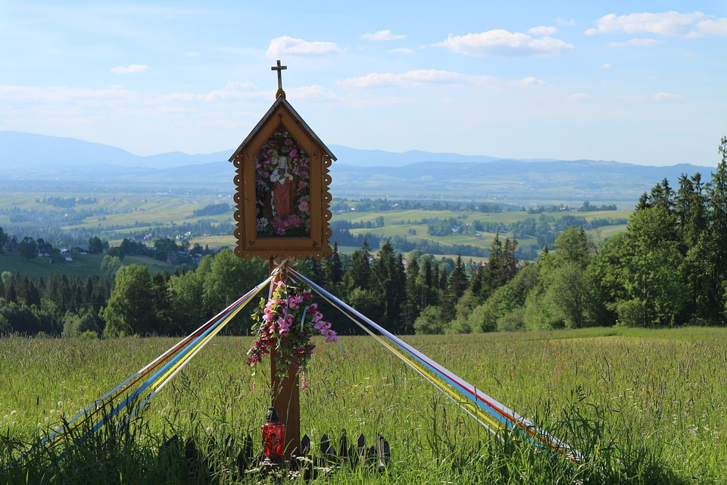
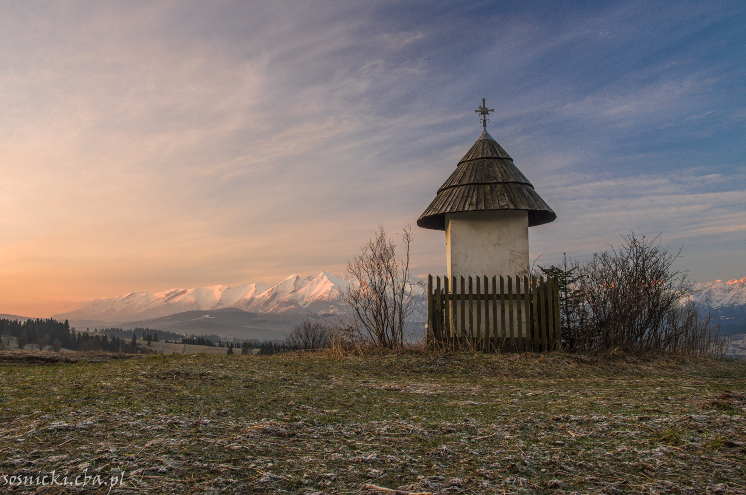
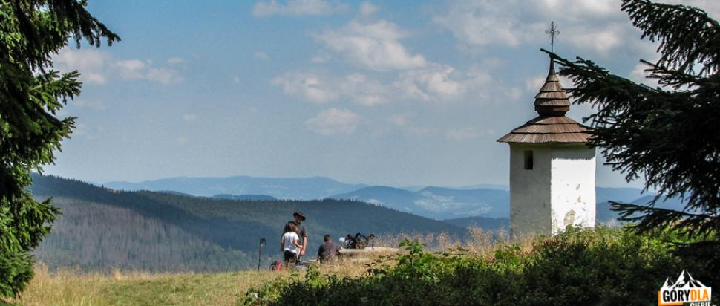
the carpatian Mountains

Slide 5
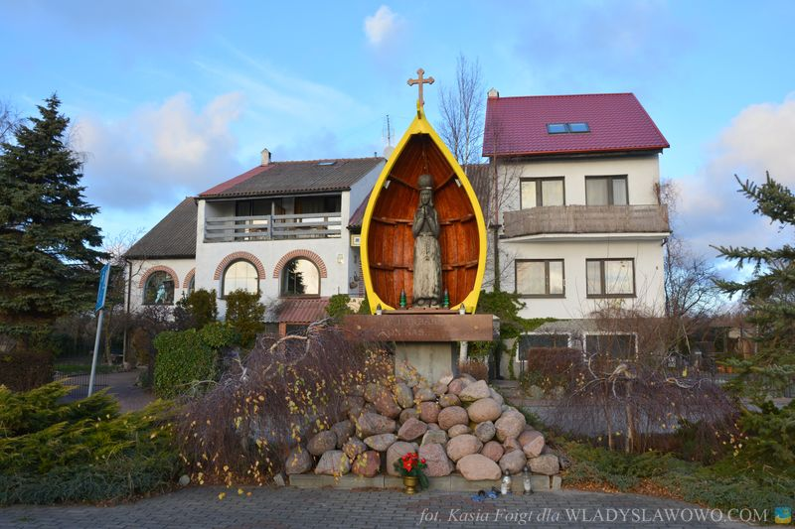
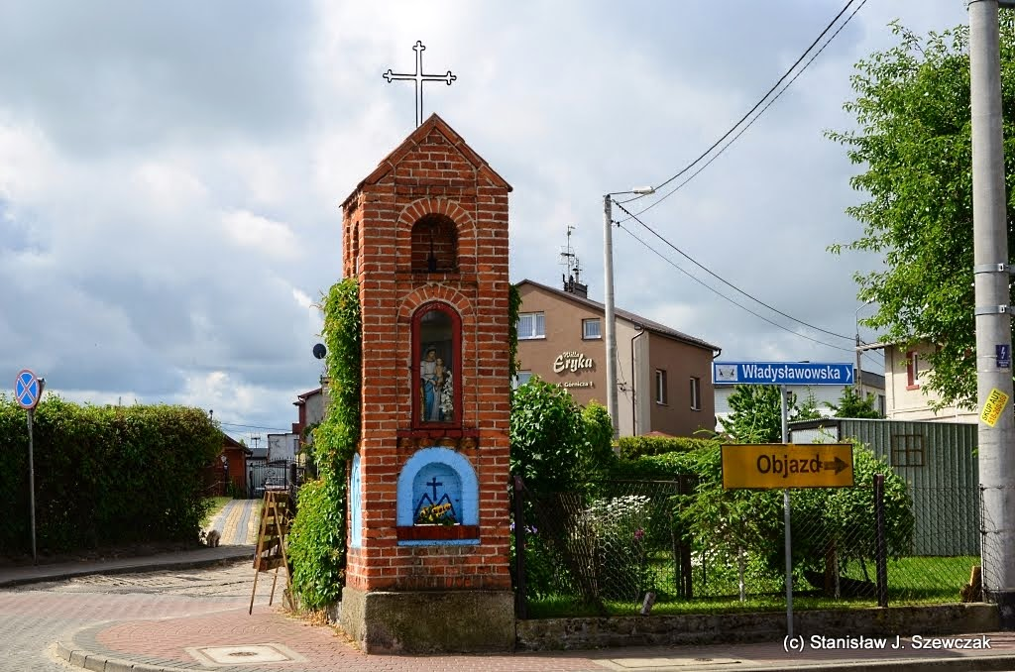
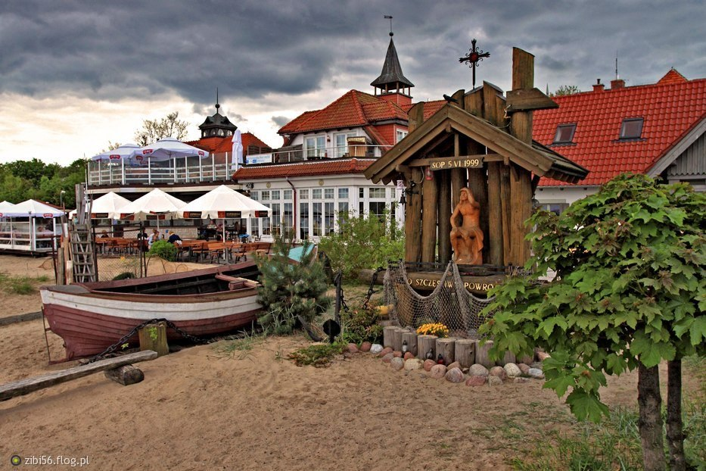
The Baltic sea

Slide 6
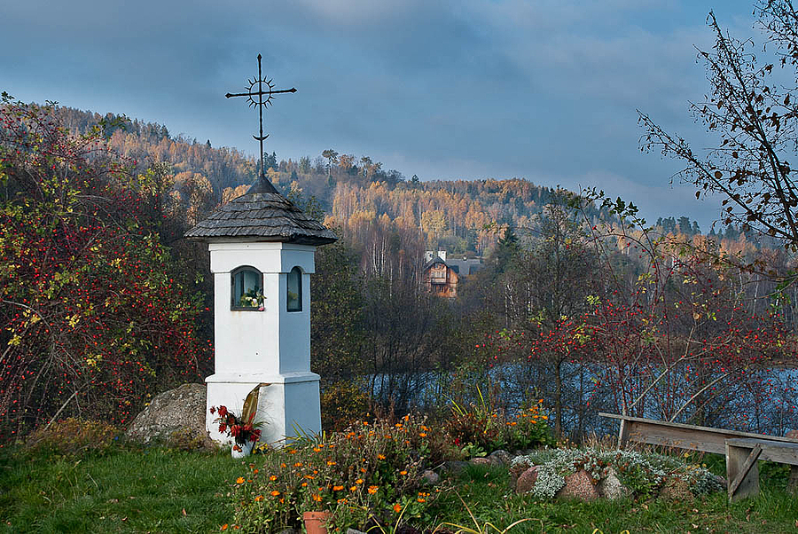
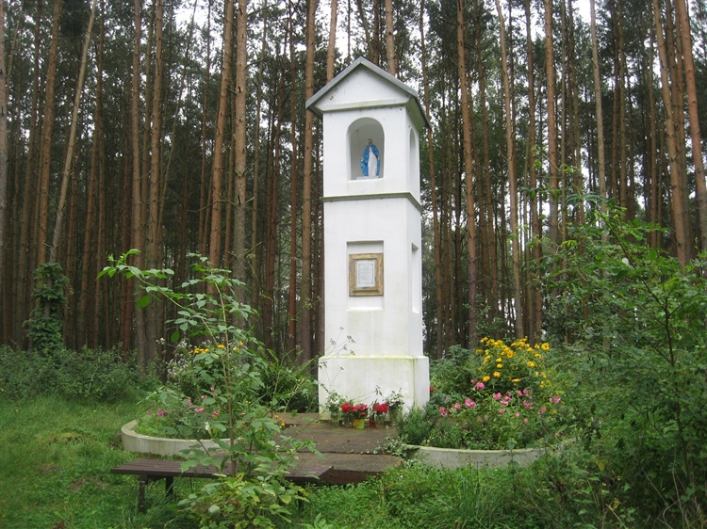
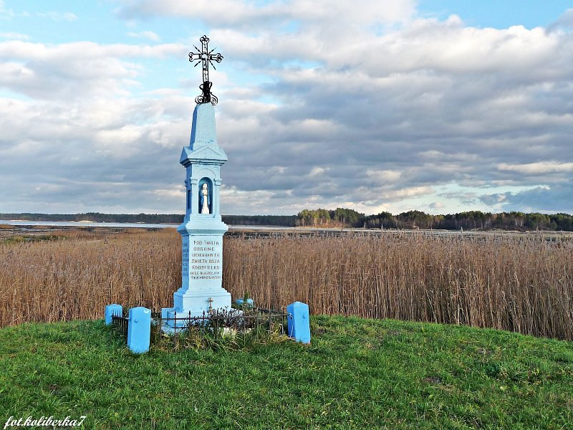
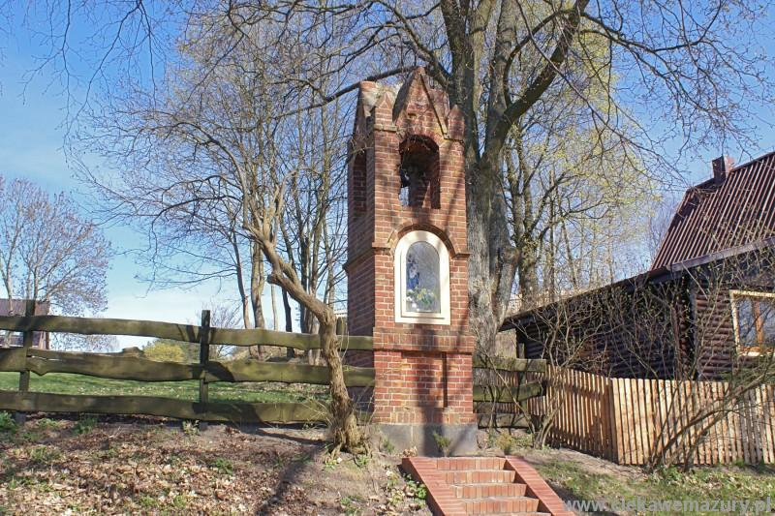
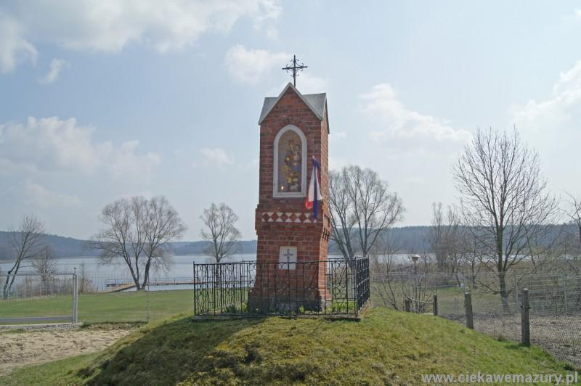
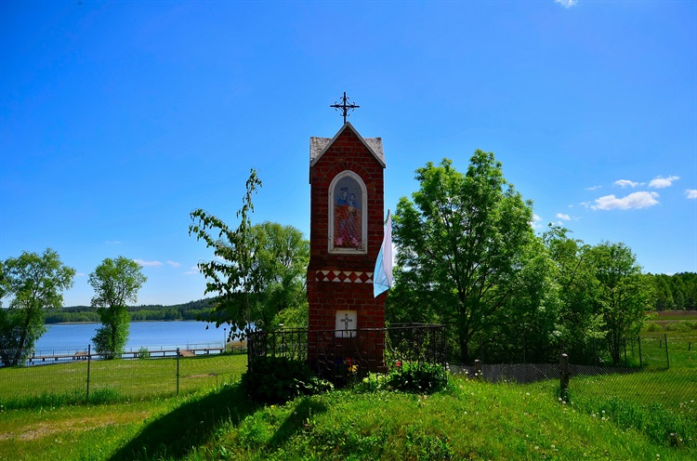
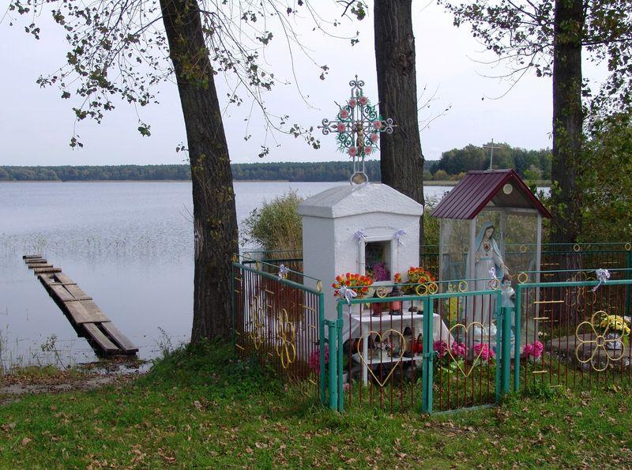
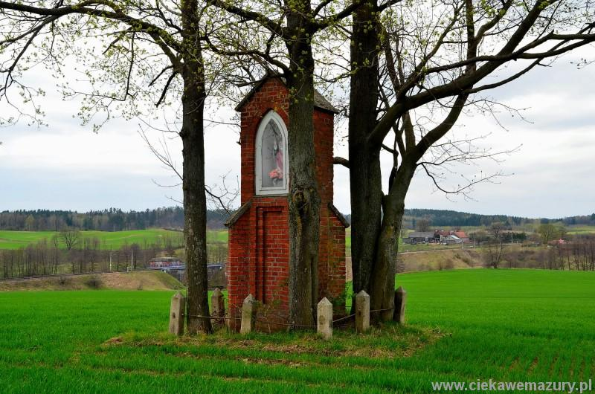
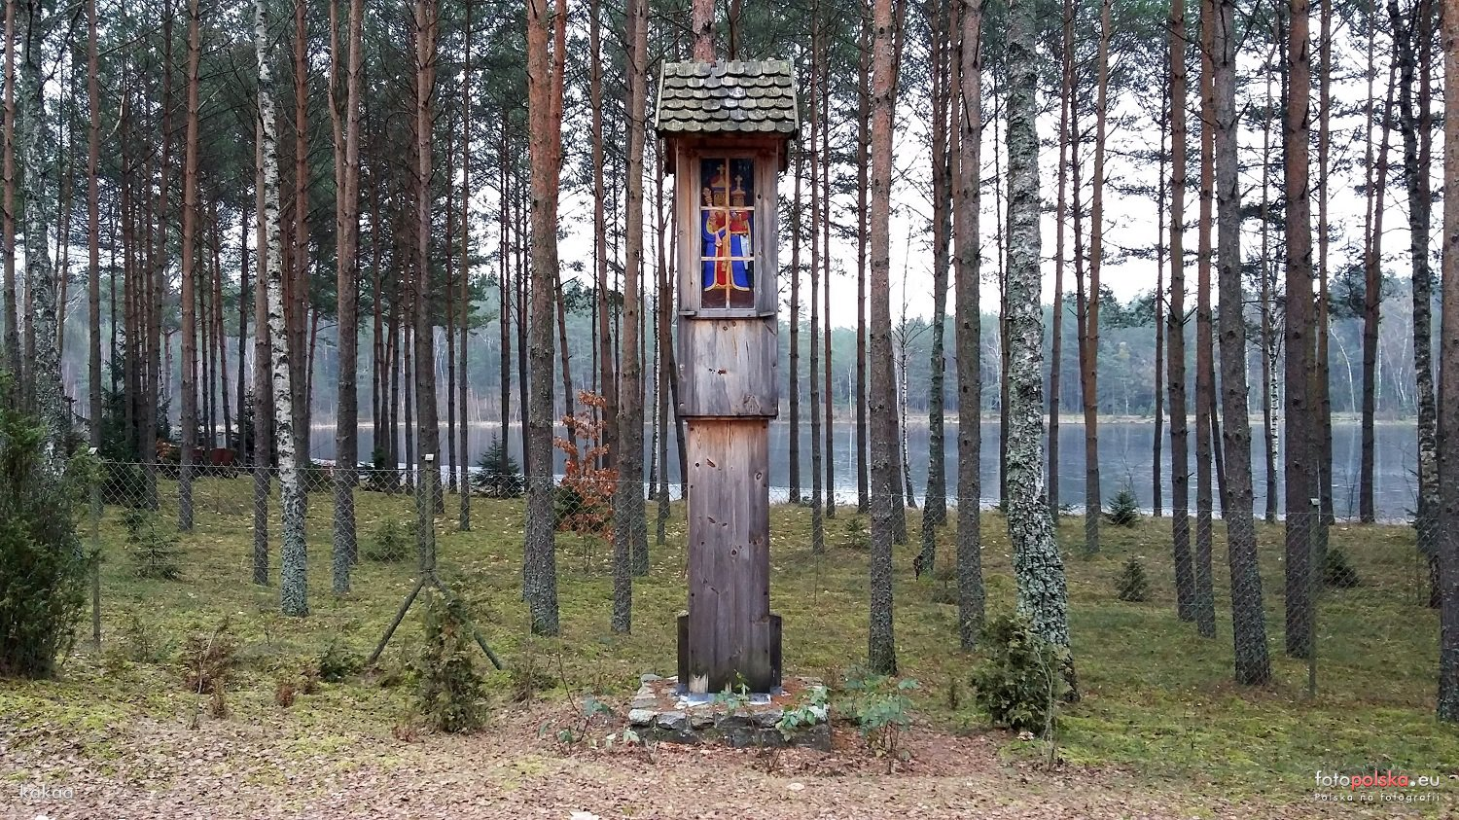
The masurian lake district

Slide 7
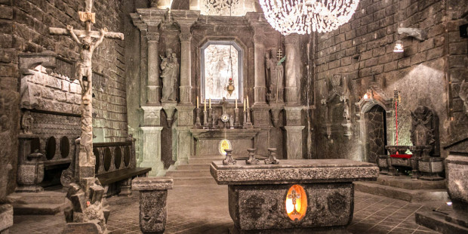
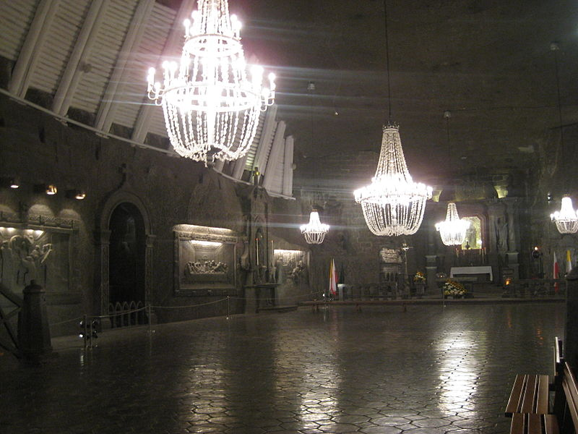
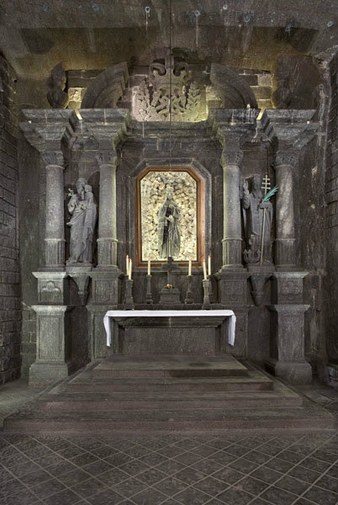
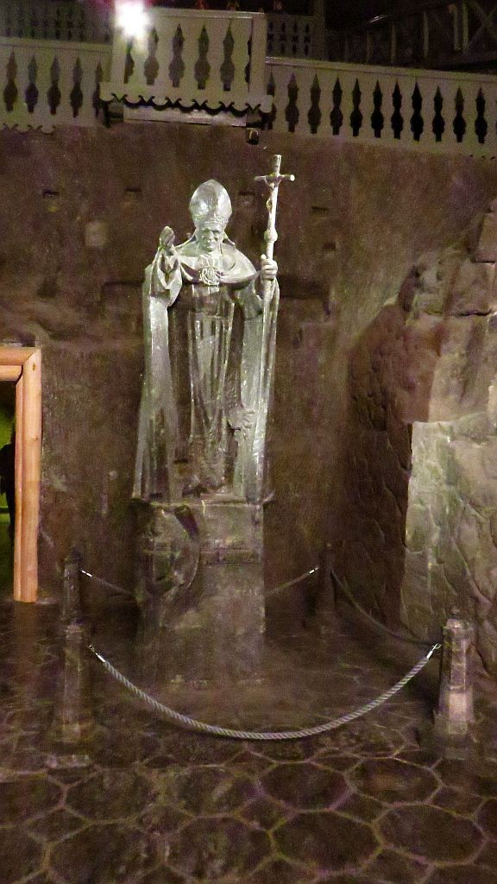
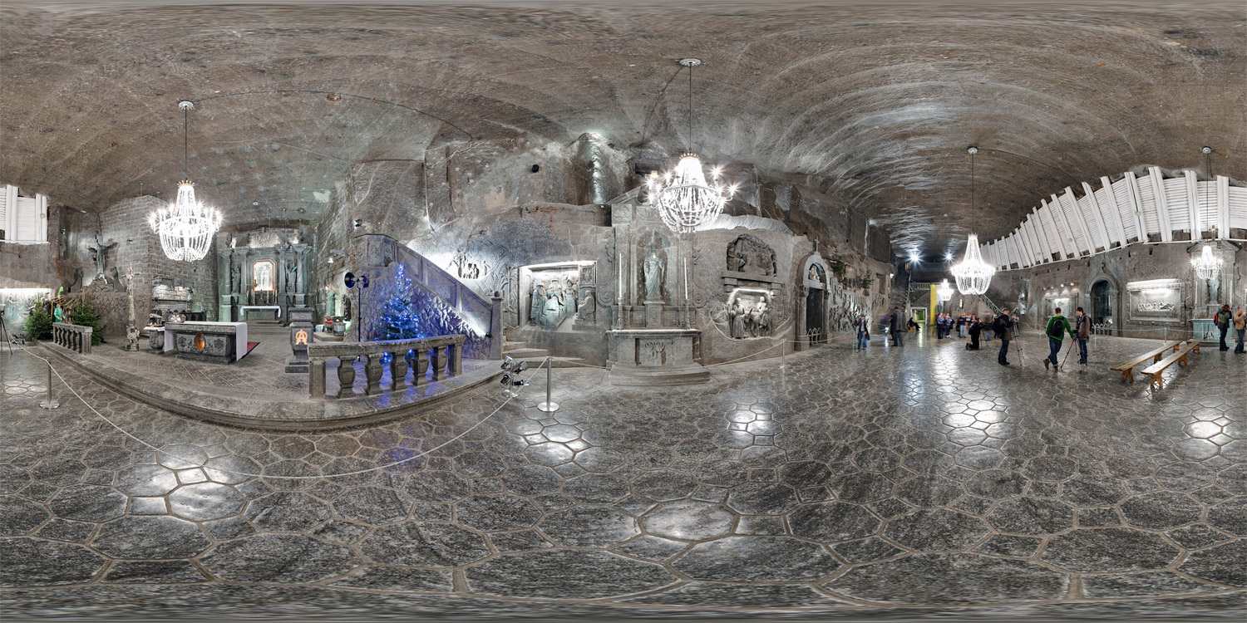
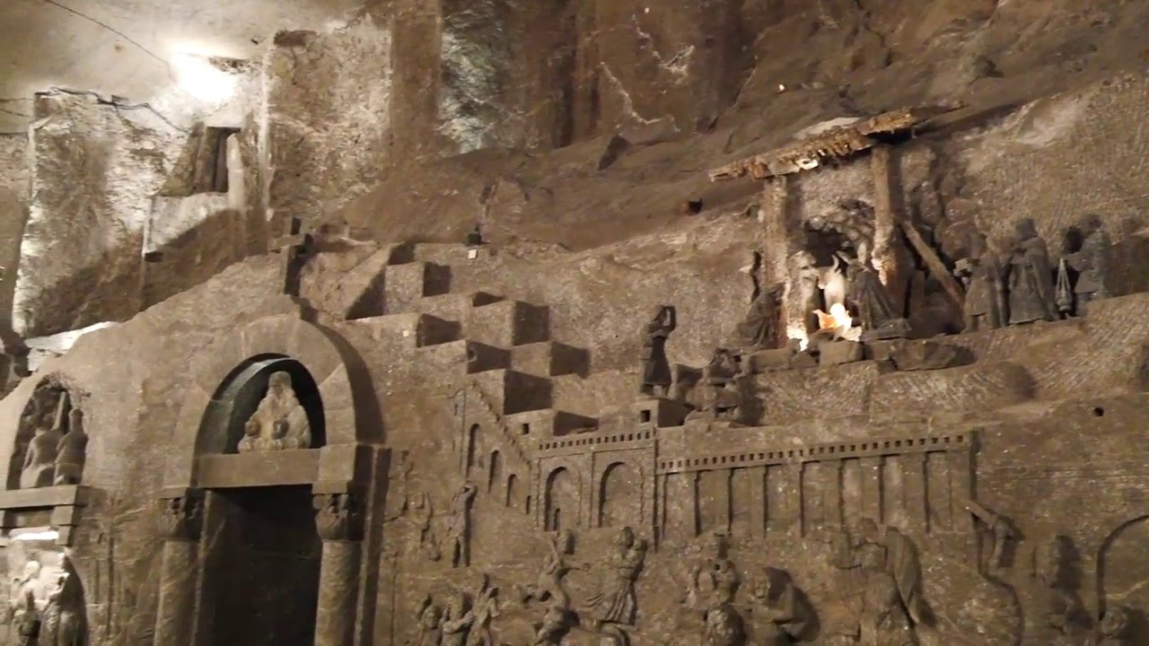
SILESIA
The Chapel of St. Kinga is the crown jewel of the “Wieliczka” Salt Mine and the miners' pride.

Slide 8
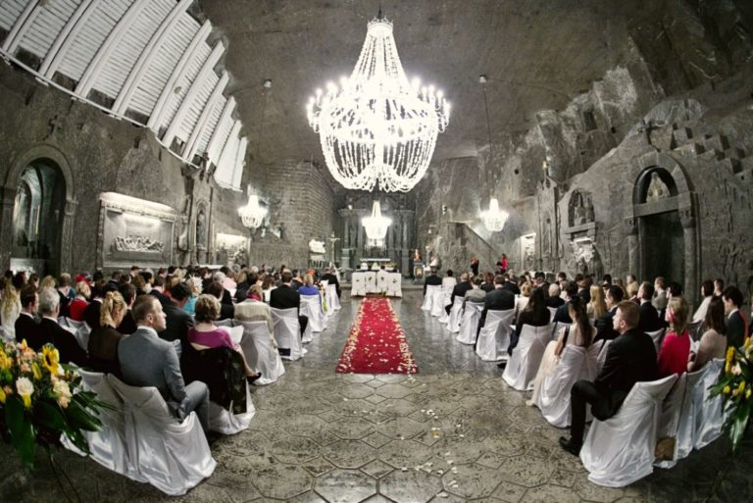
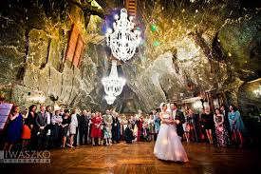
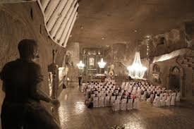
Its splendours make it the dreamland location for a Holy Mass, a wedding…

Slide 9
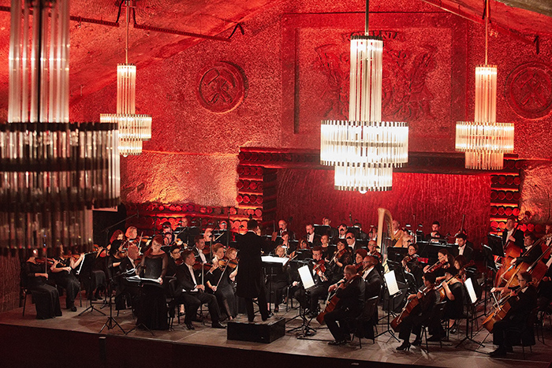
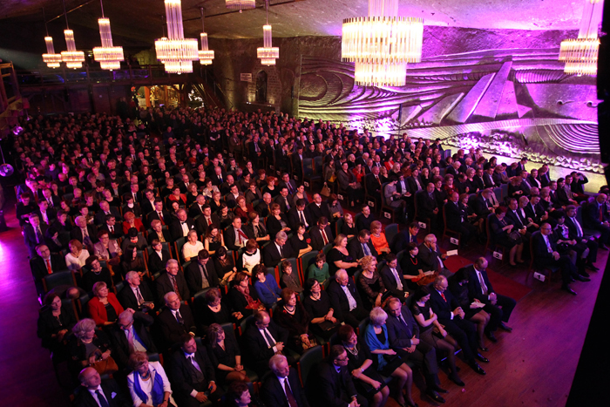
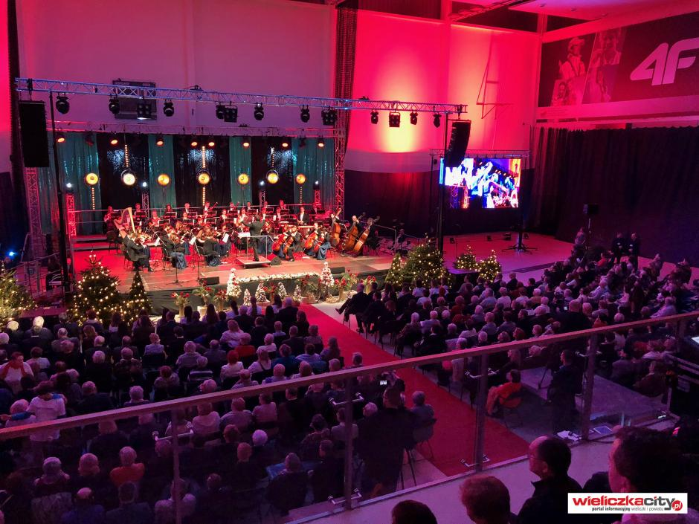
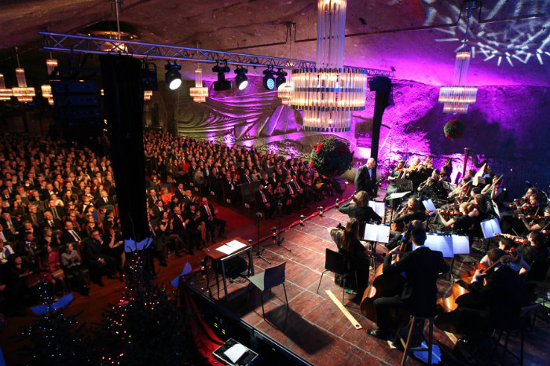
OR A music concert for groups of up to 400 people!!!
The Chapel of St. Kinga is located 101 meters underground, its dimensions are of 31 x 15 m, and its floor area is of 465 m2.

Slide 10
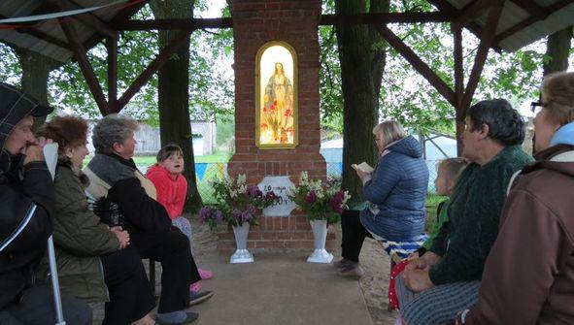
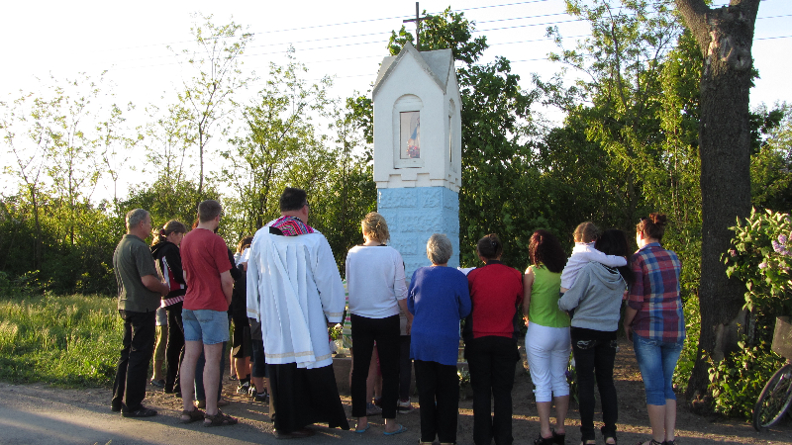
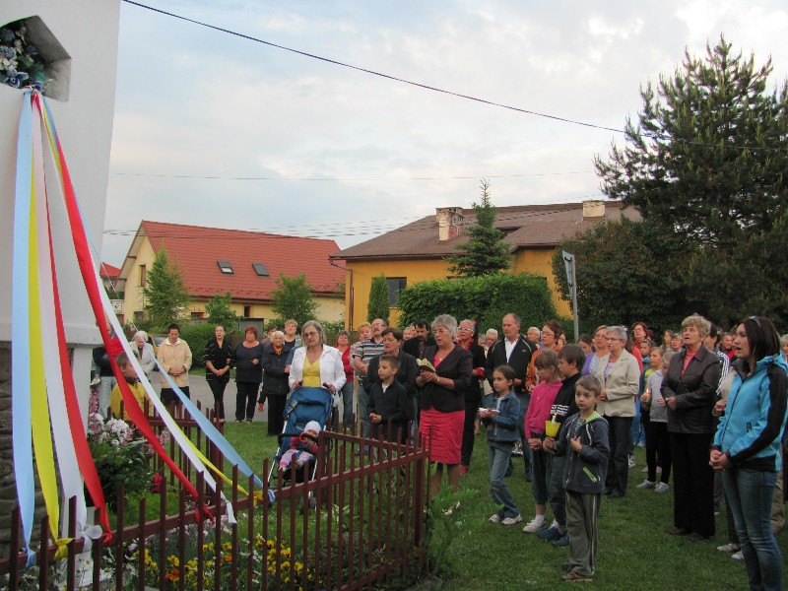
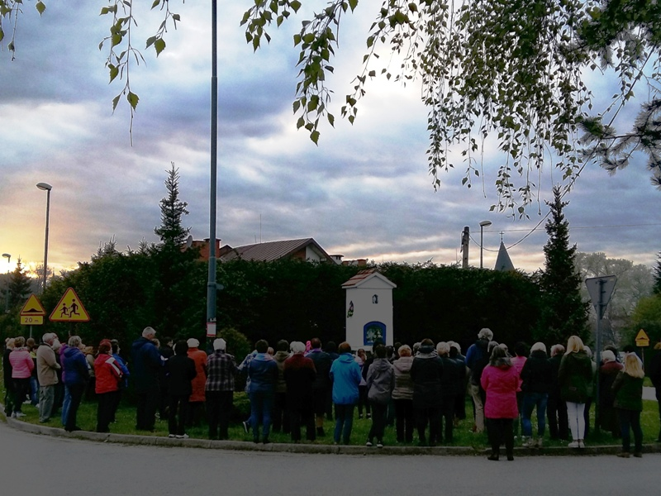
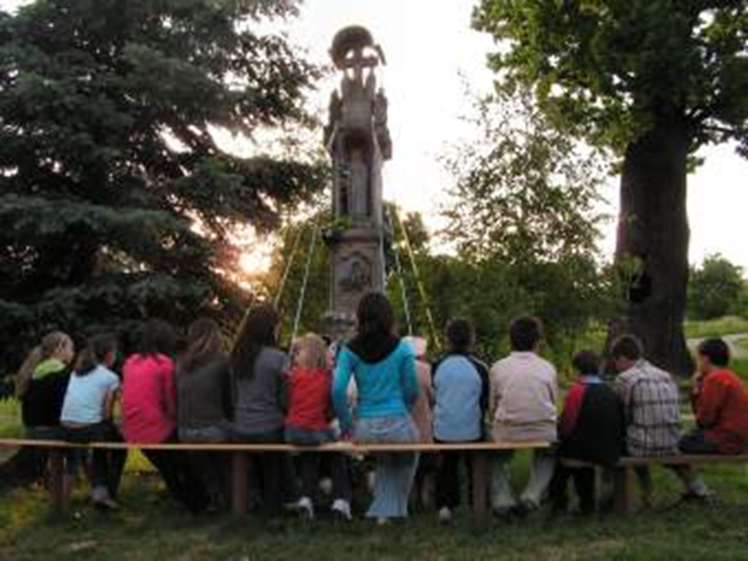
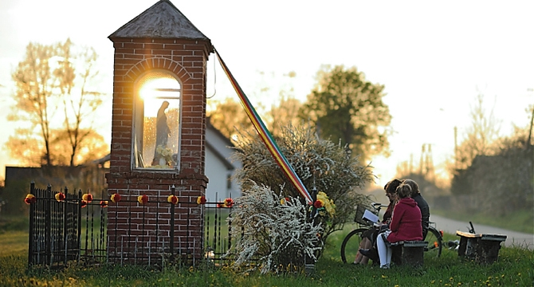
THE SHRINE IS a holy place of whorsHip.
PEOPLE GARHER THERE TO PRAY

Slide 11
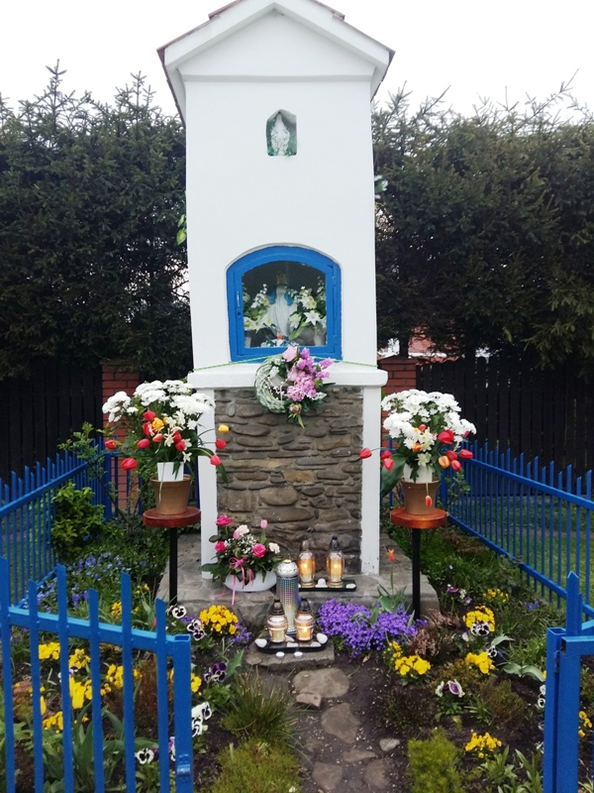
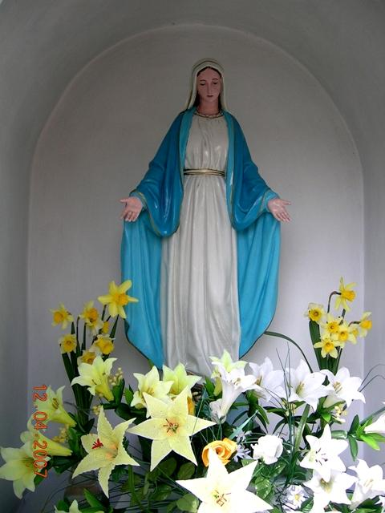
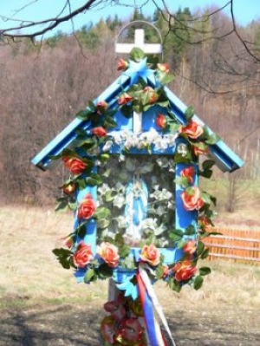
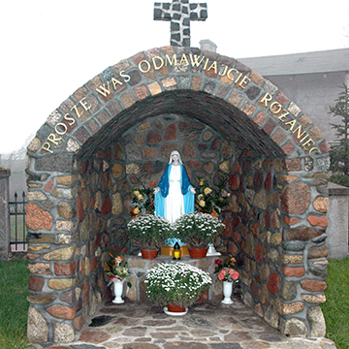
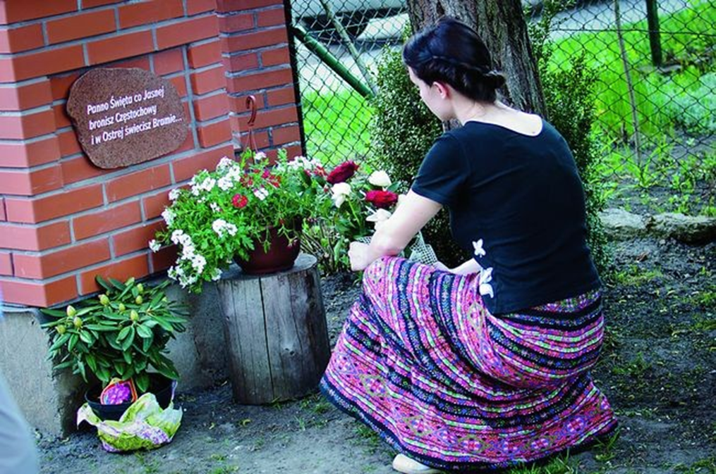
PEOPLE BRING FLOWERS AND TAKE CARE OF THESE PLACES

Slide 12
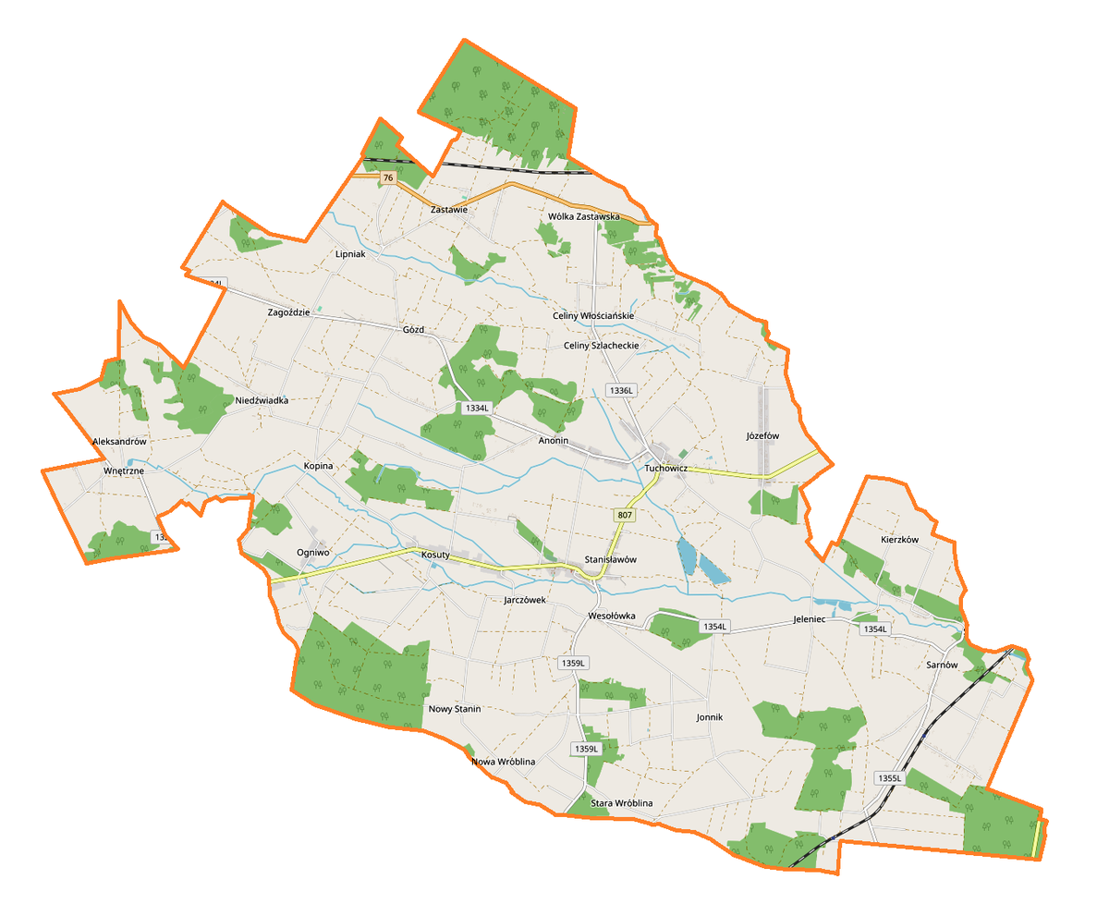
Shrines in Our little homeland – STANIN PROVINCE

Slide 13
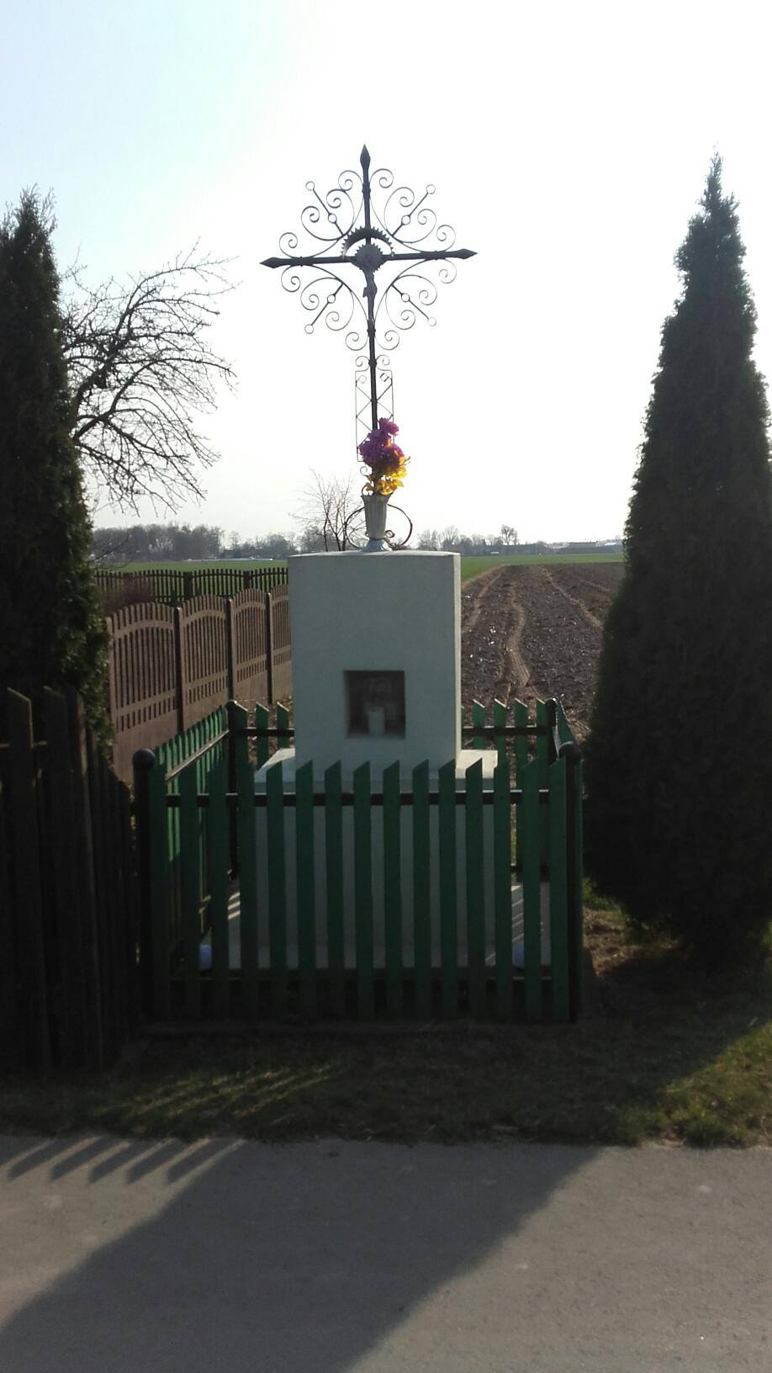
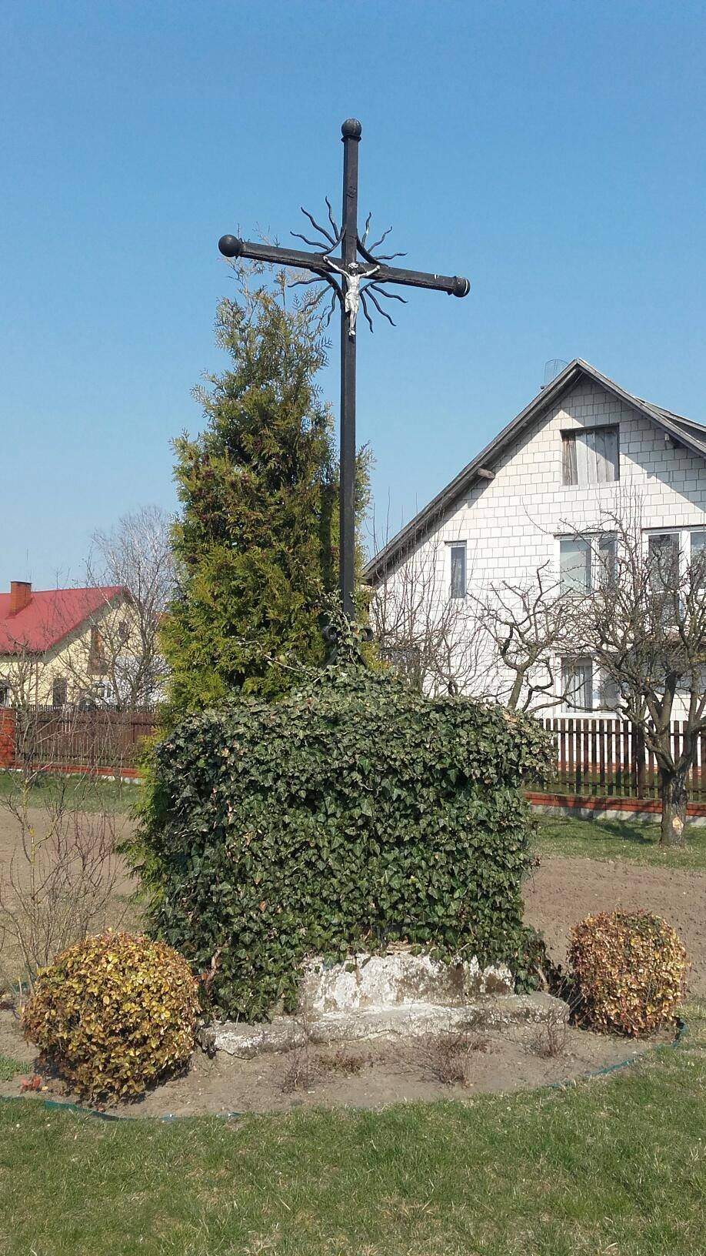
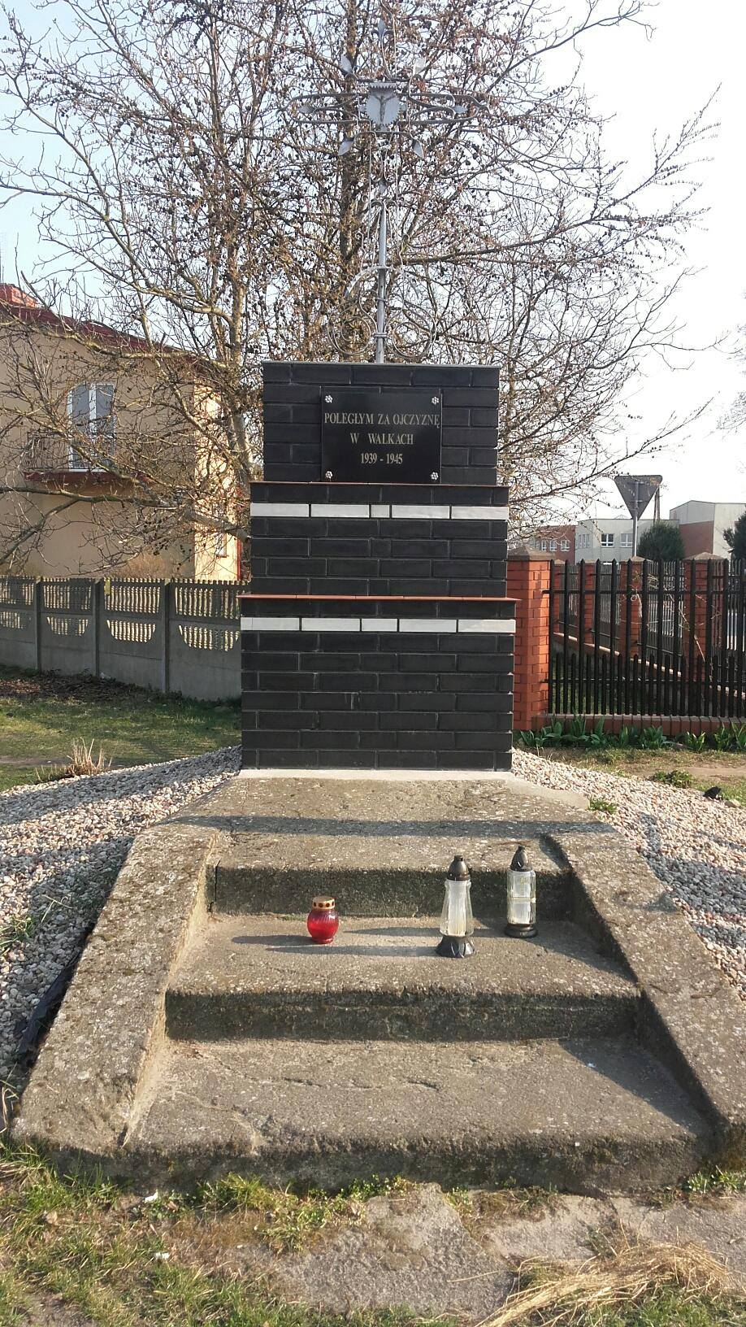
TUCHOWICZ

Slide 14
TUCHOWICZ
This is a cross with Jesus Christ in Tuchowicz, on the way to Łuków.

Slide 15
TUCHOWICZ
This monument commemorates soldiers who fought for Polan during
the World War II.

Slide 16
TUCHOWICZ
The wayside shrine located next to the church.
There is a sculpture of Virgin Mary with a rosary in her hands.

Slide 17
The wayside shrine in the outskirts of Tuchowicz, on the way to the cemetery. On the top of the shrine there is cross with Jesus Christ.

Slide 18
zagoździe
This is cross with Jesus Christ
in Zagoździe, on the way to Lipniak.

Slide 19
The cross with Jesus Christ.

Slide 20
The cross opposite the forest.

Slide 21
sarnów

Slide 22
sarnów
The column shrine. There is an image of Mary Magdalene and her figure.

Slide 23
In the shrine there is
a figure of Virgin Mary

Slide 24
Jonnik

Slide 25
JONNIK
The wayside shrine is located in the middle of the empty stretch of country road. There is a cross with Jesus Christ on it.

Slide 26
The wayside shrine in Jonnik. It’s located in a settlement. It’s a chapel shrine. There is a sculpture of Virgin Mary.

Slide 27
Celiny Szlacheckie
It is located on the main road.

Slide 28
zastawie

Slide 29
Zastawie
The wayside cross in located in a settlement.

Slide 30
zastawie
It is located at the crossroads. There is a sculpture of Jesus Christ.

Slide 31
zastawie
It is located in a settlement. It is a column shrine. There is a sculpture of Virgin Mary.

Slide 32
Wólka Zastawska

Slide 33
Wólka Zastawska
It is located in a settlement. It is a chapel shrine. There is a sculpture of Jesus Christ.

Slide 34
Wólka zastawska
The wayside cross in Wólka Zastawska. It is located in a settlement. There is a sculpture of Jesus Christ.

Slide 35
Kosuty
This shrine commemorates martyrs foughting for the freedom of Poland in 1939-1945.

Slide 36
Stanin

Slide 37
Kopina

Slide 38
Ogniwo

Slide 39
Ogniwo

Slide 40
Wesołówka

Slide 41
Jeleniec

Slide 42
Sources:
https://www.google.com/imgres?imgurl=https%3A%2F%2F1.bp.blogspot.com%2F-eADPjcu--lk%2FVr6XGxf4wmI%2FAAAAAAAAFYU%2FueCnaVSwT9Q%2Fs1600%2F%2525C5%25259Alub%252Bw%252BKopalni%252BSoli%252Bw%252BWieliczce%25252C%252BWedding%252Bin%252BSalt%252BMine%252BWieliczka%25252C%252BWinsa%252BWedding%252BPlanner%252Bin%252BKrakow%252B1.jpg&imgrefurl=http%3A%2F%2Fwinsa.pl%2Finspiracje%2Fa-gdyby-tak-zorganizowac-slub-w-kopalni-soli-w-wieliczce%2F&docid=pEbCkjWZQYATzM&tbnid=sFICtw-zrtMShM%3A&vet=10ahUKEwjoqsbZq_XhAhXCxcQBHYU4B8AQMwhEKAgwCA..i&w=700&h=466&bih=616&biw=1350&q=wieliczka%20%C5%9Blub&ved=0ahUKEwjoqsbZq_XhAhXCxcQBHYU4B8AQMwhEKAgwCA&iact=mrc&uact=8
https://www.google.com/imgres?imgurl=http%3A%2F%2Fwww.weddingsinpoland.com%2Fwp-content%2Fuploads%2F2016%2F07%2F2-768x513.jpg&imgrefurl=http%3A%2F%2Fwww.weddingsinpoland.com%2Fslub-w-kopalni-soli-wieliczka%2F&docid=znQg70AiMEaf_M&tbnid=k3LSEeNl8dZS0M%3A&vet=10ahUKEwjoqsbZq_XhAhXCxcQBHYU4B8AQMwg_KAMwAw..i&w=768&h=513&bih=616&biw=1350&q=wieliczka%20%C5%9Blub&ved=0ahUKEwjoqsbZq_XhAhXCxcQBHYU4B8AQMwg_KAMwAw&iact=mrc&uact=8
https://www.google.com/imgres?imgurl=http%3A%2F%2Fwww.jedziemynawakacje.pl%2Fphotos%2Fslub%2Fslub-wieliczka-8.jpg&imgrefurl=http%3A%2F%2Fwww.jedziemynawakacje.pl%2Fslub-kopalnia.php&docid=h_hqcrT08zCrTM&tbnid=vhSFWPZSPs7y0M%3A&vet=10ahUKEwjoqsbZq_XhAhXCxcQBHYU4B8AQMwg9KAEwAQ..i&w=300&h=200&bih=616&biw=1350&q=wieliczka%20%C5%9Blub&ved=0ahUKEwjoqsbZq_XhAhXCxcQBHYU4B8AQMwg9KAEwAQ&iact=mrc&uact=8
https://www.kopalnia.pl/imprezy/komory-do-dyspozycji/kaplica-sw-kingi
https://www.google.com/search?q=kapliczki+g%C3%B3ry&source=lnms&tbm=isch&sa=X&ved=0ahUKEwj-hq7av_bhAhVN_SoKHUhOBV8Q_AUIDigB&biw=1350&bih=616
https://www.google.com/search?q=kapliczki+mazury&source=lnms&tbm=isch&sa=X&ved=0ahUKEwj02-Hqv_bhAhWMp4sKHVjEDs0Q_AUIDigB&biw=1350&bih=616
https://www.google.com/search?q=kapliczki+nad+morzem&source=lnms&tbm=isch&sa=X&ved=0ahUKEwjMmKP5v_bhAhVrsIsKHVIFC5EQ_AUIDigB&biw=1350&bih=616
https://www.google.com/search?q=modlitwy+przy+kapliczkach&source=lnms&tbm=isch&sa=X&ved=0ahUKEwjd7f6HwPbhAhVkoYsKHZX4AC0Q_AUIDigB&biw=1350&bih=616

Slide 43
Ppepared by: zespół szkół w tuchowiczu for Erasmus + Sharing european cultural heritage through digital storytelling Italy, may 2019

