Slide 1
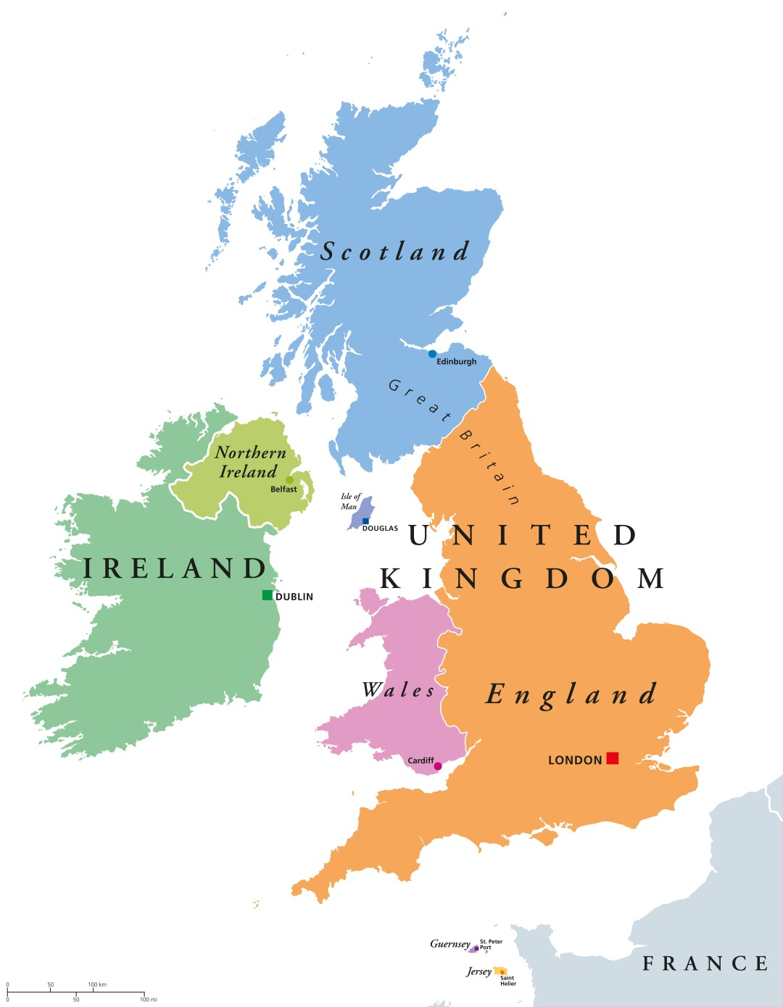
Publiczna
Szkoła
Podstawowa
W Tuchowiczu
Wykonała:
Magdalena Gryczka kl. VI

Slide 2
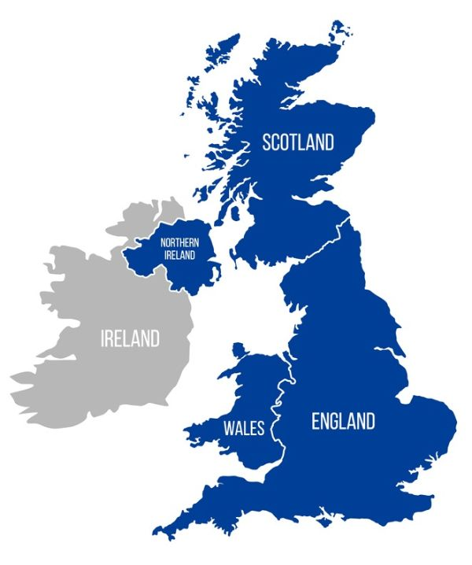
The United Kingdom States: - England - Scotland - Wales - Northern Ireland

Slide 3
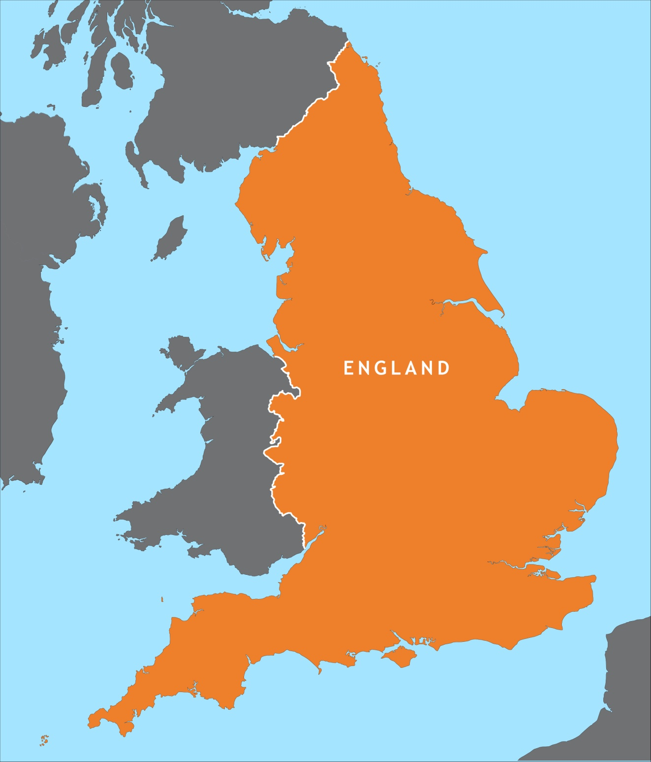
England

Slide 4
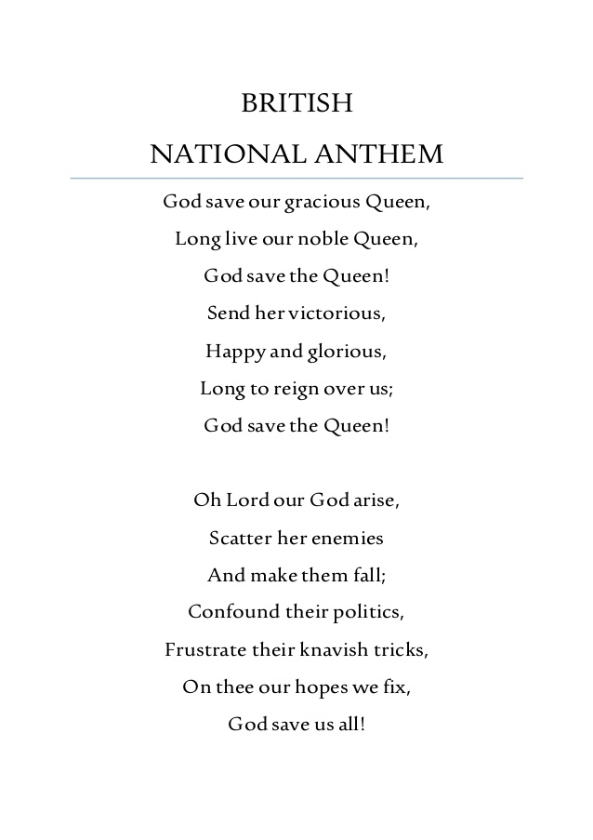
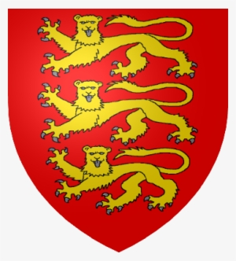
National symbols:
National Rose
Emblem
Flag

Slide 5
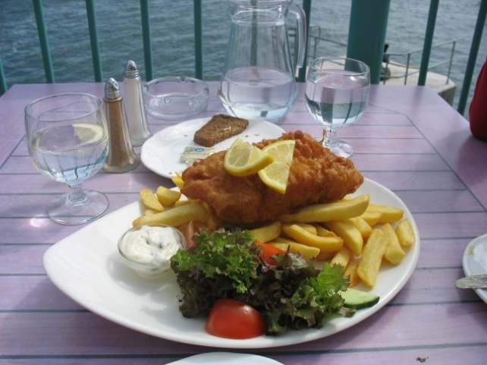
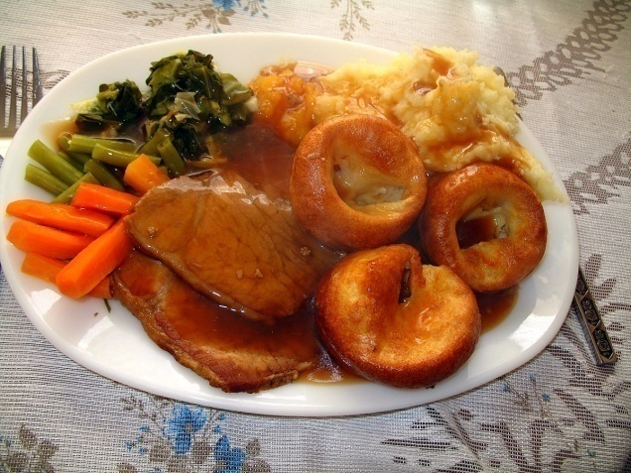
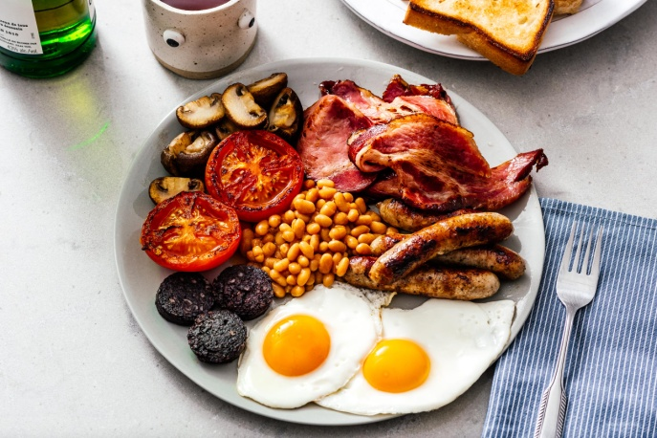
Traditional food:
Fish and Chips
Sunday Roast
Full English Breakfast

Slide 6
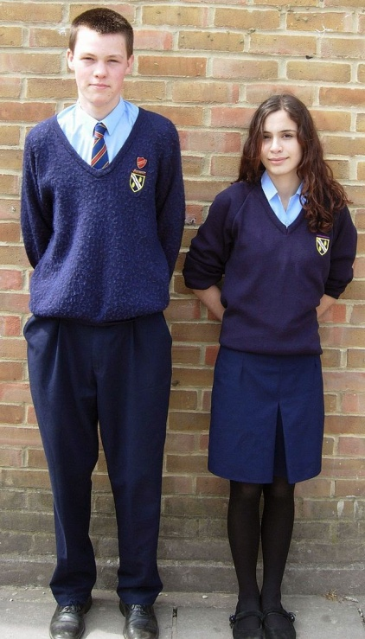
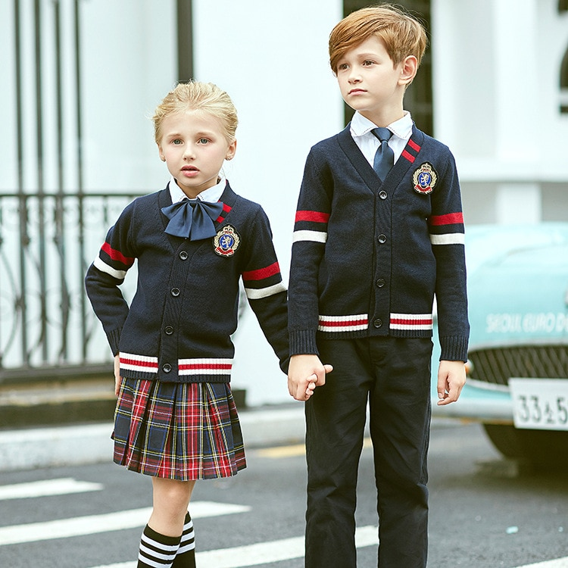
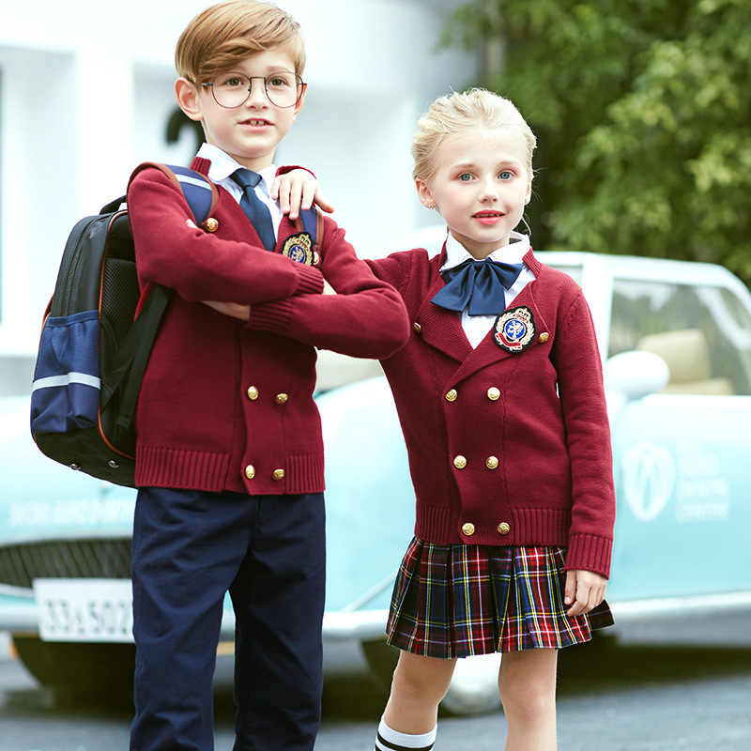
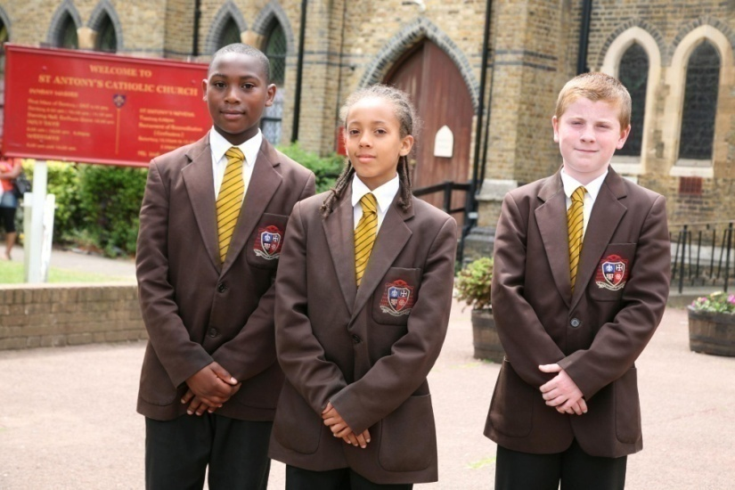
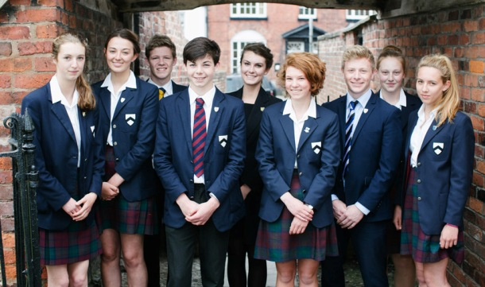
School uniforms:

Slide 7
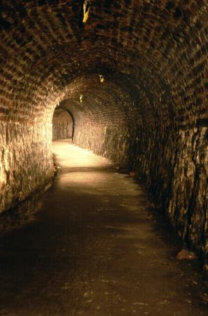
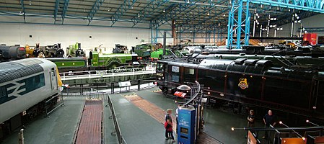
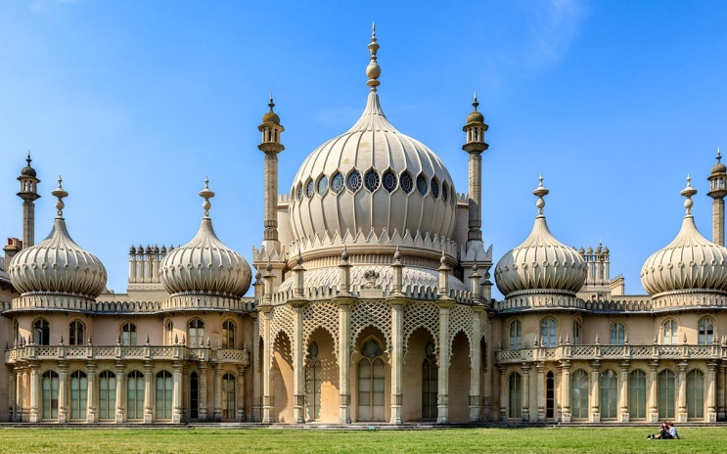
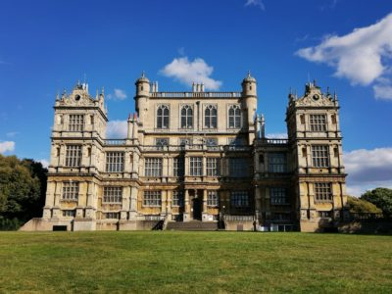
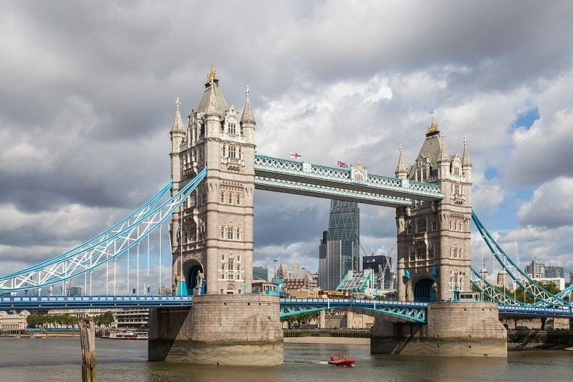
Interestnig places:
National Railway Museum
Victoria Tunnel
Royal Pavilion
Wollaton Hall and Park
Tower Bridge

Slide 8
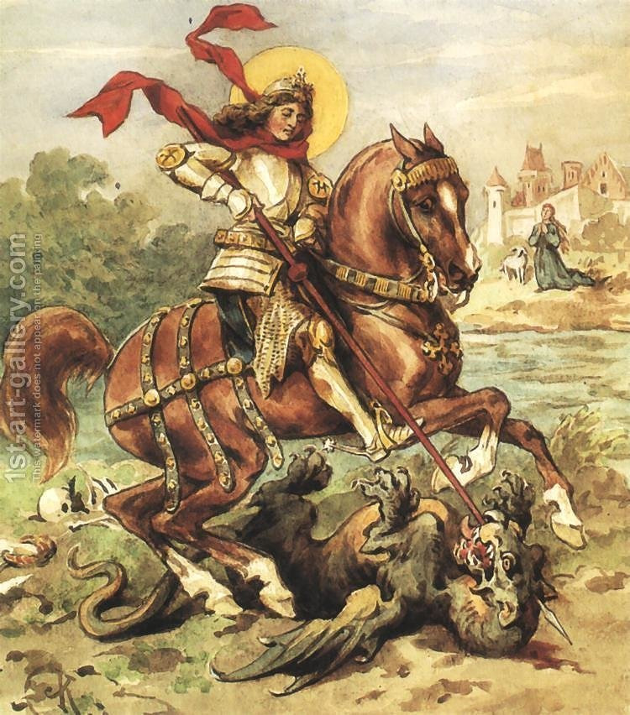
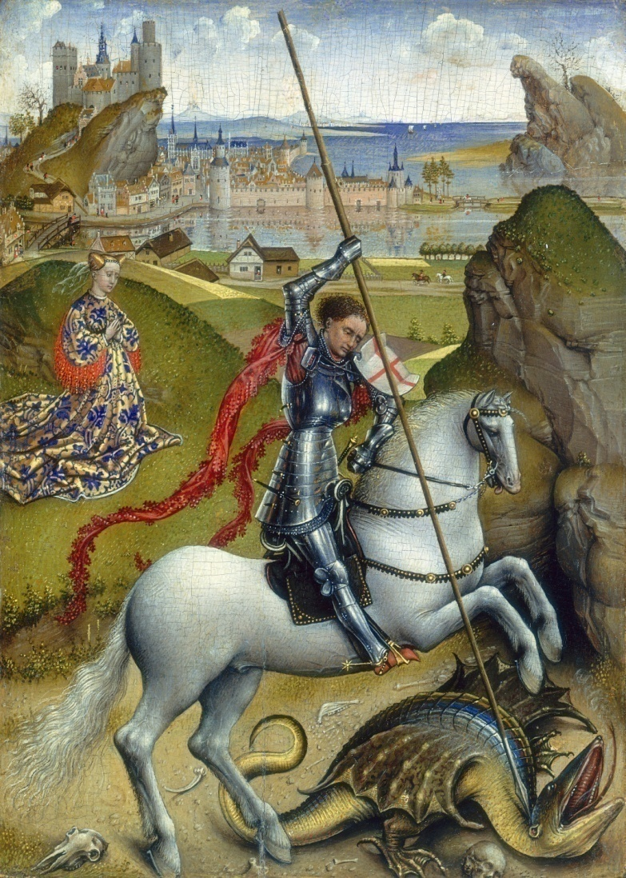
Patron:
Saint George
St. George day is on 23 of April. On St George's day some people in England wear a red rose, or put an English flag in their window. The Saint George's Cross is in the flag of England.

Slide 9
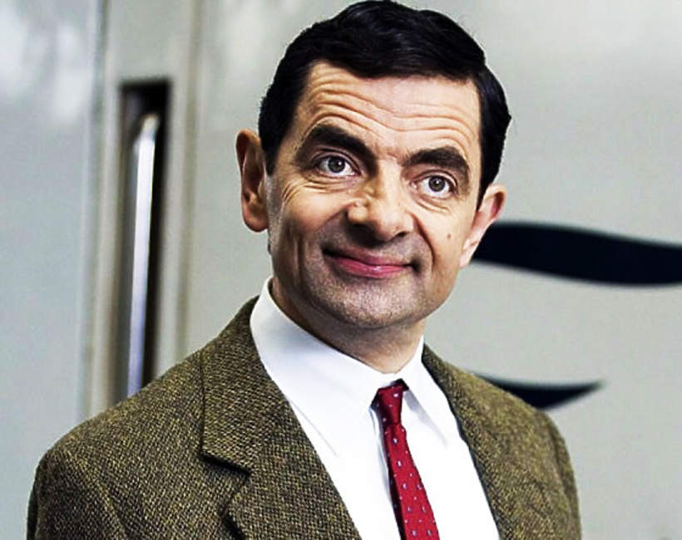
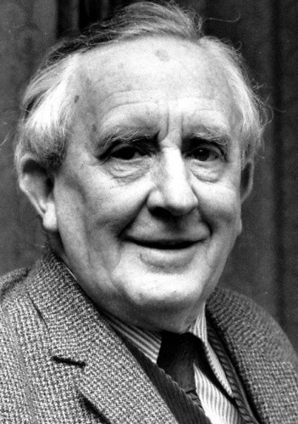
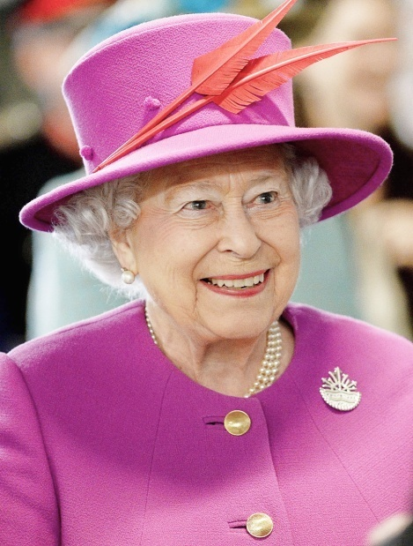
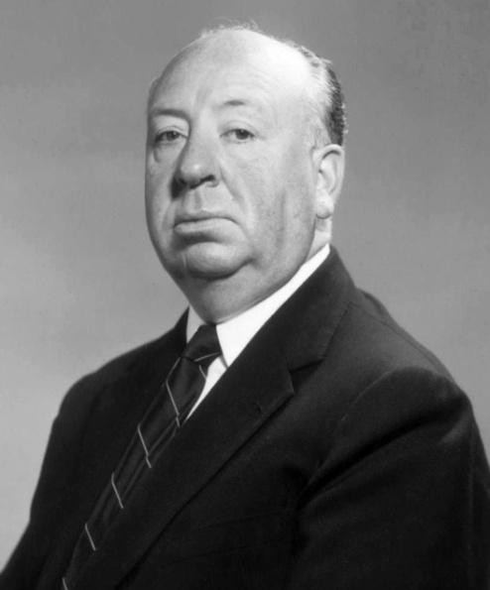
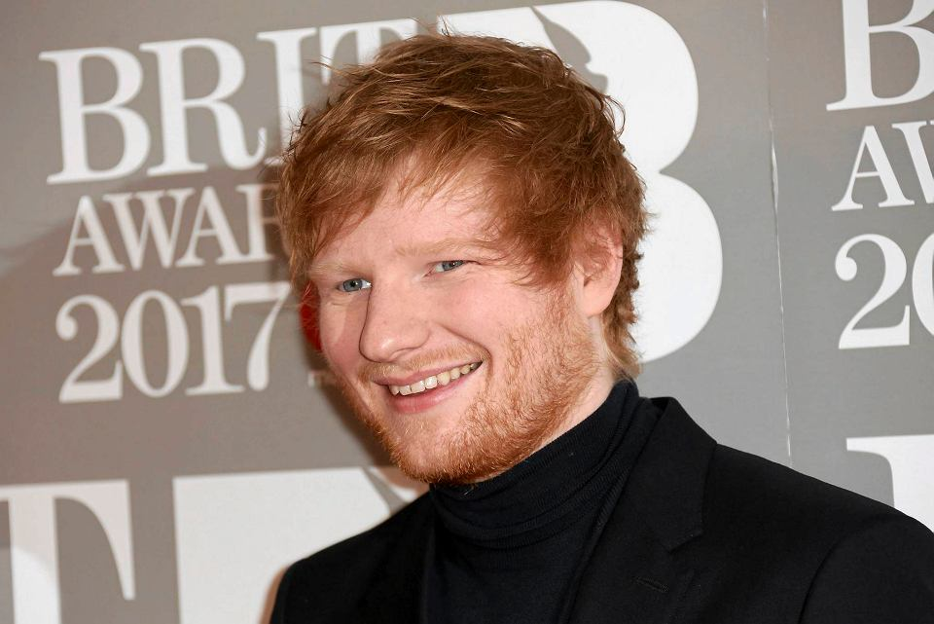
Famous people coming from England:
Rowan Atkinson
Adele
John Ronald Reuel Tolkien
Elizabeth II
Alfred Hitcock
Ed Sheeran

Slide 10
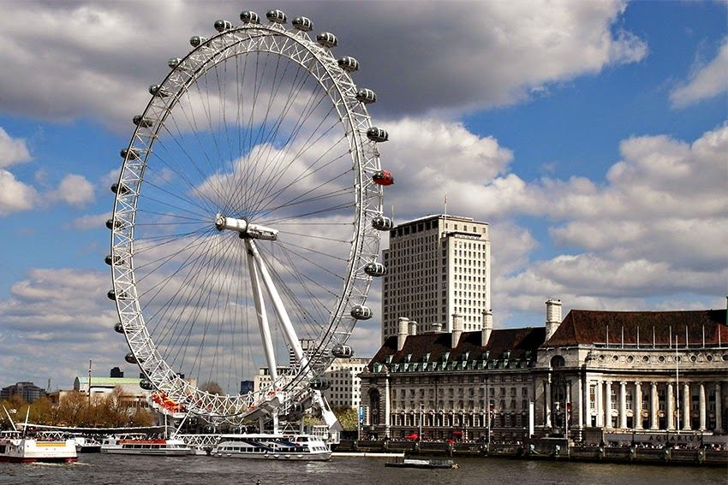
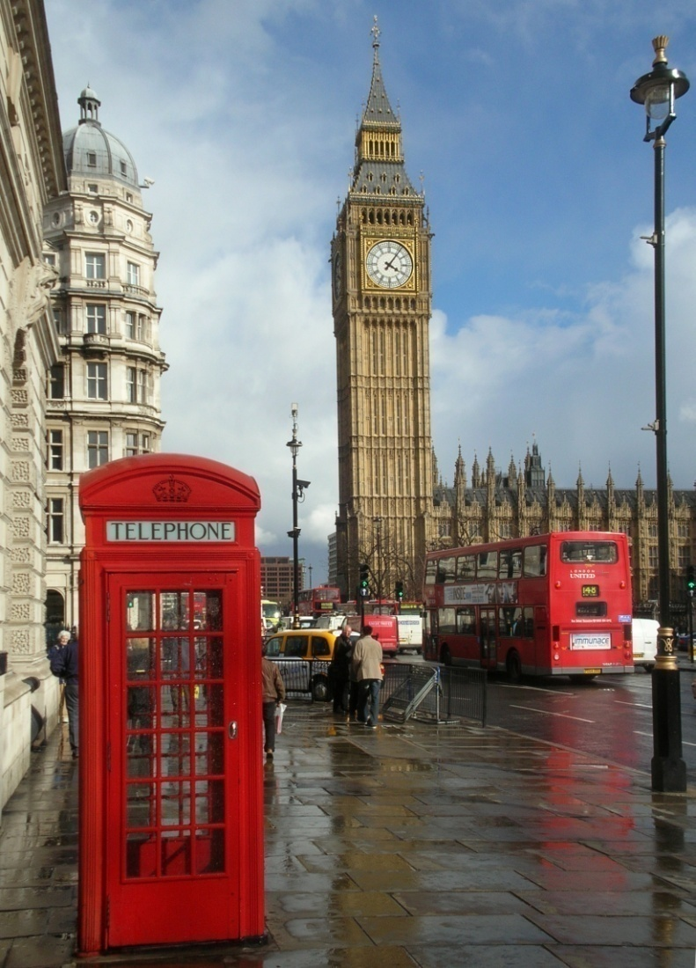
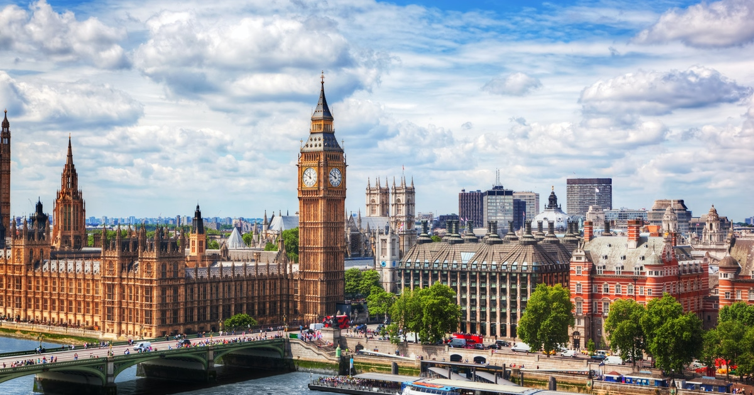
Capital city:
London

Slide 11
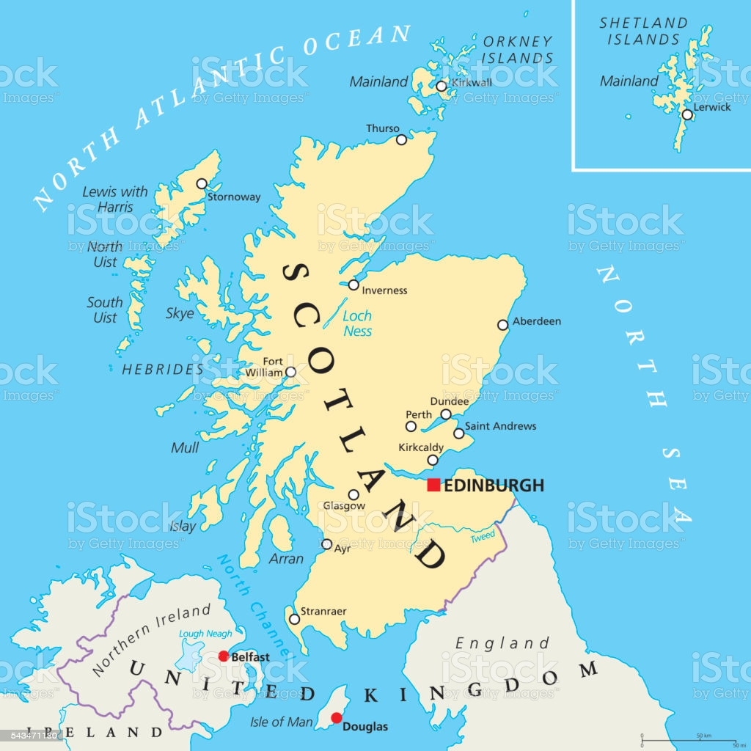
Scotland

Slide 12
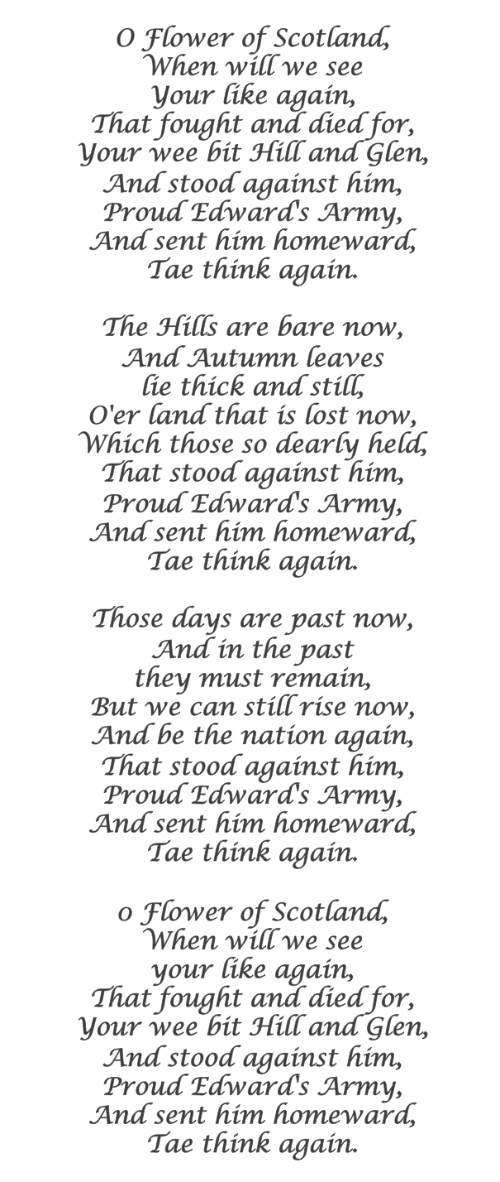
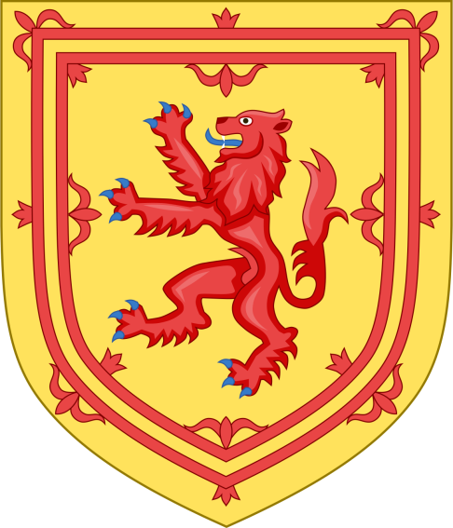
National symbols:
National Anthem
National Thistle
Emblem
Flag

Slide 13
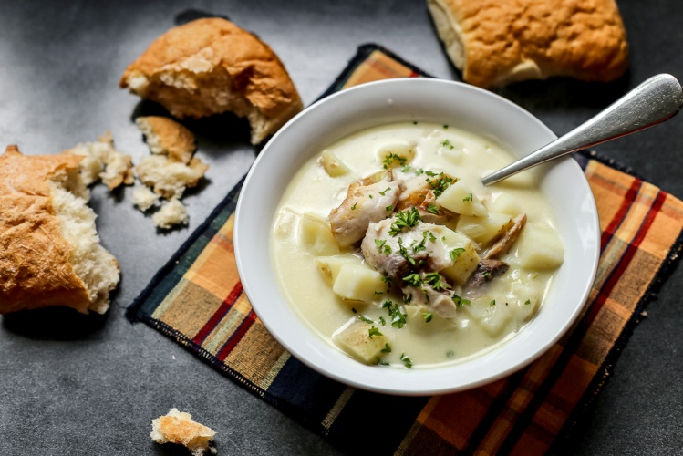
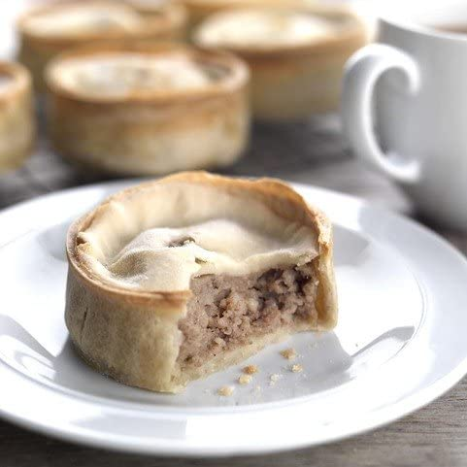
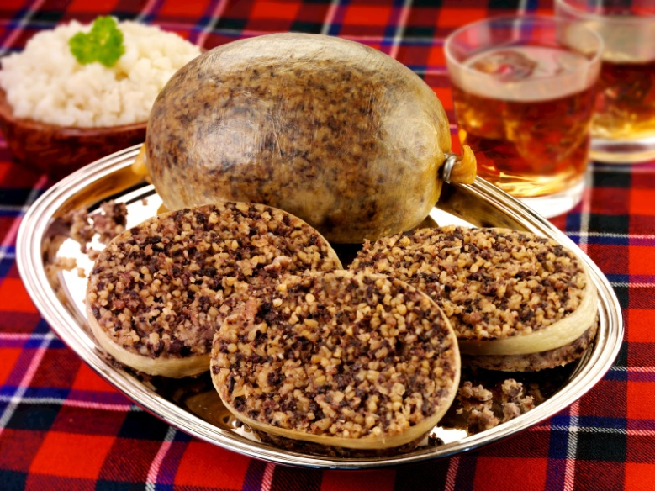
Traditional food:
Cullen Skink
Scotch Pie
Haggis

Slide 14
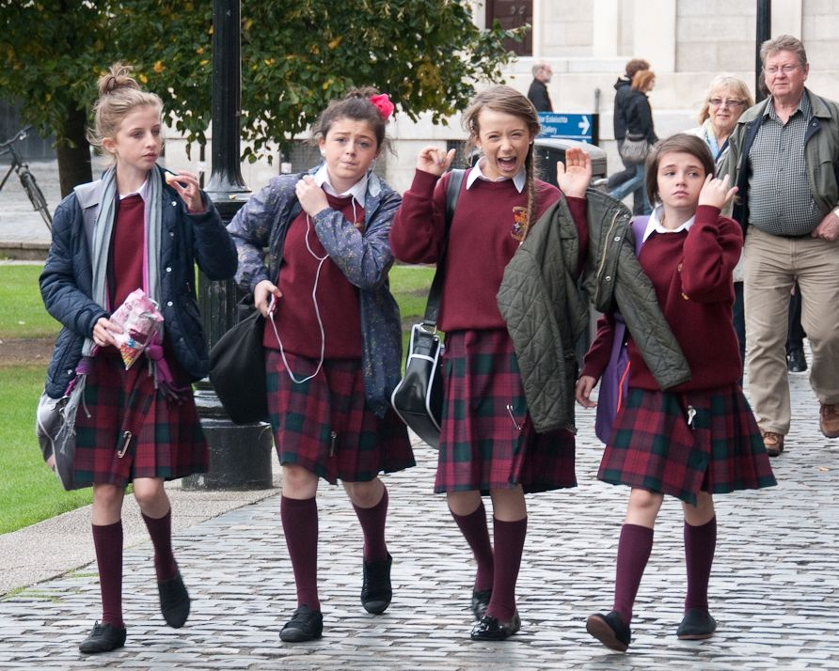
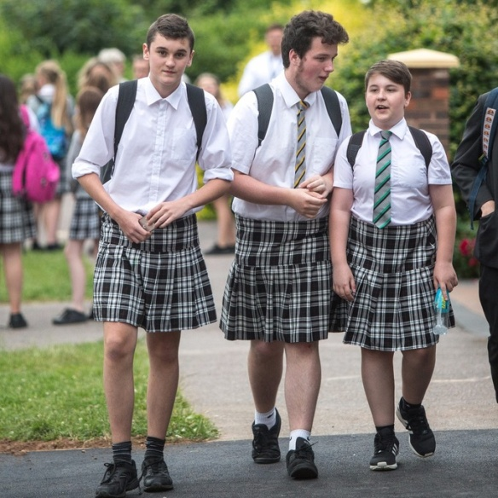
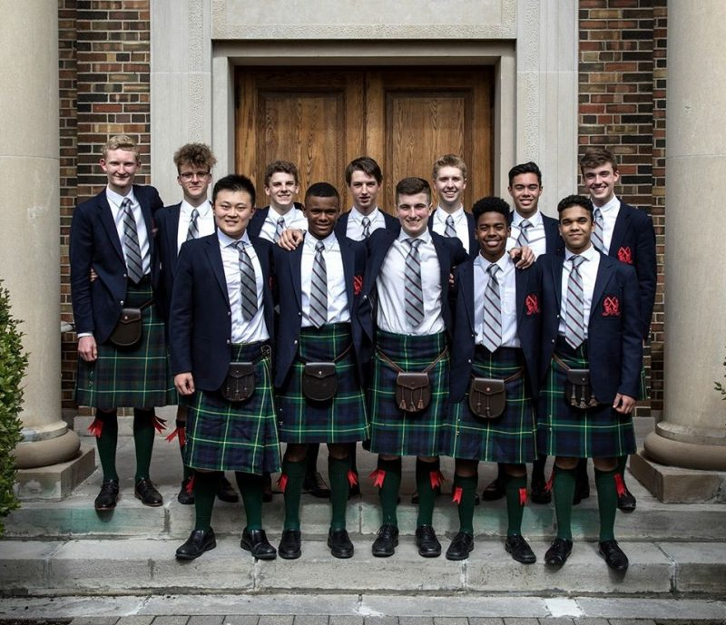
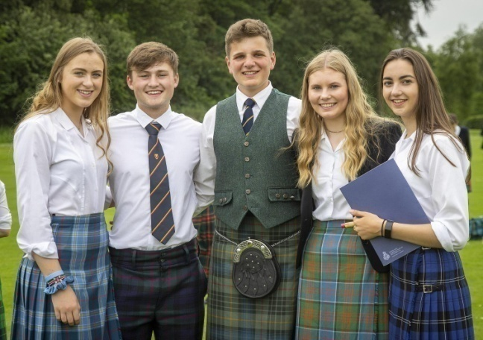
School uniforms:

Slide 15
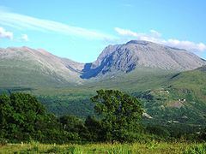
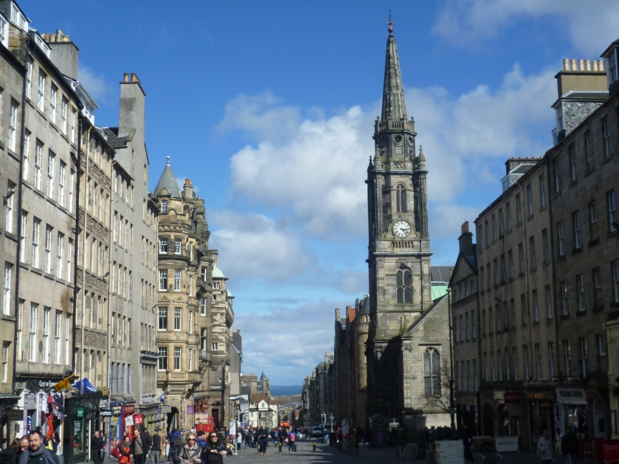
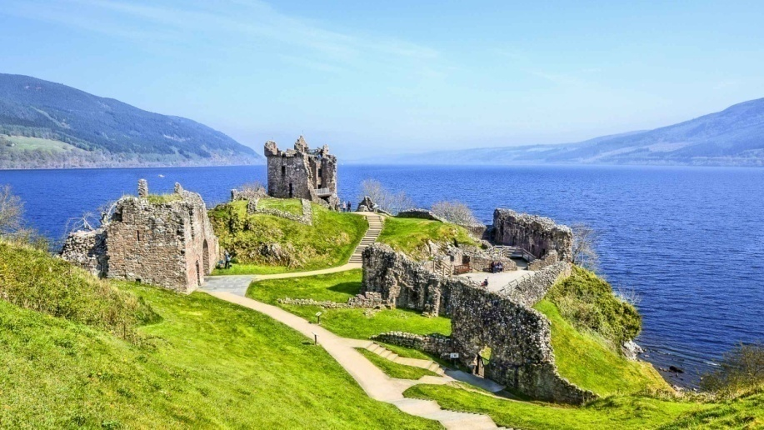
Interesting places:
Ben Nevis
Loch Lomond
Royal Mile
Loch Ness

Slide 16
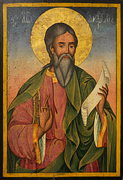
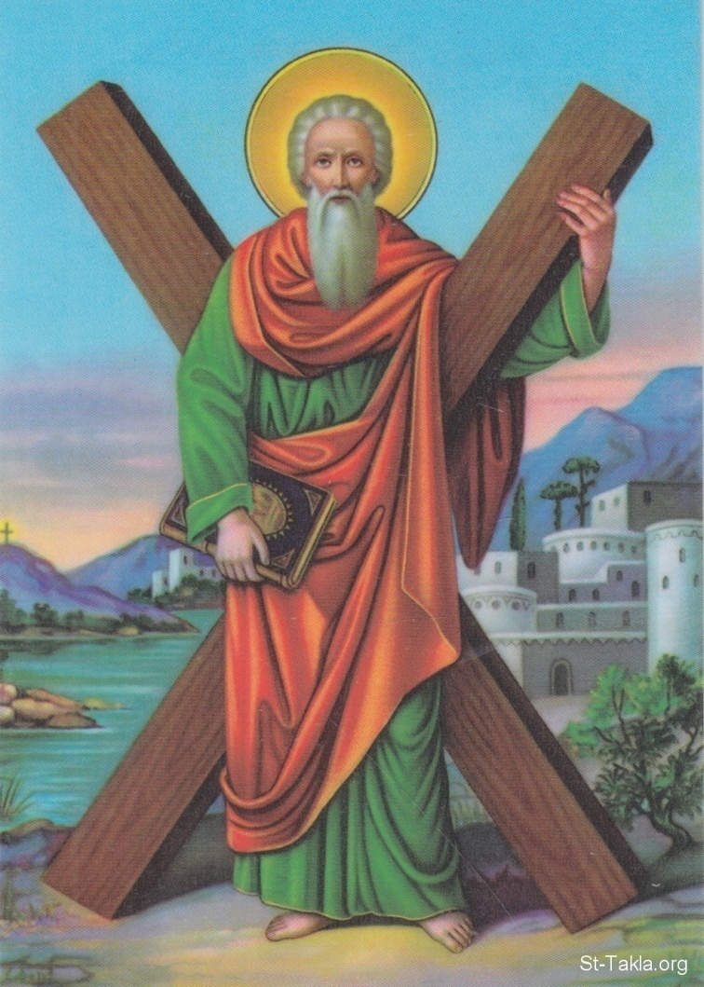
Patron:
Saint Andrew
St. Andrew is one of the twelve apostles of Jesus Christ. He was crucified on a cross. The cross was turned sideways to look like an "X". The Saint Andrew's flag is the official flag of Scotland. On this day, some people in Scotland wear a thistle. It is celebrated on 30 November.

Slide 17
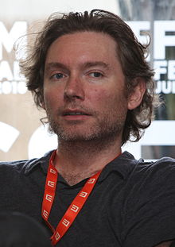
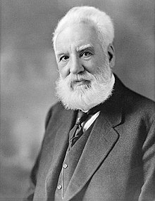
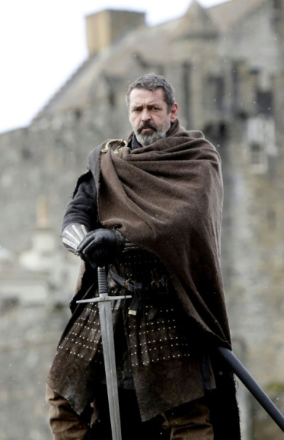
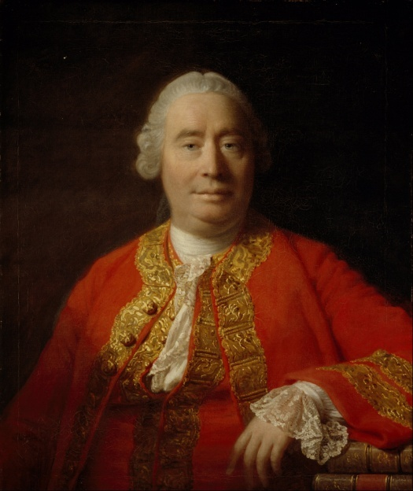
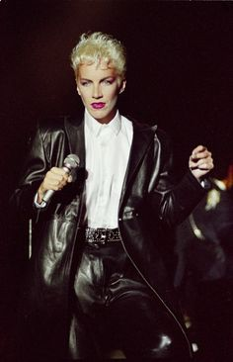
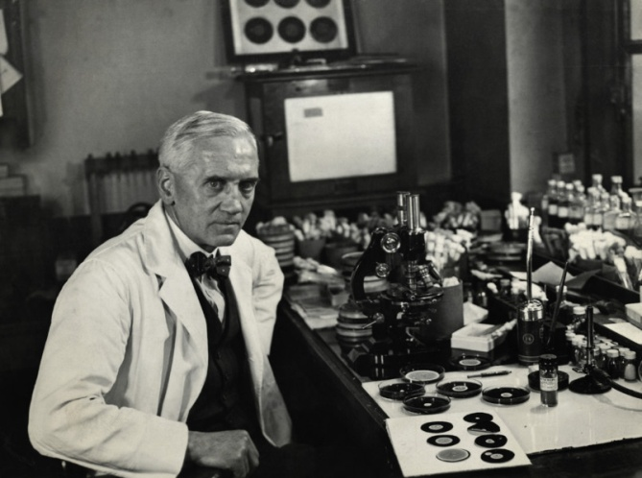
Famous people coming from Scotland:
Kevin Macdonald
Alexander Graham Bell
Roberth The Bruce
David Hume
Ann Lennox
Alexander Fleming

Slide 18
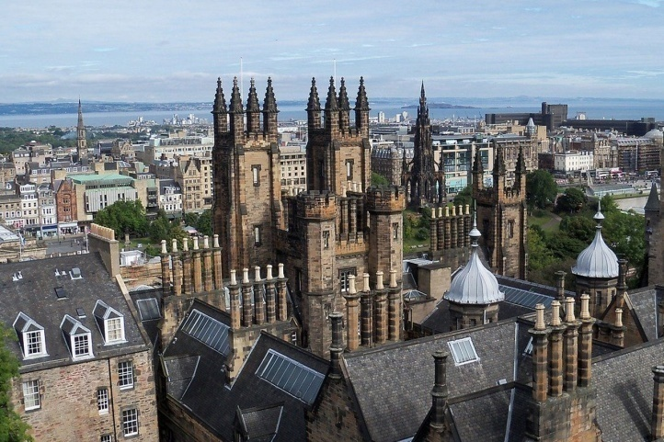
Capital city:
Edinburgh

Slide 19
Wales

Slide 20
National symbols:
Anthem
Flag
Emblem
Daffodil

Slide 21
Traditional food:
Welsh Rarebit
Bara Brith
Cawl

Slide 22
School uniforms:

Slide 23
Interesting places:
Portmeirion
Wales by Rail
Caernarfon Castle
Snowdonia

Slide 24
Patron:
Saint David
He founded many monasteries and orders. His contribution to the preaching of the faith was so great that he was elected bishop in Mynyw, now St David (named after him).

Slide 25
Famous people coming from Wales:
Bonnie Tyler
Catherine Zeta-Jones
Anthony Hopkins
Tom Jones
Timothy Dalton
Gareth Bale

Slide 26
Capital city:
Cardiff

Slide 27
Northern Ireland

Slide 28
National symbols:
Flag
Anthem
Emblem
Shamrock

Slide 29
Traditional food:
Pastie
Champ
Irish Stew

Slide 30
School uniforms:

Slide 31
Interesting places:
Tollymore Forest Park
Titanic Belfast
Belfast City Hall
Mussenden Temple

Slide 32
Patron:
Saint Partrick
St. Patrick came from a Christian family, he was the son of a deacon. When he was about sixteen years old, he was captured by Irish pirates. They sold him as a slave in Ireland. He lived there for six years and learned the local language. He then escaped and returned to his family.

Slide 33
Famous people coming from Northern Ireland:
Liam Neeson
Colin Bateman
Paula Malcomson
Jamie Dornan
Van Morrison
Rory McIlroy

Slide 34
Capital city:
BELFAST

Slide 35
The End

