Slide 1
Praca sporządzona przez Oliwię Czyzio – uczennica klasy VI
Przygotowana pod kierunkiem Pani Marty Kruk nauczycielki języka angielskiego
Publiczna Szkoła Podstawowa w Sarnowie
Adres: Sarnów 19 B
21-421 Tuchowicz

Slide 2
„THE BRITISH ISLES
GEOGRAPHY
LIFE
AND
CULTURE”

Slide 3
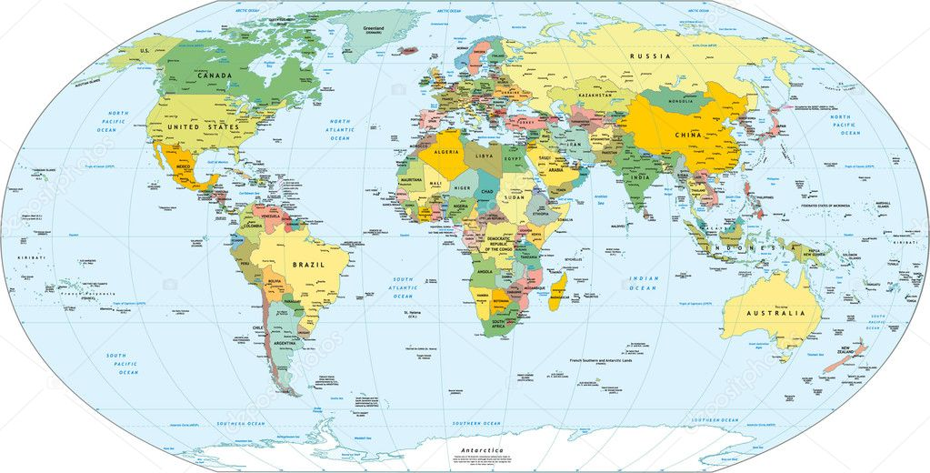
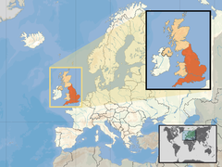
British Isles
A group of islands in the Northeast Atlantic, located northwest of mainland Europe, separated the La Manch Channel and the Kaletan Strait.

Slide 4
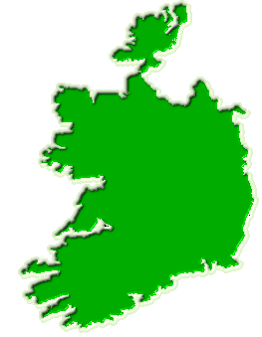
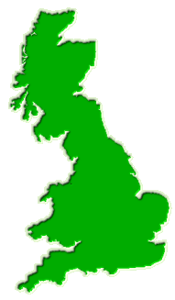
IN COMPOSITION ISLANDS BRITISH THEY COME IN :
Great Britain
209 331 km²
MORE THAN FIVE THOUSAND ISLANDS BIGGEST THIS :
Hebrides (7 555 km²)
Shetland (1 466 km²)
Orkney (975 km²)
Ireland
84 406 km²

Slide 5
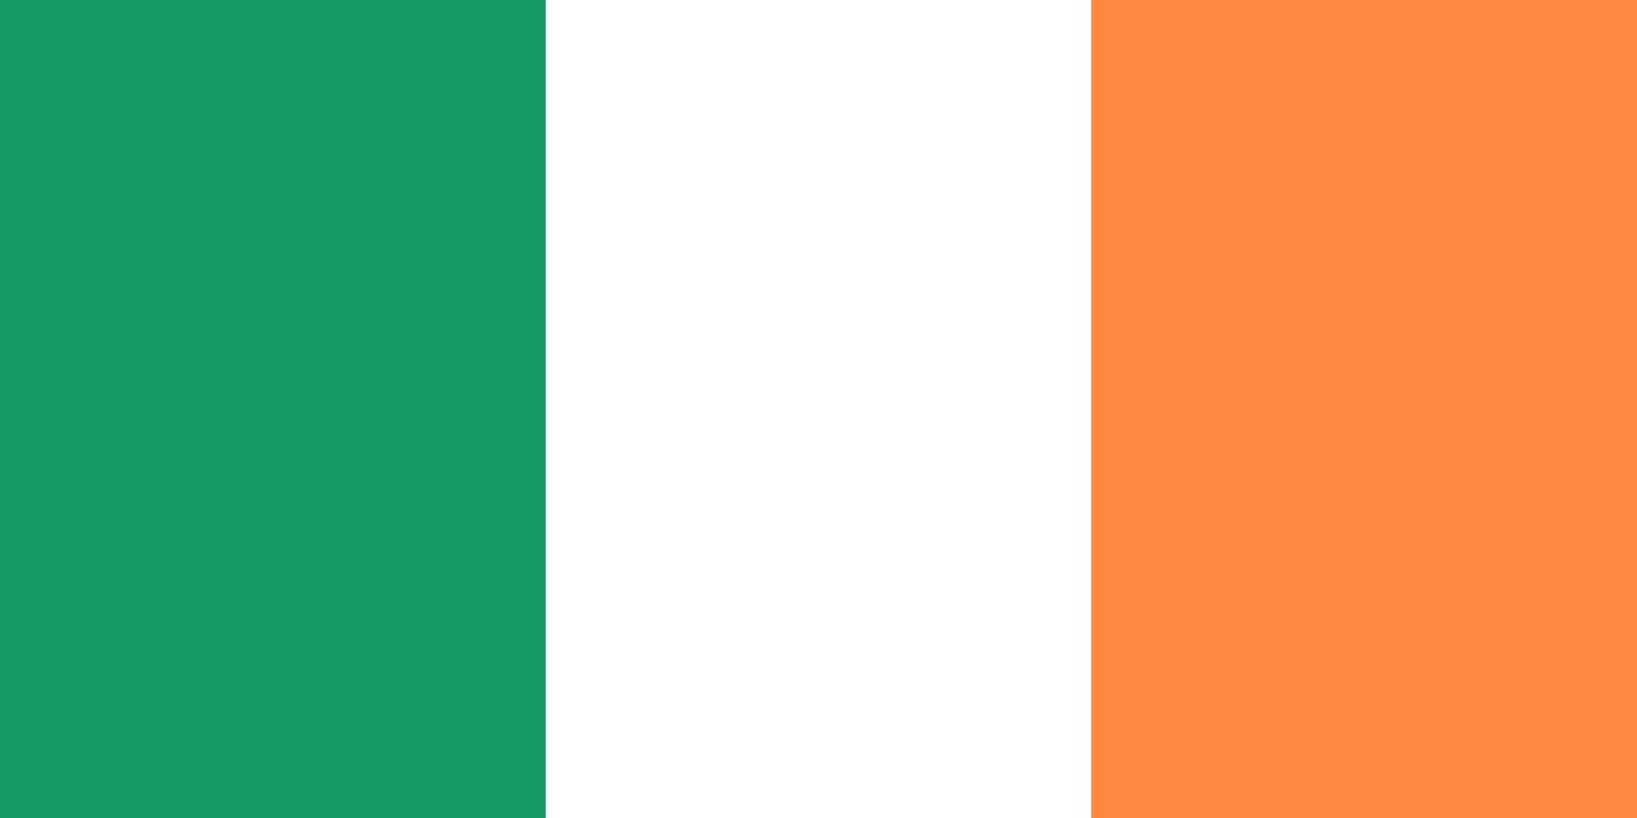
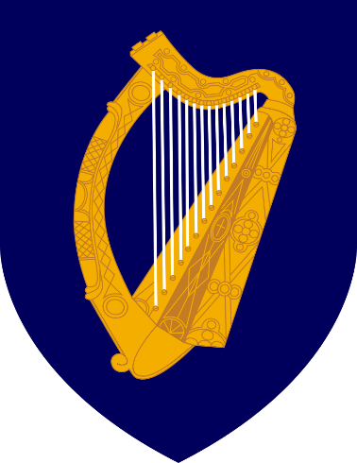
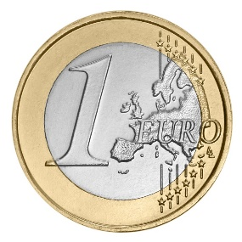
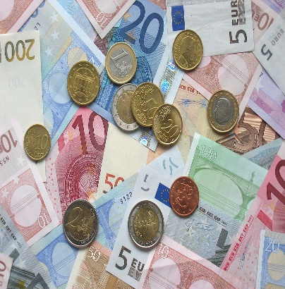
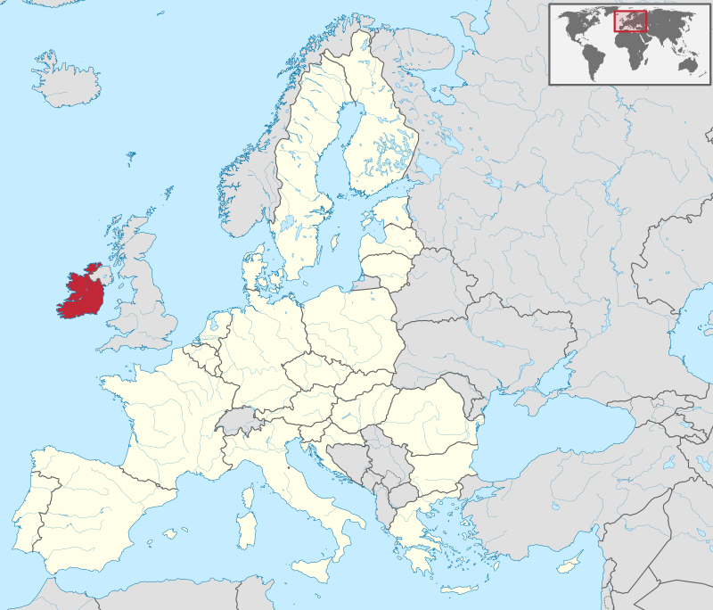
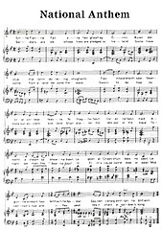
IRELAND
Arms
Flag
Currency: EURO
A country in Western Europe, located on an island.
In 1973 she joined the European Community.
It borders with Great Britain.
The capital city is Dublin.
Anthem: Amhrán na bhFiann

Slide 6
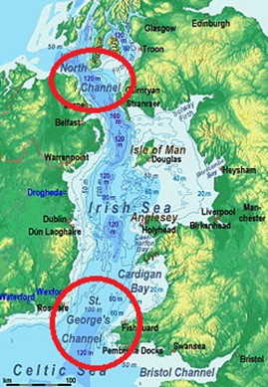
IRELAND
POSITION
Access to the Irish Sea, the Celtic Sea, the Atlantic Ocean, and is separated from Great Britain by the Channel of St. George.
Coastal length 1448 km
The length of the border with Northern Ireland (part of the United Kingdom) is 360 km
The highest point of Carrantuohill 1041 m above sea leve
Lowest point Atlantic Ocean 0 m.
The longest river Shannon 386 km
The largest lake is Lough Corrib 176 km²
Ireland occupies 84% ​​of the territory of the island of the same name. It is separated from the island of Great Britain by straits:
George 's Channel
North Channel.

Slide 7
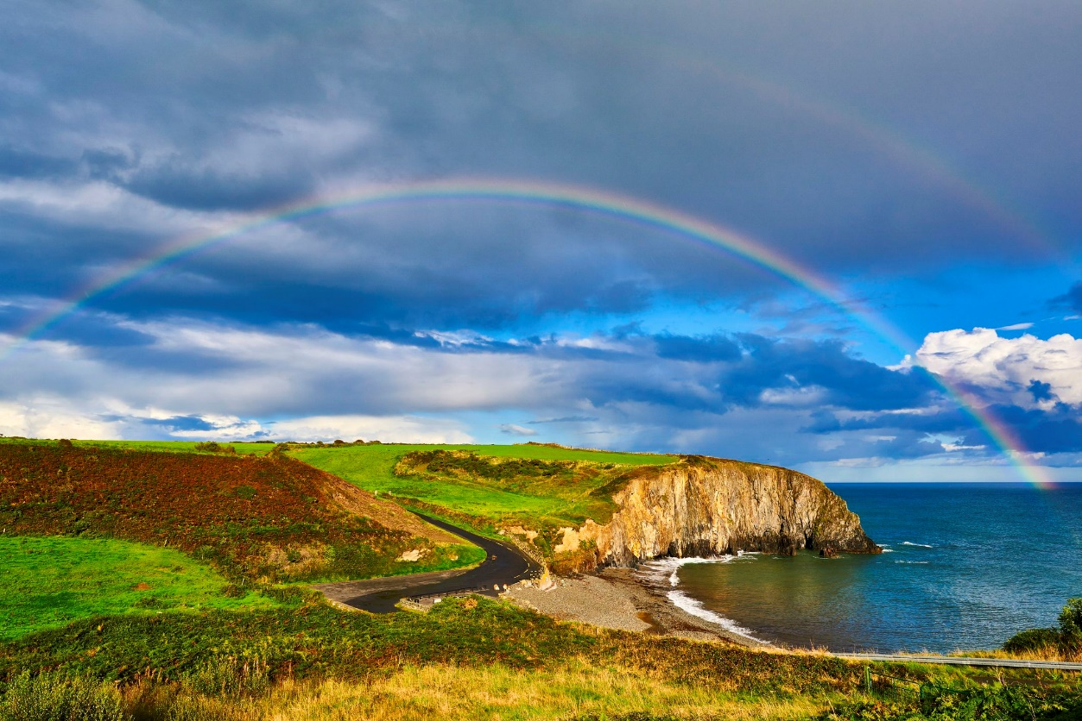
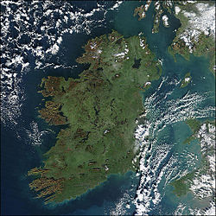
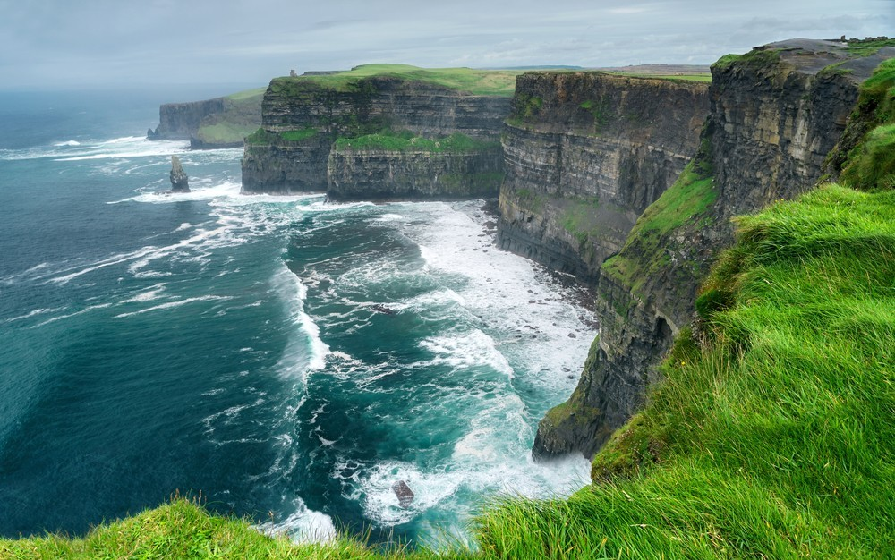
IRELAND
The island's lush vegetation, a product of its mild climate and frequent rainfall, earns it the sobriquet the Emerald Isle.
Ireland has a mild but changeable oceanic climate with few extremes. The climate is typically insular and is temperate, avoiding the extremes in temperature of many other areas in the world at similar latitudes.

Slide 8
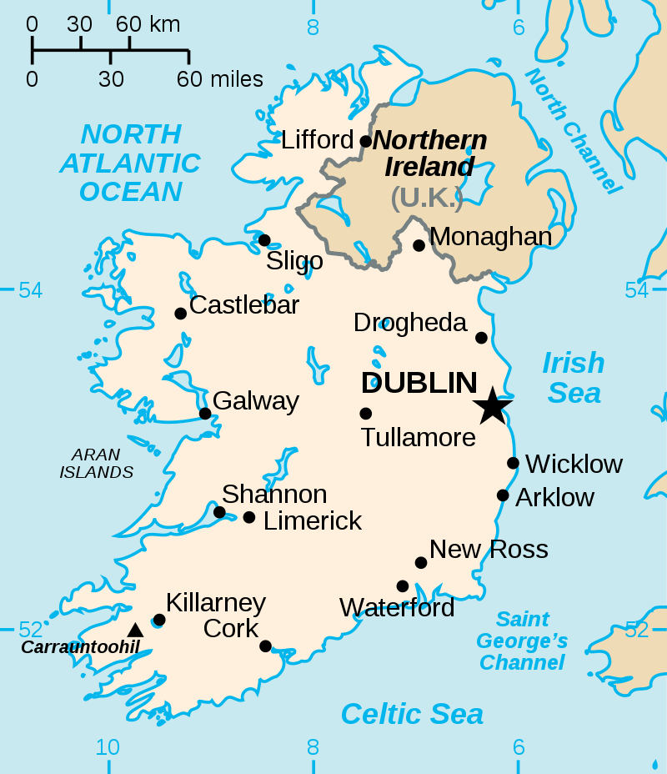
IRELAND
DUBLIN
CORK
LIMERICK
WATERFORD
GALWAY
The most important cities:

Slide 9
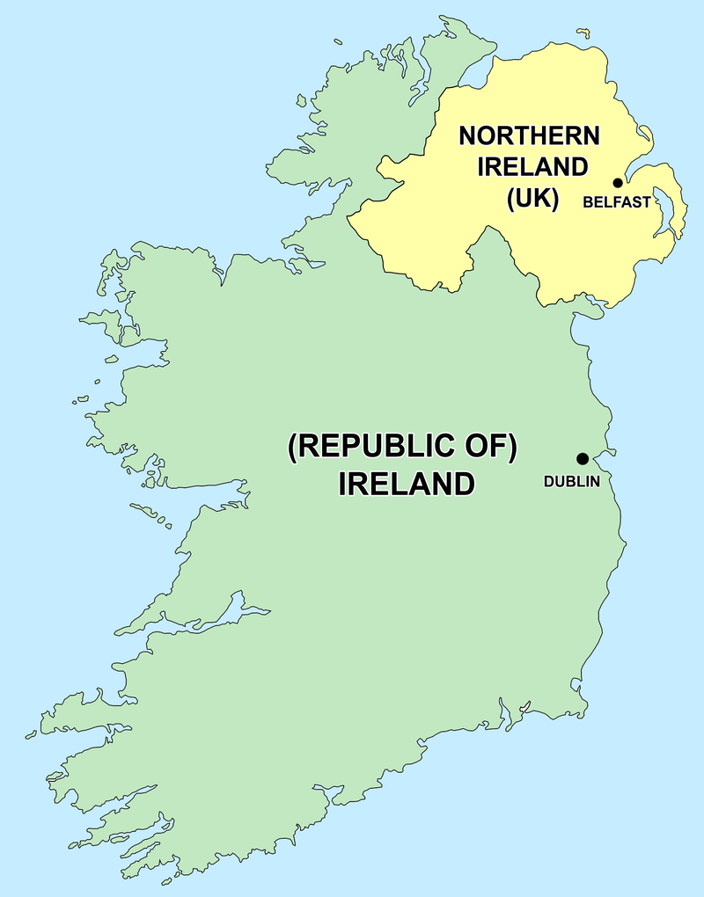
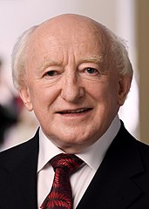
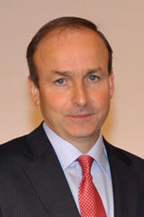
IRELAND
The island is divided between the Republic of Ireland, an independent state, and Northern Ireland (a constituent country of the United Kingdom). They share an open border and both are part of the Common Travel Area.
The Republic of Ireland is a parliamentary democracy based on the British model, with a written constitution and an elected president who has mainly ceremonial powers. The government is headed by Prime Minister Taoiseach.
PRESIDENT Michael D. Higgins
TAOISEACH Micheál Martin

Slide 10
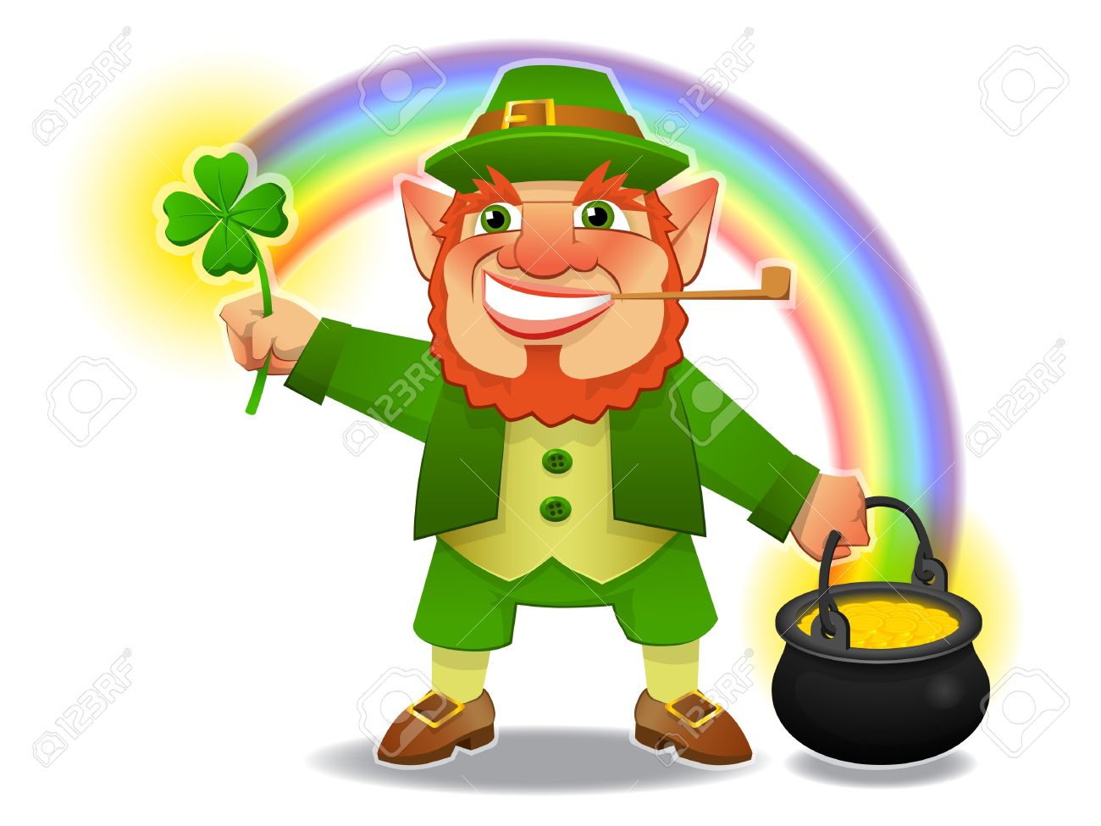
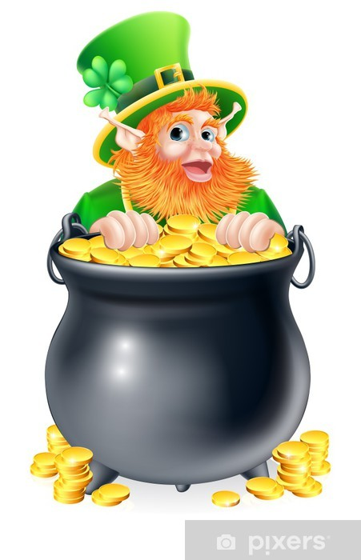
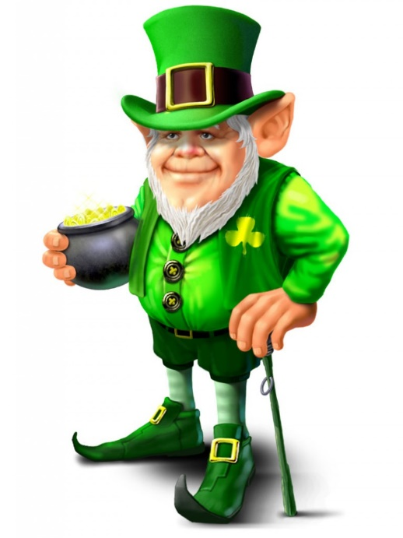
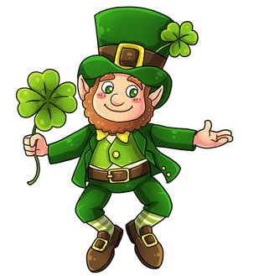
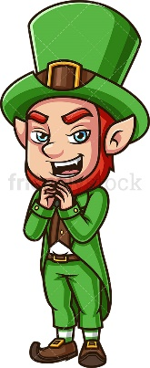
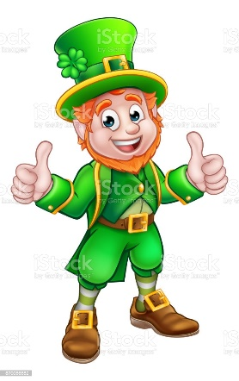
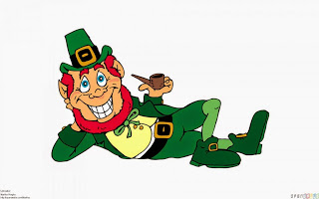
IRELAND
A leprechaun is a diminutive supernatural being in Irish folklore, classed by some as a type of solitary fairy. They are usually depicted as little bearded men, wearing a coat and hat, who partake in mischief. In later times, they have been depicted as shoe-makers who have a hidden pot of gold at the end of the rainbow.

Slide 11
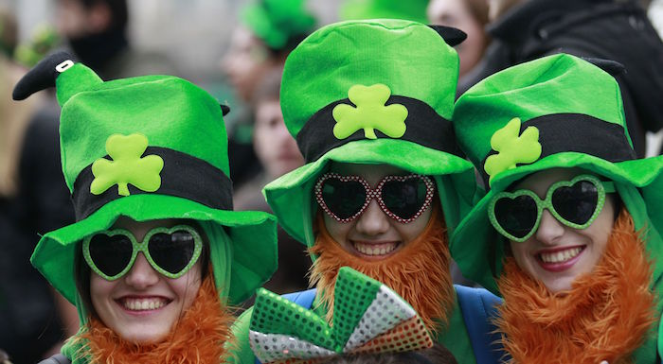
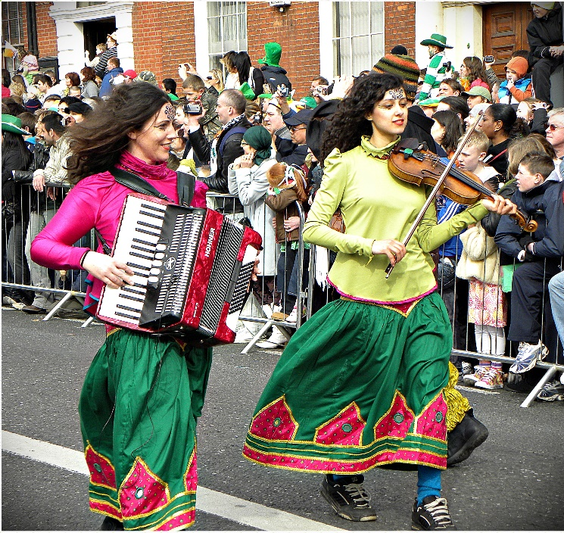
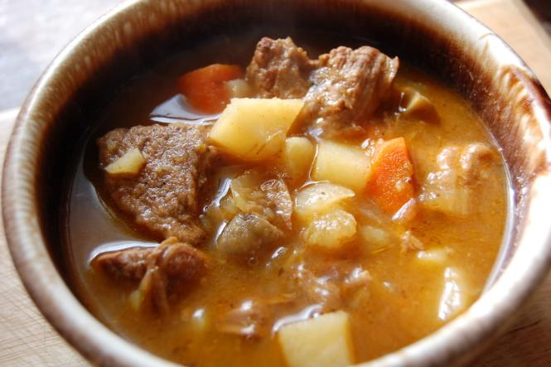
IRELAND
Irish people are very hospitable and helpful people. They most often spend their free time in pubs, where they play bingo, chess or simply sing with their friends. If a pub, then beer, which is one of the favorite beverages of the inhabitants of this country. Folk music plays an important role in the culture of Ireland
A traditional Irish dish is lamb stew with potatoes, carrots and onions.

Slide 12
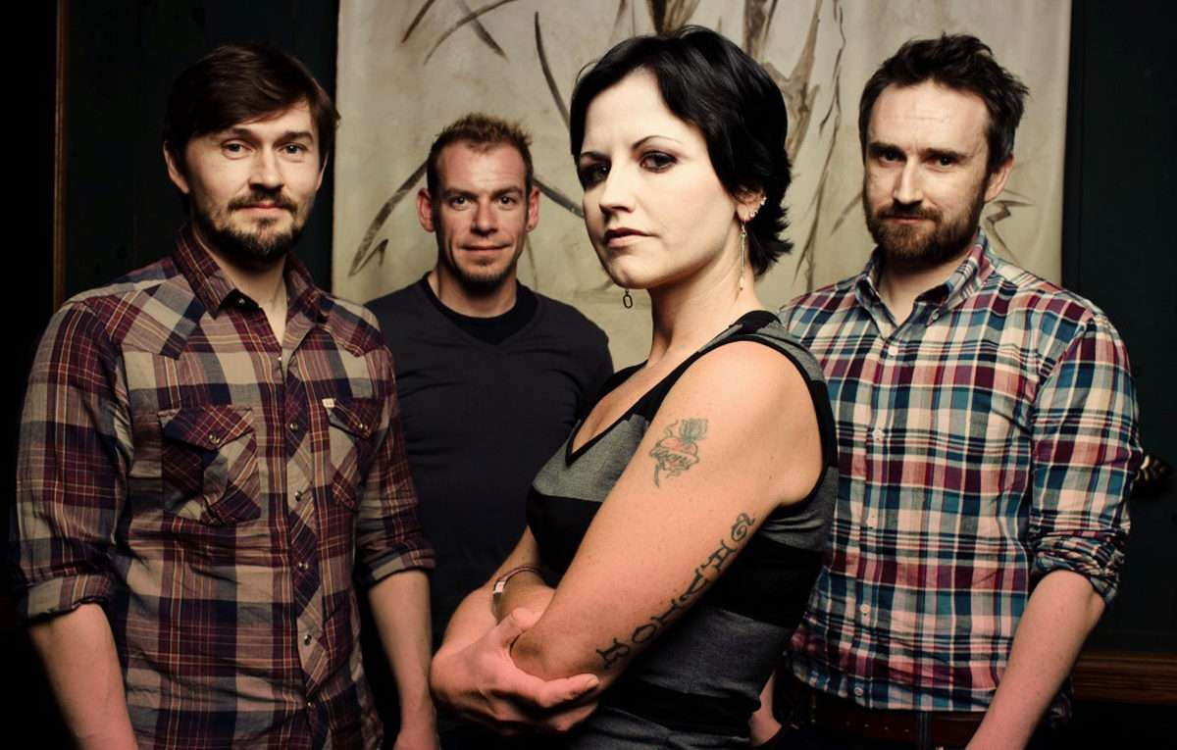
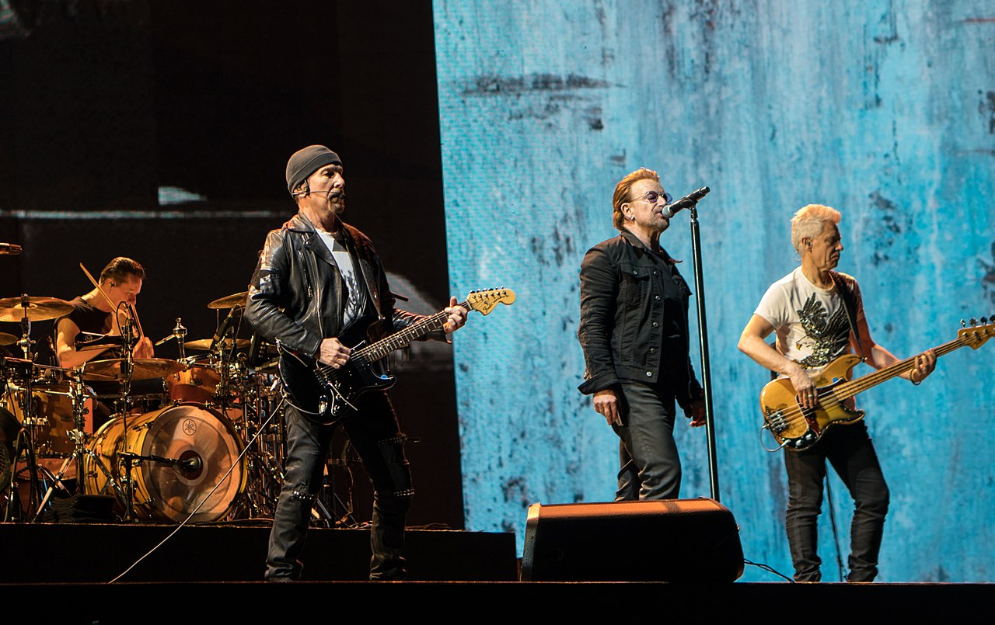
IRELAND - famous people
The Cranberries - Irish rock band
U2 - Irish rock band

Slide 13
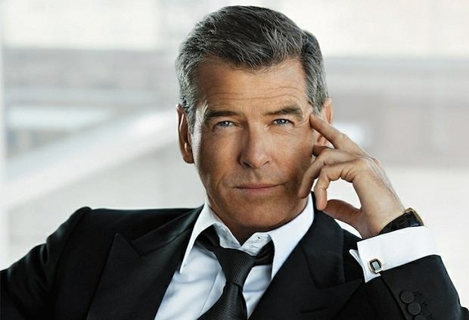
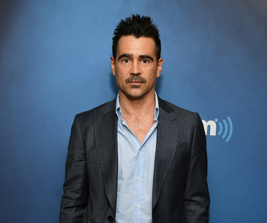
IRELAND - famous people
Pierce Brosnan - Film actor
Colin Farrell - Film actor

Slide 14
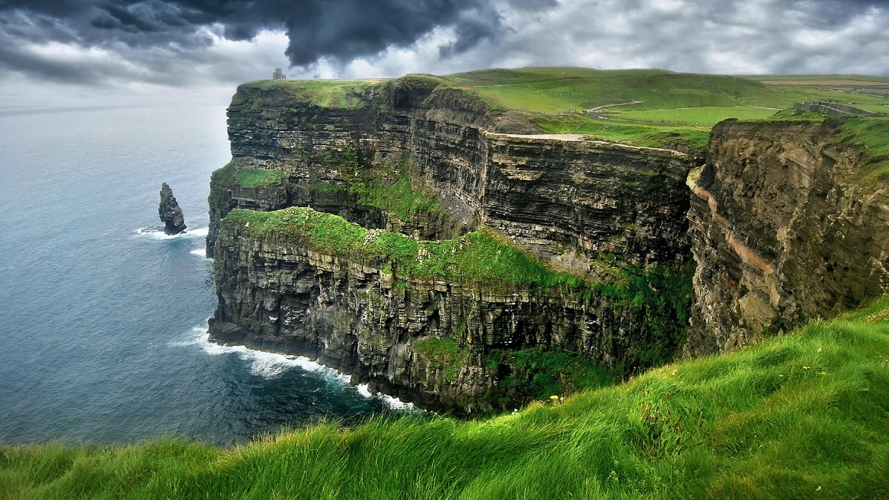
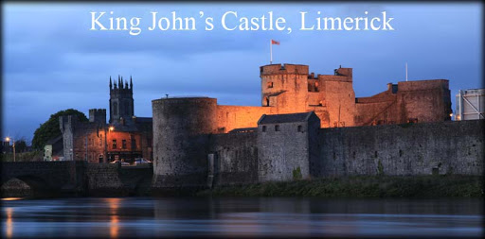
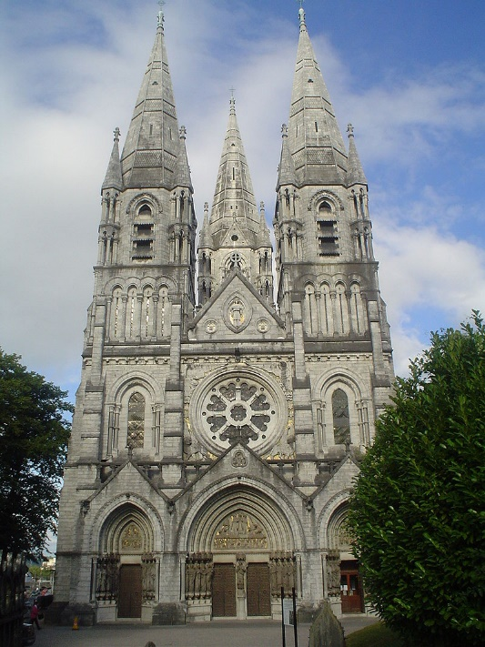
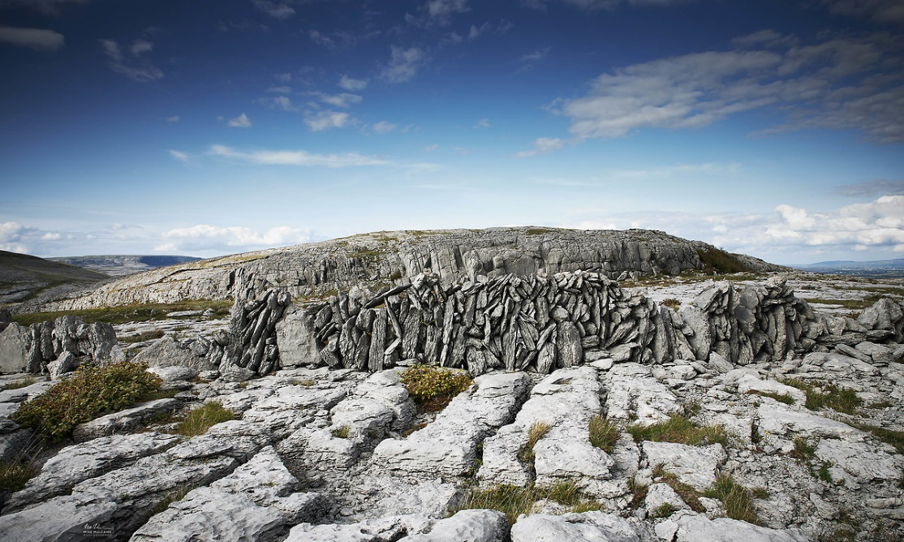
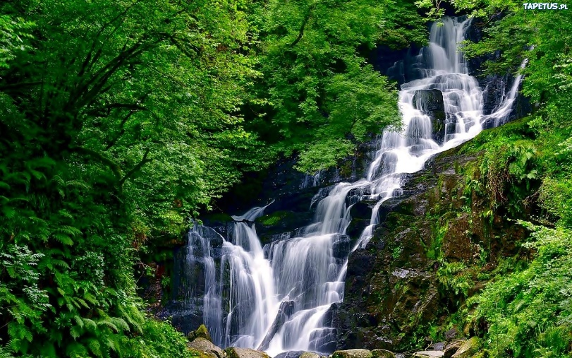
IRELAND
Ireland interesting places
Cliffs of Moher
St. Findbar in Cork
Killarney National Park
The Burren – lunar landscape

Slide 15
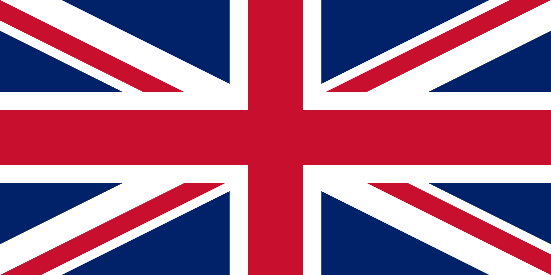
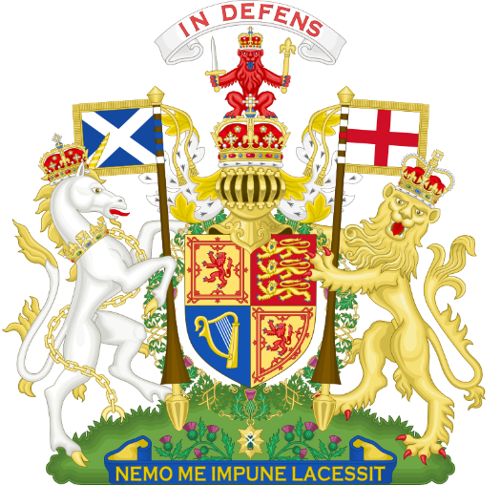
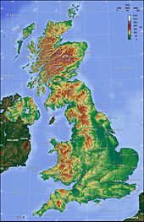
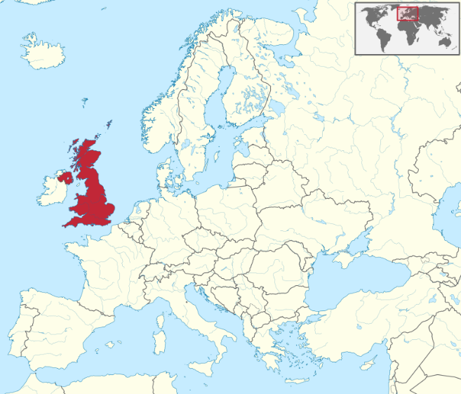
United Kingdom of Great Britain and Northern Ireland
Flag
The total area of the United Kingdom is approximately 244,820 square kilometres (94,530 sq mi).
The country occupies the major part of the British Isles[151] archipelago and includes the island of Great Britain, the north-eastern one-sixth of the island of Ireland and some smaller surrounding islands.
Arms
It lies between the North Atlantic Ocean and the North Sea with the southeast coast coming within 22 miles (35 km) of the coast of northern France, from which it is separated by the English Channel.
In 1993 10 per cent of the UK was forested, 46 per cent used for pastures and 25 per cent cultivated for agriculture.

Slide 16
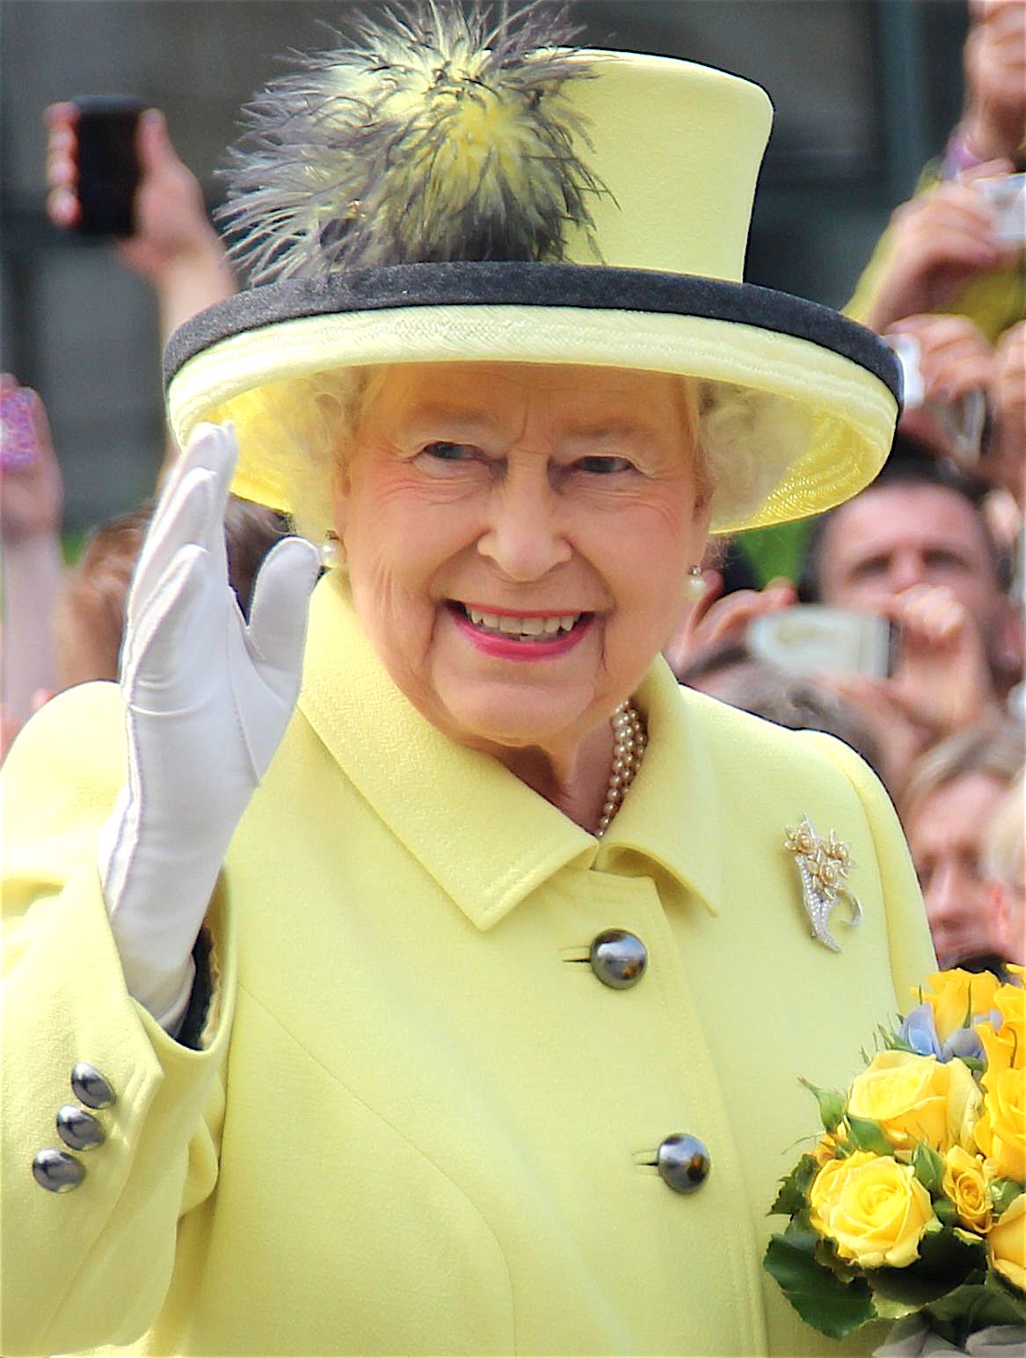
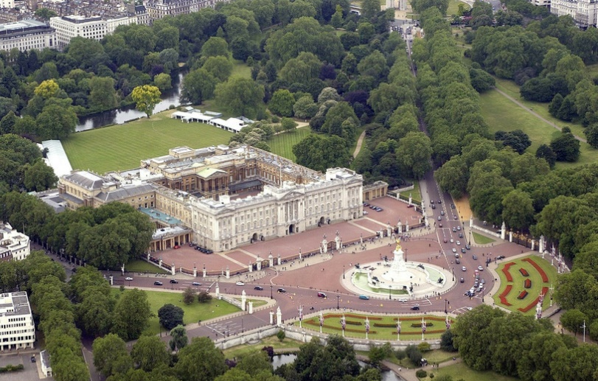
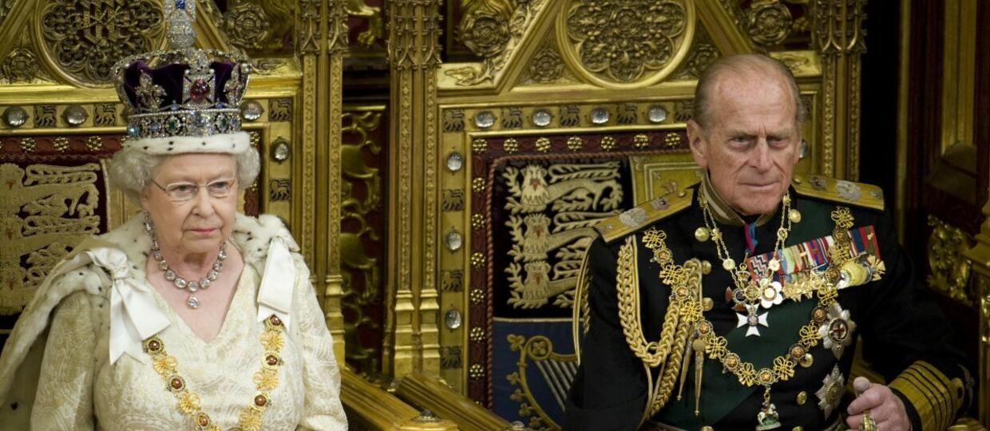
System polical United Kingdom Great Britain and Nothern Ireland
Official London residence British monarchs is palace Buckingham
Head countries is person with families royal chosen in accordance with line succession
Queen Elizabeth II is currently the head of state
Elizabeth II is not only Queen United Kongdom ,but also ports countries falling in composition British Commonwealth.
Elzabeth’s II husband was Filip, Prince Edynburga, who died on 9 April 2021 r.

Slide 17
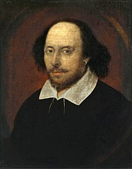
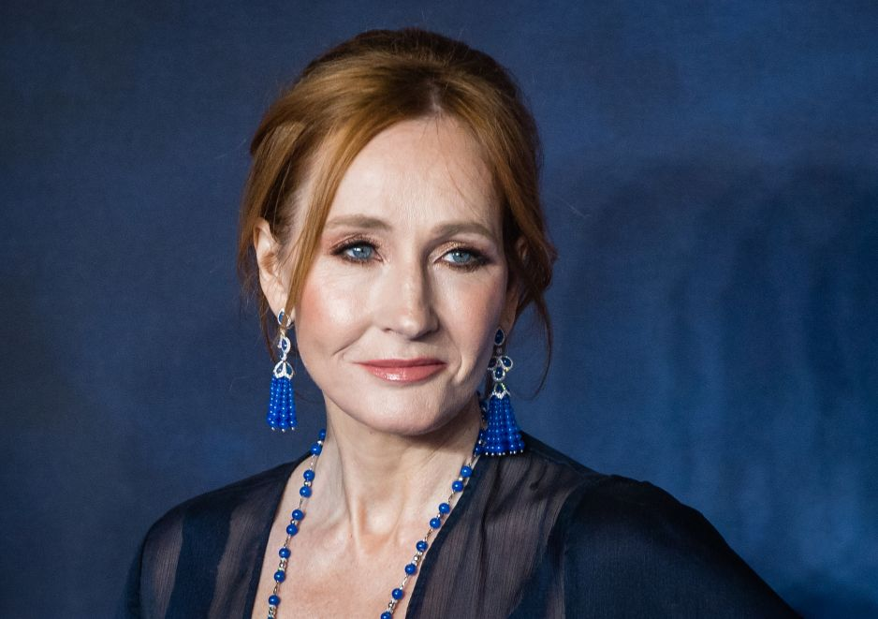
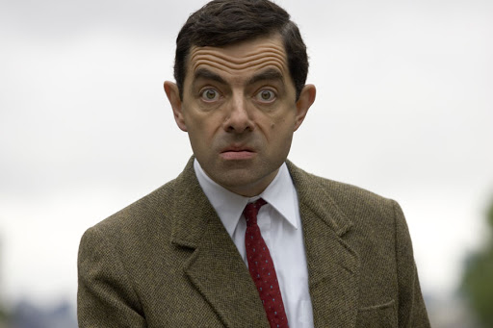
United Kingdom Great Britain and Nothern Ireland - famous people
J.K. Rowling - screenwriter, film and television producer, philanthropist, wrote the adventures of Harry Potter
William Shakespeare - poet, playwright, actor
Rowan Atkinson - actor, comedian and screenwriter, he played the role of Mr. Bean.

Slide 18
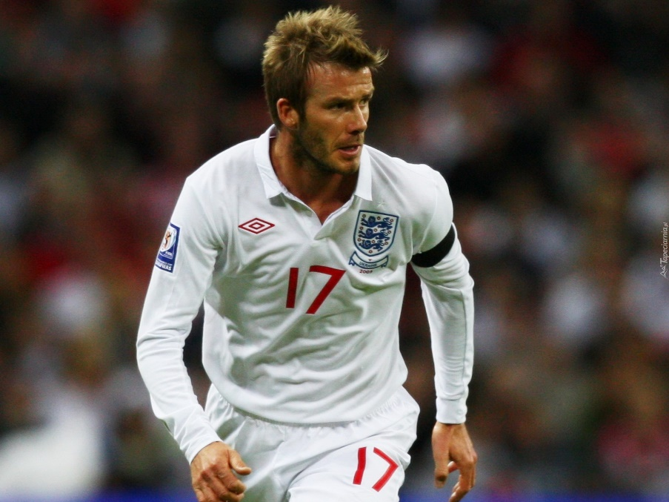
United Kingdom Great Britain and Nothern Ireland - famous people
Hugh Grant – actor
David Beckham - footballer
Elton John - singer, composer, pianist

Slide 19
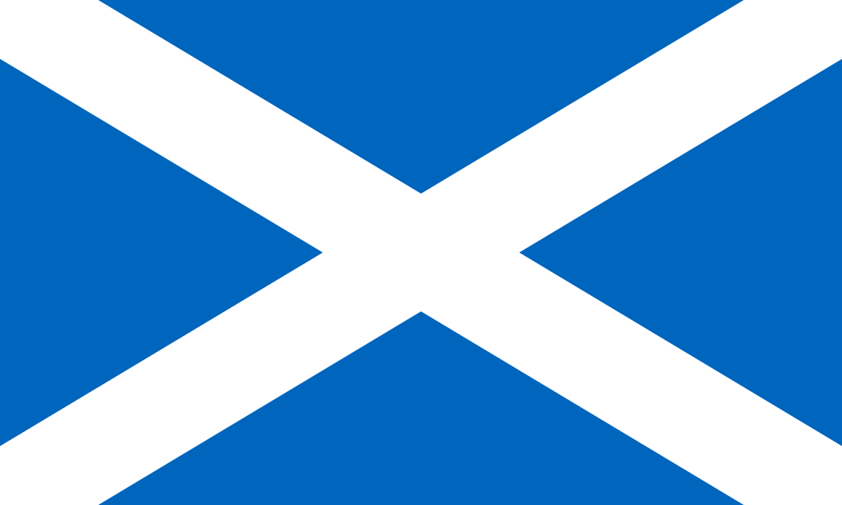
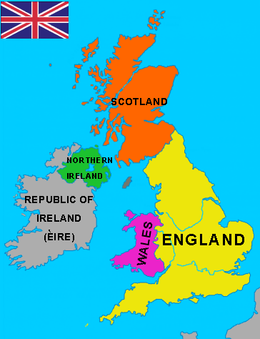
United Kingdom of Great Britain and Northern Ireland
IN COMPOSITION GREAT BRITAIN PASSES OUT :
LAYED ON ISLAND GREAT BRITAIN
ENGLAND
WALES
SCOTLAND
LOCATED IN NORTH PARTS IRELAND
NORTHERN IRELAND
Flag used from 1924 from 1953 unofficial flag gorernment Ireland North

Slide 20
ENGLAND – General information
Arms
Flag
In compoosition England enters also more than 100 smaller islets how e.g Isles of Scilly whether Isle of Wight.
Surface it take 2/3 total Great Britain
Capital : London
Official language : English
Anthem : God Save the Queen (Boże chroń królową)
Patron: St.George – Holiday is celebrated 23 april
Symbol is rose
Surface it takes 2/3 total islands Great Britain
England lives 83 % residents islands
England from west bordering with Wales , and from midnight that Scotland
Country this drenched is through Sea Northerm , Sea Irish , The Atlantic Ocean and channel La Manche

Slide 21
ENGLAND – general information
England divided is on 9 regions , which are the highest unit , local gorernment territorial. Each witch regions is divided on counties
REGIONS

Slide 22
England
Saint George
St. George - Great Orthodox martyr, saint of the Catholic Church, one of the fourteen holy helpers.
The traditional legend of Saint George tells of his encounter with the dragon.
A newer version according to the Christian legend of St. George was a Roman officer from Cappadocia who was martyred for his faith in Diospolis, Palestine.
George’s Day is celebrated on Aprill 23
George's Day is primarily associated with parades and cultural events.
During parades, white flags with a red cross are flown

Slide 23
ENGLAND – Red Rose
The national flower of England is the rose. This flower has become a symbol of England since the Wars of the Roses - civil wars (1455-1485) between the kingdom in Lancester (whose emblem was a red rose) and the kingdom in York (whose emblem was a white rose).

Slide 24
London- monunents, attractions
London, the capital and most city in England and Great Britain. Considered by many to be the cultural and entertainment center of Europe.
Situated above river Thames.
London Underground is the oldest on world beacuse first section opened in 1868 r.
Red Double Decker buses and Black Taxi Cabs.
London Underground

Slide 25
London – monunents , attractions
Red Telephone Box and Post Box - Both the mailbox and the telephone box have a picture of the crown on them. The crown on the mailbox also has the monarchs' initials.

Slide 26
London- monunents, attractions
London Eye That is, the London Eye, is a ferris wheel attraction, being an observation wheel.
Viev z Eye

Slide 27
London- monunents, attractions
Big Ben is the name given to the Great Bell of the clock in the Elizabeth Tower, Which is Located in Westminiter, London

Slide 28
London– monunents attractions
Tower Bridge
Is the work XIX-century London architects and bulider.
The most famous London bridge, which is the only one of the five to have a drawbridge.
Royal Guards
A special military formation guarding Buckingham Palace.
The royal guards dressed in red uniforms and tall fur.

Slide 29
ENGLAND – popular food
English fish dishes and chips
Black pudding - sausage, made of offal and blood
Apple pie
Gingerbread man - spice cookies

Slide 30
SCOTLAND- general information
Flag
Arms
Scotland it takes the Surface 78,8 tyś. km² and has about 6 mln residents
Landscape in overwhelming parts highlands and mountain
Covers northern portion islands Great Britain Hebrides, Orkney and Shetland
Capital : Edynburg
Biggest city Glasgow.
Language : English , scotch , greek, west germanic
Antherm : „Flower of Scotland”
Patron: Holy Andrew – holiday celebrated 30 november
Symbol: thistle
Callanish Stone Circles on Lewis

Slide 31
SCOTLAND – thistle, blubells
The national flower of Scotland is thistle, a purple flower with spiky leaves that hasbeen used as a symbol of defense. Scottish blue bells are also shown as the flower of Scotland.

Slide 32
SCOTLAND – Saint Andrew
The apostle Andrew was condemned to martyrdom for preaching the Gospel.
It was stretched on an X-shaped cross. The cross was later called St. Andrew's Cross.
St. Andrew was killed on the cross on November 30, 60 CE. that is why this day falls on the celebration of the patron saint.
On this day, the Scots hold all sorts of traditional religious and state celebrations. Most cities have concerts and dance parties where bagpipe bands take to the streets and wear the traditional Scottish tartan kilt.
St.Andrew was a fisherman , sothe traditional dishes serred on scottish tables and in restarans that day are fish dishes

Slide 33
SCOTLAND-regional culture
Scotland is the greatest administrative separateness, it has its own parliament, education and judiciary, as well as traditional folklore
A special feature of Scottish society is the clan system, distinguished by its distinctiveness:
costumes, including famous ones KILTS ,
piper competitions,
skill games, including throwing pine trunks,
CEILIDH social meetings, rich in music and folk dance.

Slide 34
SCOTLAND–regional culture
Auld Lang Syne
A popular Scottish folk song , to which he wrote the next in 1788 Robert Burns. It is traditionally song during the Hogmany (Scottish equiralent of Sylwestra ) and during the New Year’s Eve in Angle Saxon counties.
It is one of the most popular any most frequently performed songs in the world .

Slide 35
SCOTLAND – popular food
Haggis - finely chopped sheep offal mixed with fat, oats and a handful of secret spices
Neeps and tatties - sweet swede and potatoes. Addition to haggis
Sticky toffee pudding - date cake served warm with toffee sauce and a scoop of vanilla ice cream

Slide 36
SCOTLAND– interesting places
The Fairy Pools, Isle of Skye
At foot of the Black Cuillins near Glenbrittle are the Fairy Pools, beautifully crystal clear blue pools on the River Brittle.

Slide 37
SCOTLAND –interesting places
GREAT MOOR OF RANNOCH
One of the last remaining wildernesses in Europe, the Great Moor of Rannoch is a beautiful outdoor space stretching far north and west from Rannoch Station.
The area is a vast stretch of land composed of blanket bog, lochans, rivers, and rocky outcrops which makes it a very challenging environment which still supports varieties of flora and fauna. A wealth of plants, insect, bird and animal life can be seen here ranging from curlews and grouse to roe and red deer.

Slide 38
SCOTLAND –interesting places
GLENFINNAN VIADUCT
Glenfinnan Viaduct landscape. The unique scenery of the Scottish highlands here became the reason why Glenfinnan was selected for the location of several films. Wizards young and old can associate him with three parts of the Harry Potter series: the Chamber of Secrets, the prisoner of Azkaban and the Goblet of Fire.

Slide 39
SCOTLAND- interesing places
Old mAN of storr
Old Man of Storr is the flagship of the Isle of Skye. The volcanic rock in the shape of a huge club can be seen from anywhere in the northern part of the island. The beauty of The Old Man of Storr has not escaped the attention of Hollywood filmmakers. In January 2012, scenes for the science-fiction movie Prometheus were filmed here .

Slide 40
SCOTLAND– interesting places
WIR CORRYVRECKAN
Corryvreckan vortex is a natural and constant whirlpool and the third largest such whirlpool in the world. It is located on the west coast of Scotland, in the strait between the Jura and Scarba islands.

Slide 41
SCOTLAND– interesting places
DUNROBIN CASTLE
The fairy-tale Dunrobin Castle, surrounded by beautiful gardens, is the seat of the Dukes and Counts of Sutherland. This 14th-century residence is designed to resemble French chateaux on the Loire, which makes it significantly different from other Scottish monuments.

Slide 42
SCOTLAND – interesting places
National Park Cairngorms
Cairngorms is the largest national park in Great Britain, covering 4,528 km². It is located in the Cairngorms mountains in the Highlands of Northern Scotland and was created by the Scottish Parliament in 2003. The park has rocky moorland and mountain half-water terrain. Four of Britain's five highest peaks are also here.

Slide 43
WALES – general informations
Flag
Anthem: Hen Wlad Fy Nhadau
Patron: Saint David of Menevia
Capital: Cardiff
Language: Eanglish, Welsh
Badge: leak and daffodol
It is situated on the Irish Sea, in the south-here part of the island of Great Britain.
This land is dominated by mountainous areas. The main mountain range - Cambrian Mountains.
Wales has an area of ​​20 779 km². It is inhabited by over 3 million people.
Arms
CARDIFF

Slide 44
WALES – Saint David
Saint David (David of Menevii) has been the patron saint of Wales since the 12th century. He is a monk (and later also the bishop of Menevia) who contributed to the establishment of several monasteries.
According to traditions and legends that have survived to our times, he was to have the gift of healing (he restored his teacher's eyesight), and various miracles were also to happen around him.
Saint David died on March 1
Saint David's Day is celebrated on March 1. There are concerts and parades in many cities, some lessons are canceled at schools. People carry the flags of St. David, their clothes are decorated with daffodils and pores.
Traditional dishes are prepared, leek soup, vegetable and meat stew, bread with raisins.

Slide 45
WALES –leak and daffodil
The national flower of Wales is the daffodil.
Leek is considered a traditional symbol of Wales
Daffodils are flowers that bloom in March to remind us of the death of St. David. In turn, leek is a vegetable that was to help the Welsh defeat the Anglo-Saxons - Saint David, patron of Wales, advised them to attach a leek to their helmets. This was to help them on the battlefield distinguish comrades from enemies.

Slide 46
WALES – regional culture
Slightly less characteristic than Scottish culture, but equally different is the culture of Wales. It is particularly characterized by the maintenance of the pure Welsh language, which is compulsory in schools. Wales is characterized by specific castles and a festival of regional song and dance.

Slide 47
WALES – popular food
Laverbread - is a food product, made from the edible seaweed (littoral alga) consumed mainly in Wales as part of local traditional cuisine
Cawl cennin - leek soup is a soup made of traditional potatoes, comparisons, broth and cream
Bara brith - is a traditional Welsh tea bread flavoured with tea, dried fruits and spices
Welsh cakes - Cookies have been popular since the end of the 19th century, adding fat, sugar and dried fruit to a longer-standing recipe for pan-baked flat bread

Slide 48
WALES – interesing places
St. Davids Cathedral
St Davids Cathedral is situated in St Davids in the county of Pembrokeshire, near the most westerly point of Wales.

Slide 49
WALES – interesing places
TENBY
Tenby is a colorful and postcard city in Wales. This is where the fishermen's houses have pastel colors. It is located on the west coast of Carmarthen Bay as well as in the Pembrokeshire Coast National Park.

Slide 50
WALES – interesing places
NATIONALS PARKS
BRECON BEACONS
PEMBROKESHIRE COAST NATIONA PARK
SNOWDONIA

Slide 51
WALES – interesing places
Castle Harlech
The building belongs to the complex of castles and town fortifications in Gwynedd, which in 1986 were inscribed on the UNESCO World Heritage List.

Slide 52
WALES – interesing places
Castell Caernarfon
The building belongs to the complex of castles and town fortifications in Gwynedd, which in 1986 were inscribed on the UNESCO World Heritage List.

Slide 53
NORTHERN IRELAND – general informations
Language: English, Irish, West Germanic
Hymn: Amhrán na bhFiann (Song of the soldiers). The words were written in 1907 by Peadar Kearney, who together with Patrik Heeney composed the music. The anthem is a march, it alludes to independence struggles.
Patron: St. Patrick whose holiday is celebrated March - 17th March
Green color
Symbol: white clover (shamrock)
Northern Ireland is situated on the northeastern tip of the island of Ireland and covers an area of ​​14,139 km², which is approximately one-sixth of the island.
Capital: Belfast
For many years, Northern Ireland has been divided over whether it should remain part of the United Kingdom or become part of Ireland
BELFAST

Slide 54
NORTHERN IRELAND – St. Patrick and the Four-Leaf Clover (shamrock)
The national flower of Northern Ireland is clover. According to the legend of St. Patrick, he used this plant to explain to the first Irish Christians the dogma of the Holy Trinity. They could not understand how it is possible that there are Three Divine Persons and at the same time they are one God.

Slide 55
NORTHERN IRELAND – Saint Patrick
Saint Patrick - bishop and apostle of Ireland, saint of the Catholic, Old Catholic, Anglican and Orthodox Church, missionary and organizer of religious life in Ireland.
St. Patrick's Day
is celebrated on March 17.
St. Patrick's Day is a day off from work in Ireland
Events, festivals and parades are organized in many cities.
The most important tradition associated with St. Patrick's Day is wearing green clothes.

Slide 56
NORTHERN IRELAND – popular food
Pasty
is a large to medium-sized battered round of minced meat and vegetables common to Northern Ireland. Generally served with chips.
Ulster fry
their regional breakfast
Stew
traditional Irish stews include mutton or veal as well as potatoes, carrots, onions and parsley.

Slide 57
NORTHERN IRELAND – interesing places
Giant's Causeway
Northern Ireland, despite the multitude of beautiful and impressive places created by nature, has only one site on the UNESCO World Cultural and Natural Heritage List, the famous Giant's Causeway
This amazing rock formation is a revision of nearly 40,000 basalt columns

Slide 58
NORTHERN IRELAND – interesing places
Mussenden Temple
The Temple of Mussenden is a small circular building located on the very edge of the cliff.

Slide 59
NORTHERN IRELAND – interesing places
Carrick-a-Rede Rope Bridge
Carrick-a-Rede Rope Bridge is a rope bridge near Ballintoy in County Antrim, Northern Ireland

Slide 60
NORTHERN IRELAND – general informations
White Rocks Beach
Beautiful White Rocks Beach is located on the Causeway Coastal Route in County Antrim. Its beautiful limestone cliffs stretch from Curran Strand to Dunluce Castle and contrast beautifully with the blue and clear water.

Slide 61
NORTHERN IRELAND – general informations
The Dark Hedges
The avenue of beech trees was planted in the 18th century by the Stuart family who wanted to create a magnificent landscape that would impress their visitors.
Dark Hedges - the darkest road in Ireland.

Slide 62
Bibliography
https://pl.wikipedia.org/wiki/Wielka_Brytania
https://pl.wikipedia.org/wiki/Irlandia
https://pl.wikipedia.org/wiki/Anglia
https://pl.wikipedia.org/wiki/Szkocja
https://pl.wikipedia.org/wiki/Walia
https://pl.wikipedia.org/wiki/Irlandia_P%C3%B3%C5%82nocna
https://zwiedzamy.co.uk/15-najpiekniejszych-zakatkow-irlandii-polnocnej-ktore-trzeba-zobaczyc/
https://pl.tripadvisor.com/Attractions-g186425-Activities-c47-Wales.html
https://www.podrozepoeuropie.pl/londyn-zwiedzanie/
https://idziemydalej.pl/szkockie-potrawy-ktorych-musisz-sprobowac/
https://pol.worldtourismgroup.com/10-foods-you-have-try-wales-36400
https://pl.wikipedia.org/wiki/Kuchnia_irlandzka

Slide 63
Thank you for your attention

