Slide 1
Uczeń: Patricija Stech VIIIB,
Nauczycielka: Małgorzata Matyszek,
Adres: Zespół Szkół w Staninie,
Stanin 149.

Slide 2
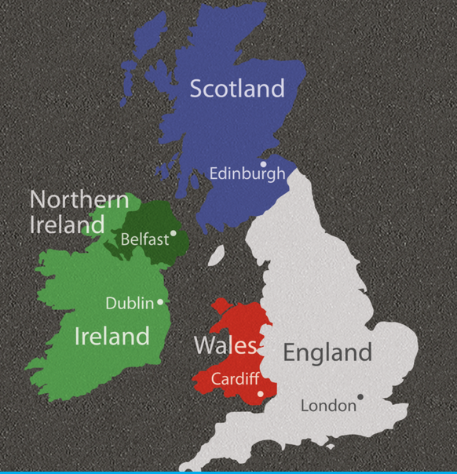
THE BRITISH-ISLES

Slide 3
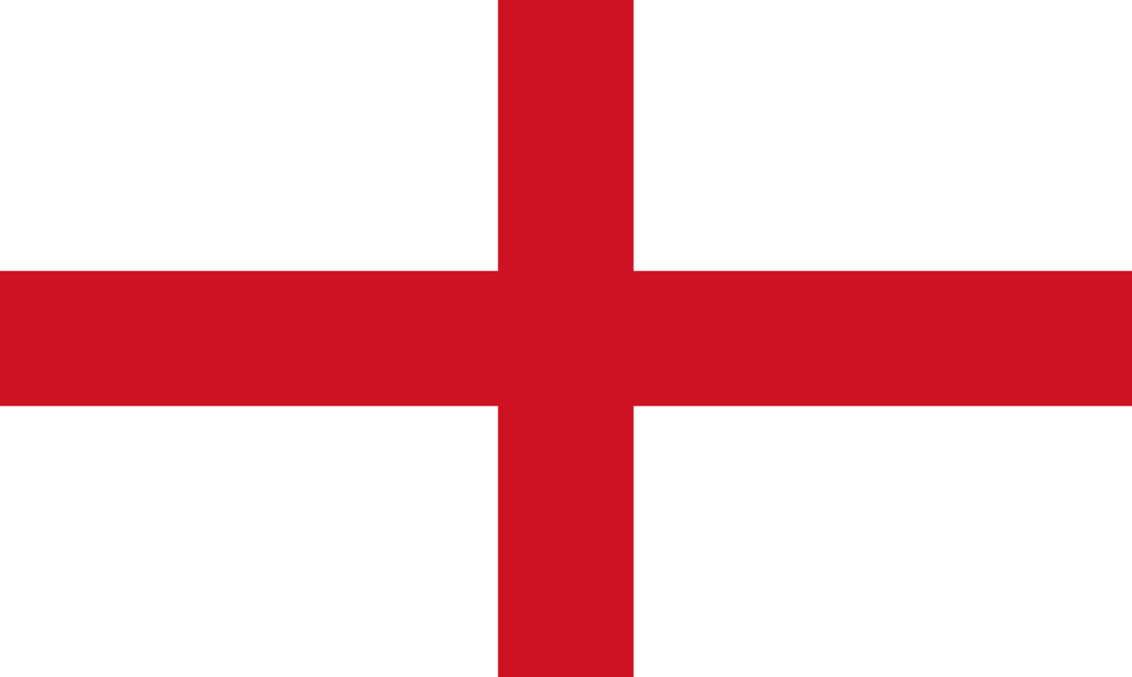
England
Area: 50,334 sq mi,
Population: 68,169,978 (2021),
Capital: London,
National Bird: Robin,
National Flower: Red Rose,
National Tree: Oak,
National Animal: Lion
National Day: 23rd April
Currency: Pound Sterling
Official Language: English
The flag represents the emblem of St. George.
England is the largest country in Great Britain and the UK. Nearly 84% of the population of the UK lives in England.

Slide 4
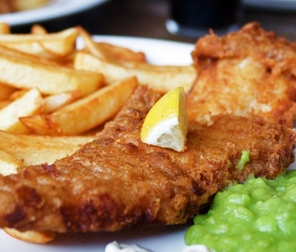
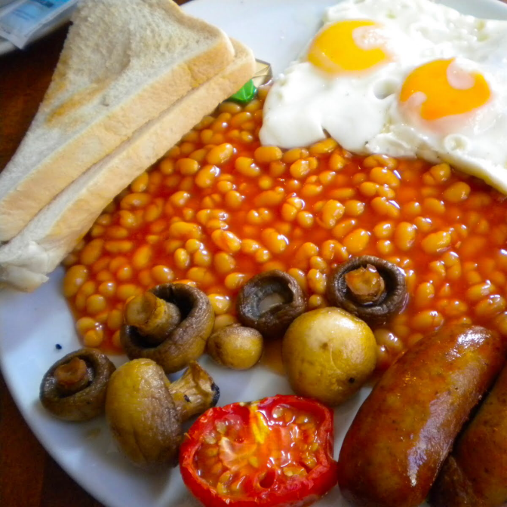
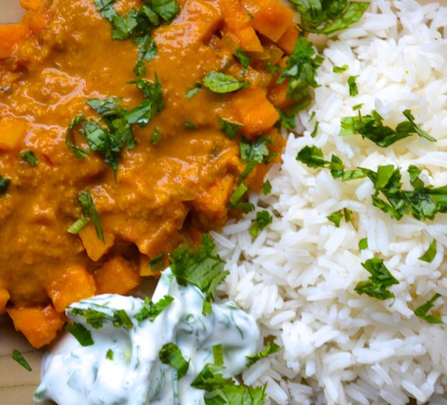
What is England known for?
England is known for its food!
The most common and typical foods are: sandwiches, fish and chips, pies like the Cornish pastry, trifle and roasts dinner. The Traditional English Breakfast consists of: eggs, bacon, sausages, fried bread, baked beans and mushrooms. For lunch they really like to eat sandwiches with prawns and mayonnaise or tuna and mayonnaise. For dinner many people like to eat fish and chips or curry. The most popular desert is the Black Pudding. Everyday they drink 165 million cups of tea!

Slide 5
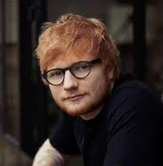
Known for music!
England is more famous for pop music than it is for classical composers or jazz musicians. Most teenagers listen to punk, garage, house, rock, pop and R&B. The most popular artists are: Tom Walker, Mabel, 24kGoldn, Ed Sheeran, Adele and many more. A popular Christmas song is “Last Christmas” by Wham!

Slide 6
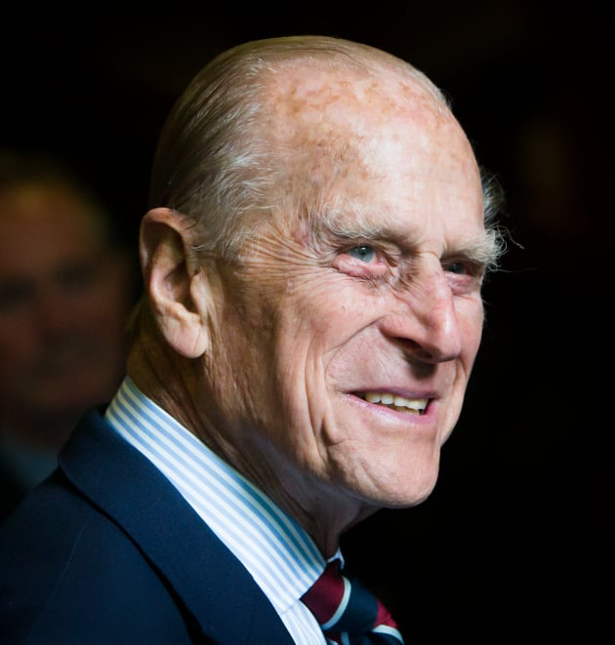
Known for its Royal Family!
The British Royal Family have belonged to the House of Windsor since 1917 and Queen Elizabeth II has ruled Head of State since 1953, amassing a huge 65 years! Prince Charles is the heir apparent and will eventually succeed the Queen. Sadly, on the 9th of April 2021 Prince Philip, Queen Elizabeth II’s husband died aged 99.

Slide 7
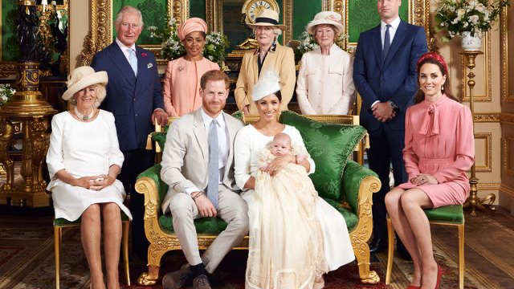
The Royal Family

Slide 8
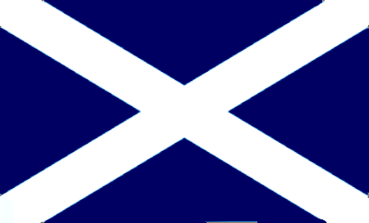
Scotland
Area: 78,789 sq km,
Population: 5,463,300 (2019),
Capital: Edinburgh,
National Bird: Golden Eagle,
National Flower: Thistle
National Tree: Scots Pine,
National Animal: Unicorn,
National Day: 30th November,
Currency: Pound Sterling,
Official Language: English (Scottish Gaelic is my spoken by 1.4% of the population).
The flag represents Saint Andrew, who was crucified and according to the folklore, he felt unworthy of being crucified on a cross as Jesus was. Instead he chose the white saltire, a diagonal cross.

Slide 9
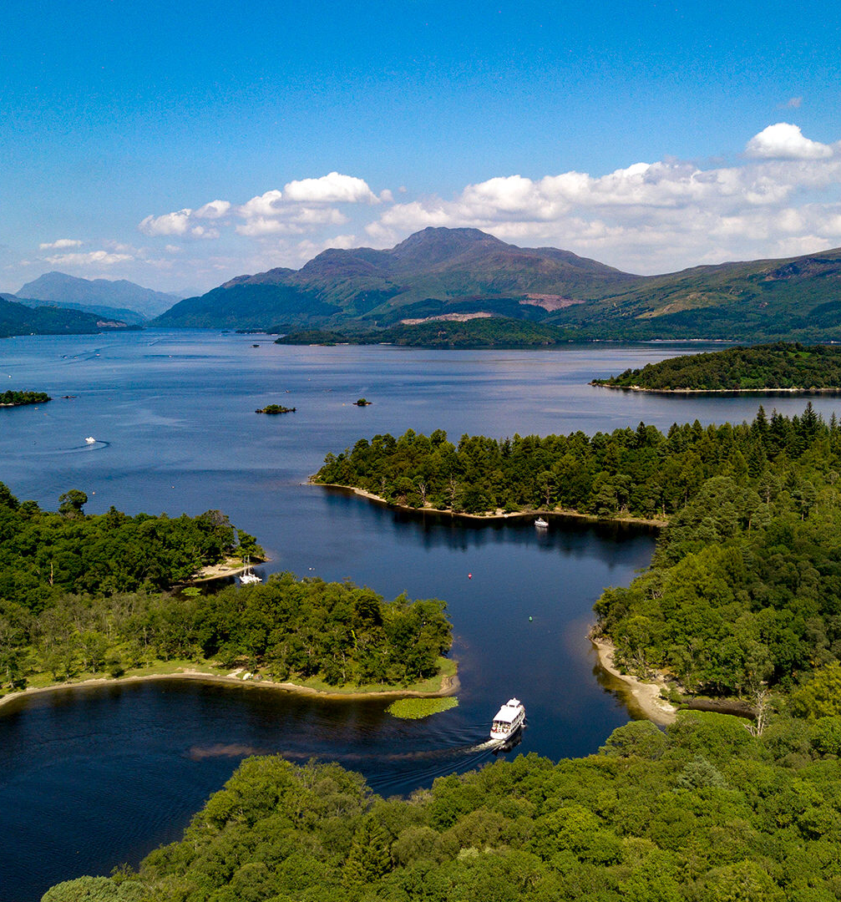
What is Scotland known for?
Scotland is famous for its fresh water lochs (lakes)!
There are over 600 square miles of them. One of the most famous is Loch Ness, where a mysterious monster is said to lurk in the depths of the water. Loch Lomond is the largest loch and it is surrounded by highland areas and oak woodlands.

Slide 10
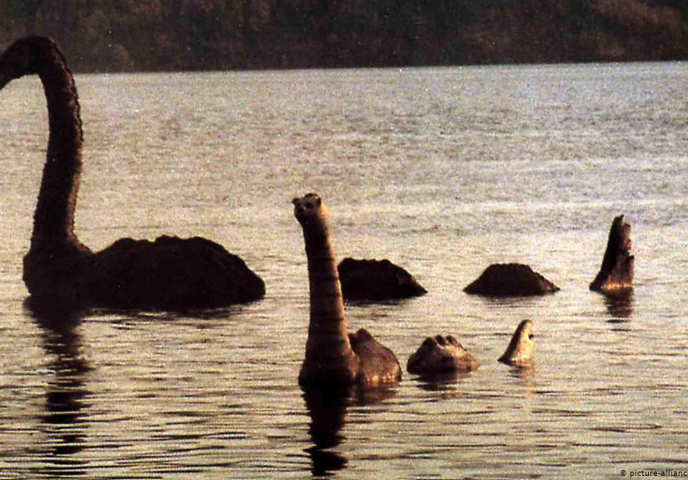
Loch Ness and the mysterious creatures...

Slide 11
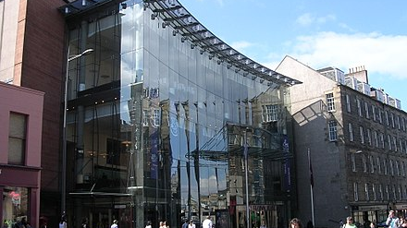
Known for the Festival Theatre!
The Edinburgh Festival Theatre is a performing arts venue located on Nicolson Street. It is used primarily for performances of opera and ballet, large-scale musical events and touring groups. After it’s most recent renovation in 1994, it seats 1,915 people. In October 1928 a first musical was performed called “Show Boat.” During the first Festival in 1947, Margot Fonteyn danced in “The Sleeping Beauty”.

Slide 12
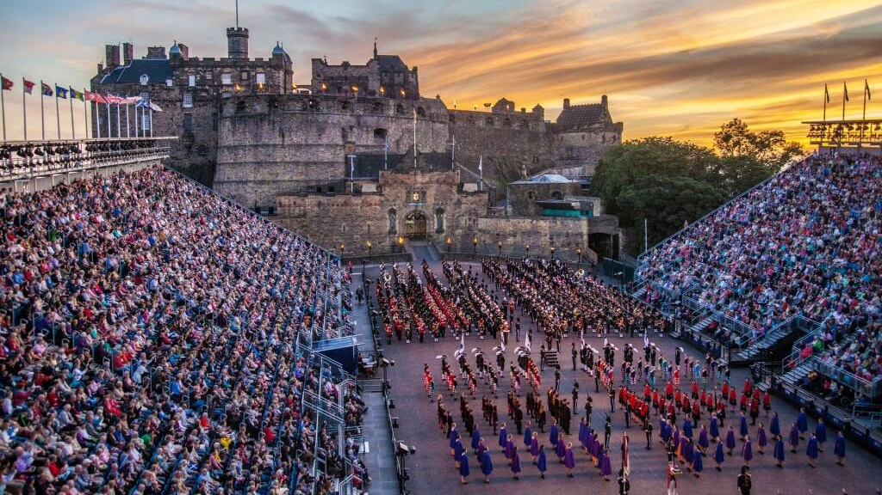
Known for The Royal Edinburgh Military Tattoo!
Scotland’s most iconic performance takes place in the Edinburgh Castle. They put on an incredible musical and artistic display to a rapt audience every summer. The festival is held in August, playing weekday evenings and two shows on Saturday nights. “Tattoo” meant to signify the last duty call of the day and a nod to the evening entertainment about to begin by musicians in the military. The amazing castle venue allows over 200,000 people to enjoy the music of Massed Pipes and Drums.

Slide 13
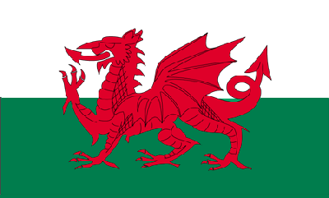
Wales
Area: 20,779 sq miles,
Population: 3,15 million (2019),
Capital: Cardiff,
National Bird: Red Kite,
National Flower: Daffodil,
National Tree: Sessile Oak,
National Animal: Dragon,
National Day: 1st March,
Currency: Pound Sterling,
Official Language: English and Welsh,
It is considered that the Welsh kings of Aberffraw first adopted the dragon in the early fifth century in order to symbolise their power and authority after the Romans withdrew from Britain. Later, around the seventh century, it became known as the Red Dragon of Calwaladr, king of Gwynedd from 655 to 682.

Slide 14
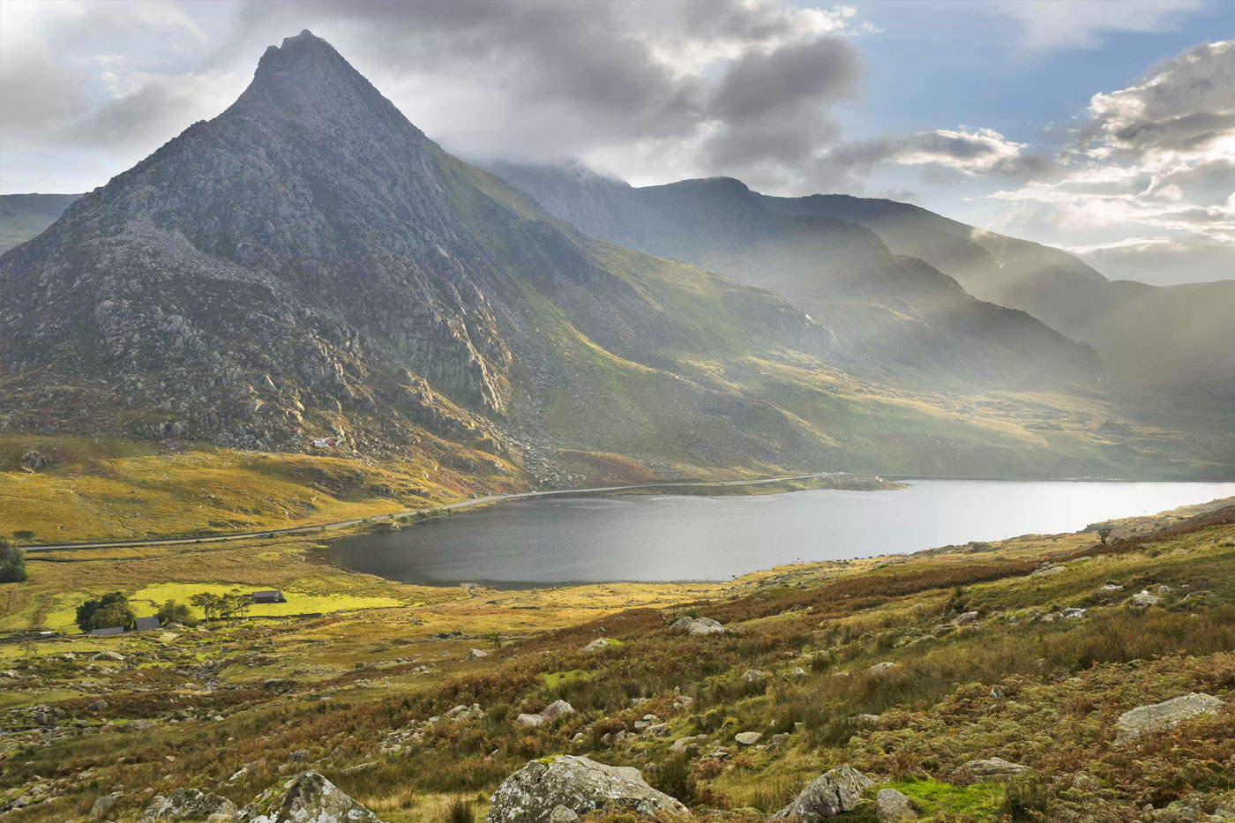
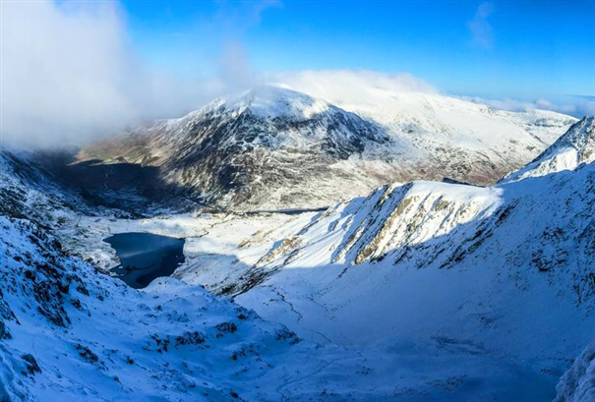
What is Wales known for?
Wales is known for Snowdonia! Snowdonia is a beautiful and iconic national park in the northwest corner of Wales. 1 of the tallest mountains in the UK. It is listed among the most popular places for hiking and climbing in Britain. The rugged landscape is bathed in history and legend, featuring in the tales of King Arthur.

Slide 15
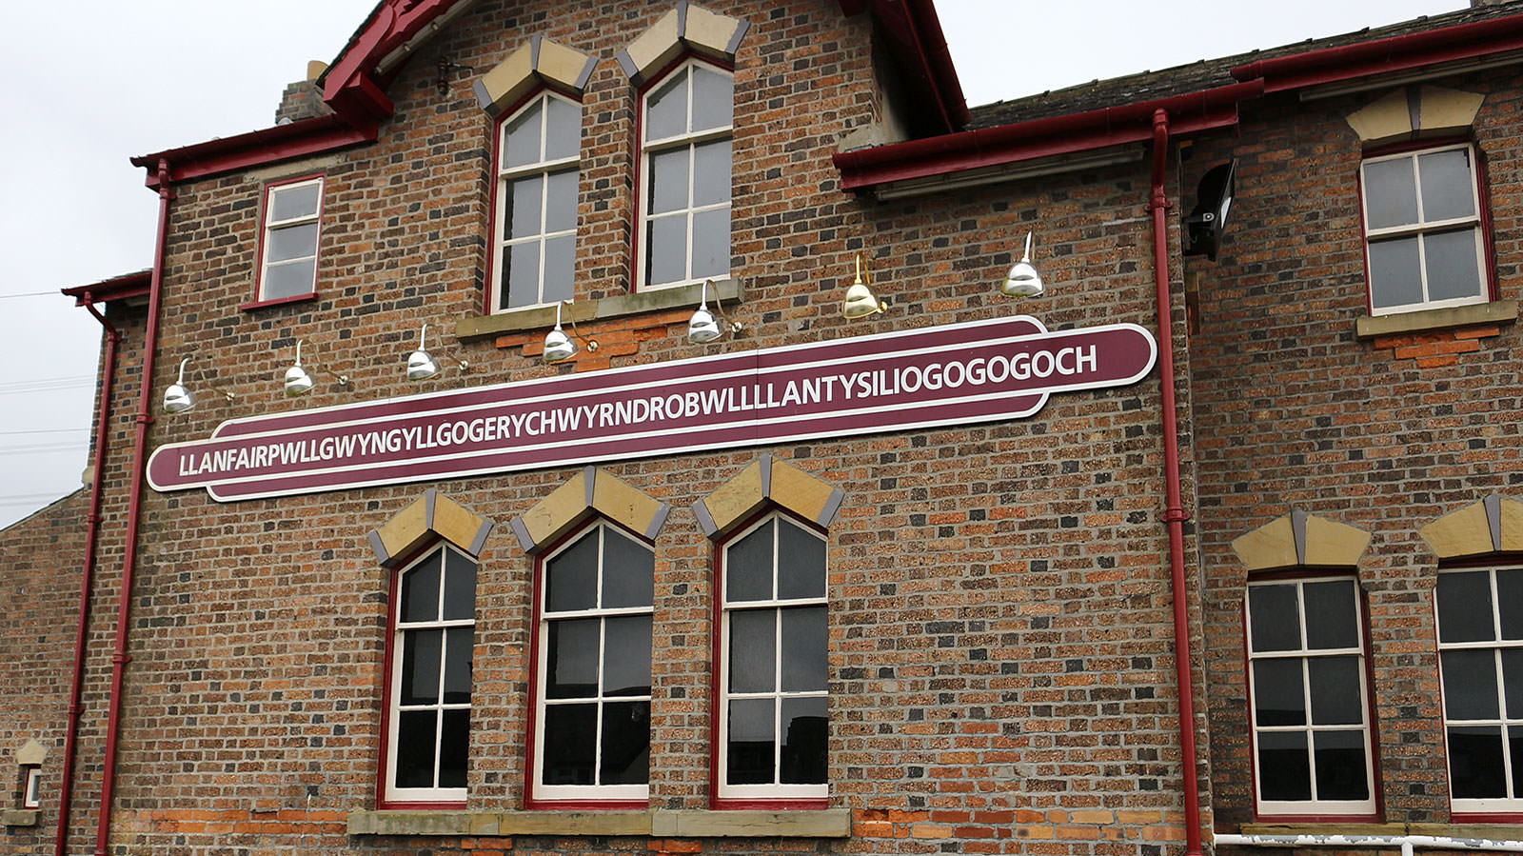
Known for Llanfairpwllgwyngyllgogerychwyrndrobwllllantysiliogogogoch!
This Welsh village holds the undisputed title of the longest name in the UK and one of the longest in the world. There’s also an old church “St Mary’s Church in the hollow of the white hazel near to the rapid whirlpool of Llantysilio of the red cave.” Usefully, the train station sign shows the 58 – letter name written phonetically, so you can try pronouncing it yourself.

Slide 16
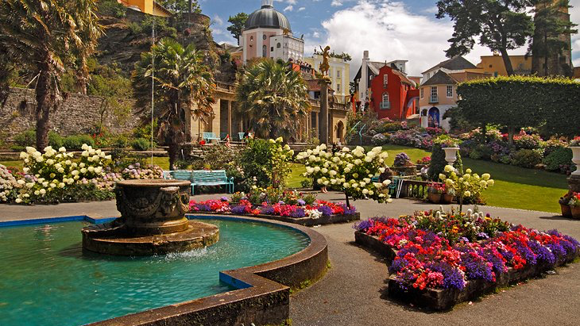
Known for Portmeirion!
Portmeirion is a beautiful hotel resort and visitor attraction on the coast of Snowdonia National Park in Gwynedd, North Wales. Built by sir dough Williams-Ellis between 1925 and 1975, this place was designed to resemble a quaint Italian fishing village. Portmeirion has been the location for numerous films and TV programs like “The Prisoner”.

Slide 17
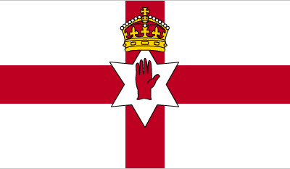
Northern Ireland
Area: 5,459 sq miles,
Population: 1,89 million (2019),
Capital: Belfast,
National Bird: Northern Lapwing,
National Flower: Shamrock,
National Tree: Sessile Oak,
National Animal: Irish Hare,
National Day: 17th March St Patrick’s Day,
Currency: Pound Sterling,
Official Language: English, Irish and Ulster Scots.
Northern Ireland doesn’t have a flag of it’s own. Flags in Northern Ireland are a very controversial subject. Historically the ‘ulster banner’ was used by the Unionist government at Stormont but the banner has no current legal standing and it’s use is seen as extremely divisive.

Slide 18
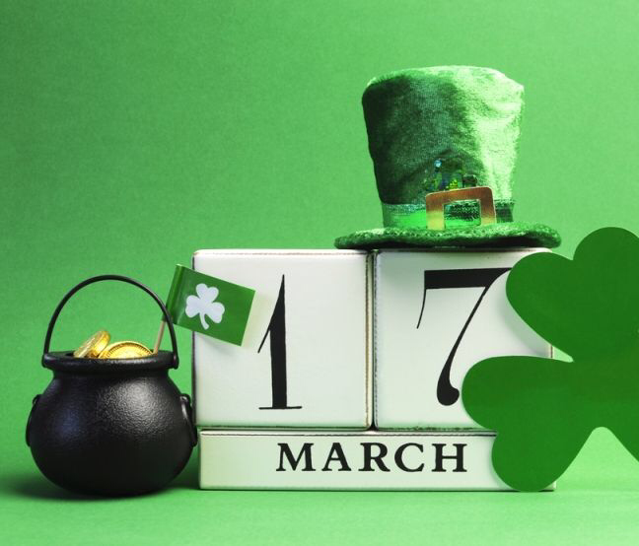
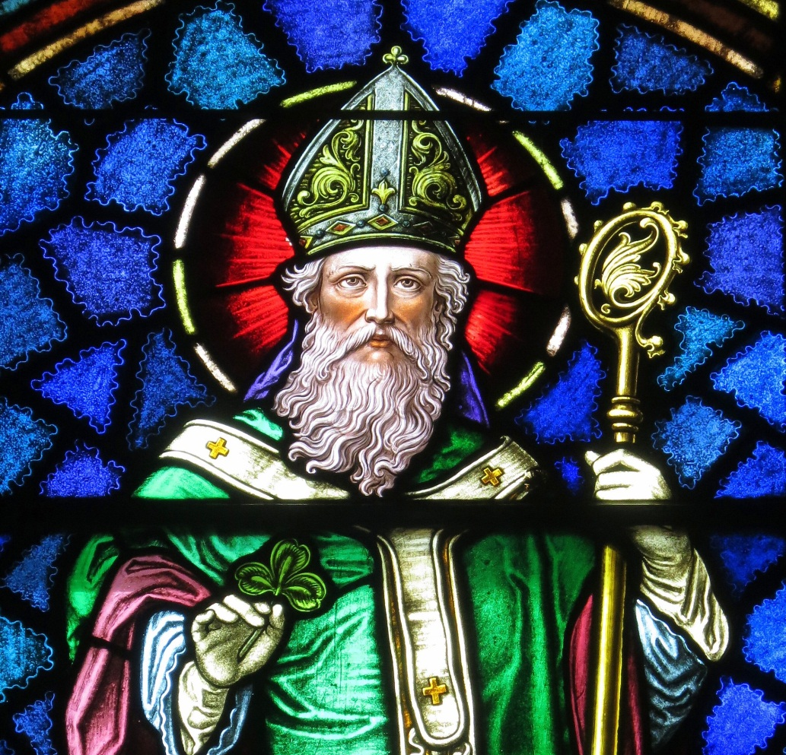
What is Northern Ireland known for?
It is known for St Patrick’s Day!
St. Patrick’s Day observes of the death of St. Patrick, the patron saint of Ireland. The holiday has evolved into a celebration of Irish culture with parades, special foods, music, dancing, drinking and a whole lot of green. St. Patrick was a 5th-century missionary to Ireland and later served as bishop there. He is credited with bringing Christianity to parts of Ireland and was probably partly responsible for the Christianisation of the Picts and Anglo-Saxons.

Slide 19
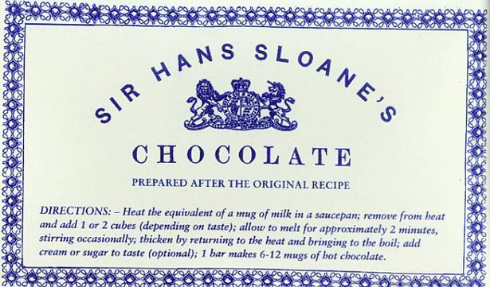
Known for their inventions!
They invented milk chocolate! Hans Sloane from Killyleagh in Co Down was a Royal physician who travelled to Jamaica in 1687. During his time there he catalogued hundreds of botanical species, including the cocoa bean. Locals mixed it mixed it with water, but Sloane found this hard to drink, so instead boiled the cocoa with milk and sugar inventing chocolate milk. When back in the UK, Sloane later used this recipe to treat digestion issues and consumption. More than 60 years later, Cadbury then produced 'Sir Hans Sloane's Milk Chocolate’. They also invented: The Modern Tractor, Streetcars, Electric Tramways, Safety Lamps and many more.

Slide 20
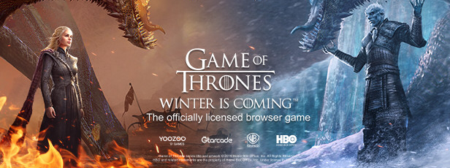
Known for Games Of Thrones!
Games Of Thrones was filmed in Northern Ireland. Filming of seasons one to eight took place in around 25 locations around Northern Ireland including Titanic Studios in Belfast, Cushendun Caves, Murlough Bay, Ballintoy Harbour, Larrybane, Antrim plateau, Castle Ward, Inch Abbey and Downhill Strand.

Slide 21
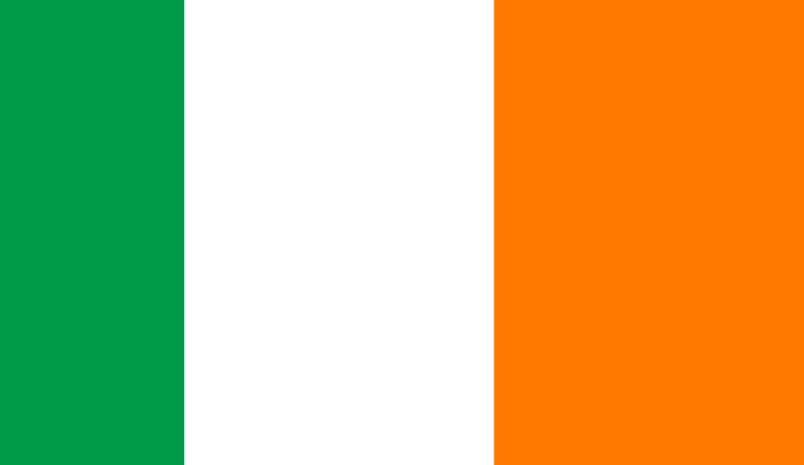
Ireland
Area: 84,421 km2,
Population: 4,981,461 (2021),
Capital: Dublin,
National Bird: Northern Lapwing,
National flower: Shamrock,
National Tree: Sessile Oak,
National Animal: Irish Hare,
National Day: 17th March St Patrick’s Day,
Currency: Euro,
Official Language: Irish Gaelic and English.
The tree colours represent: The green represents Irish nationalism; the orange, Ireland’s Protestant minority, and the Orange Order; the white, lasting peace between the two.

Slide 22
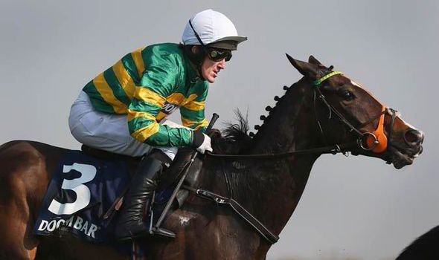
What is Ireland known for?
Horse racing has been a huge part of Irish culture for centuries but the country has also produced arguably the greatest ever jockey to live and compete in the sport. AP McCoy, or Anthony Peter McCoy over the course of a 23 year career won a record 4358 races! During his career, spanning three decades from 1992 to 2015, McCoy won almost every major race possible, including the Grand National and Cheltenham Gold Cup, and was a Champion Jockey for 20 consecutive seasons!

Slide 23
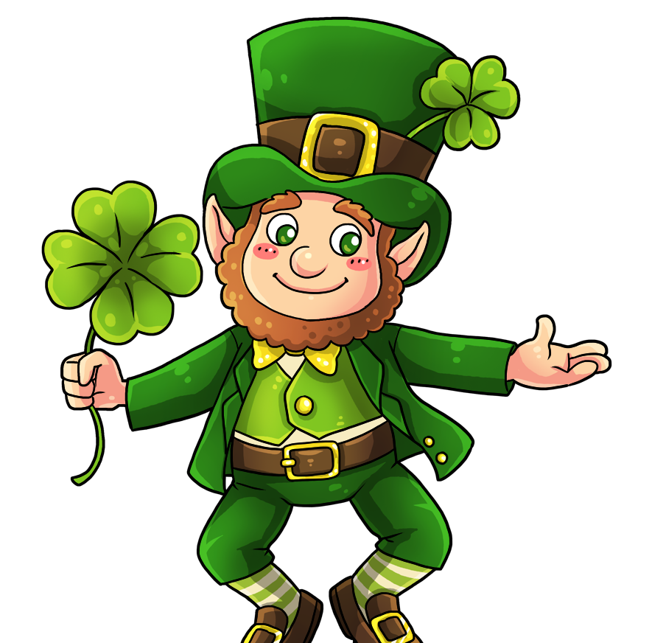
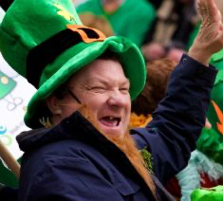
Known for Leprechauns!
Tourist trap or beloved fairytale creature, that is the question that Irish people have been grappling with for centuries now. Ireland is famous for its mythical, mischievous creatures called leprechauns, and they’re now an unofficial symbol of all things Irish. Stories abound including leprechauns. You might find one at the end of the rainbow with a pot of gold, for instance. If you do happen to see one, make sure you try to catch him before he gets away from you.

Slide 24
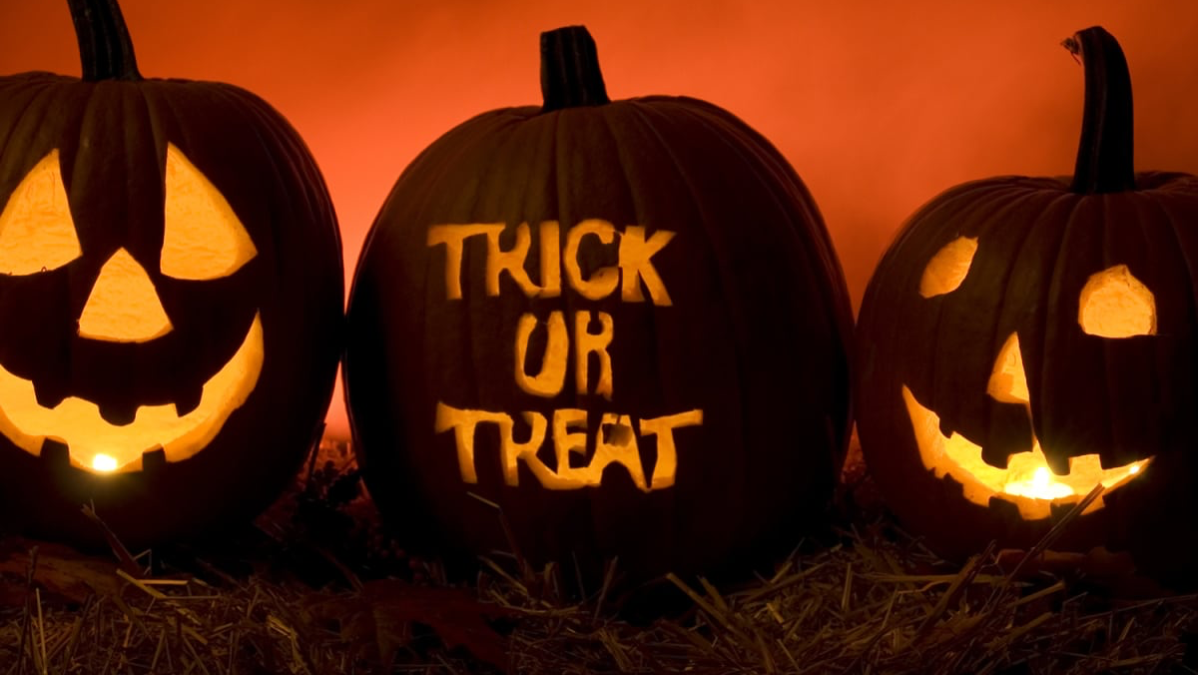
Known for Halloween!
Ireland is known for being the original celebrators of Halloween. In Ireland, Halloween is celebrated a little differently, however. For dinner, Irish kids will often have the dish Colcannon. Colcannon is a dish made up of boiled potatoes and curly kale (cabbage), mashed together with raw onions. As an added bonus, parents hide coins inside wrapped in baking paper for kids to find!

Slide 25
Dziękuje za uwagę!

